Slide 1
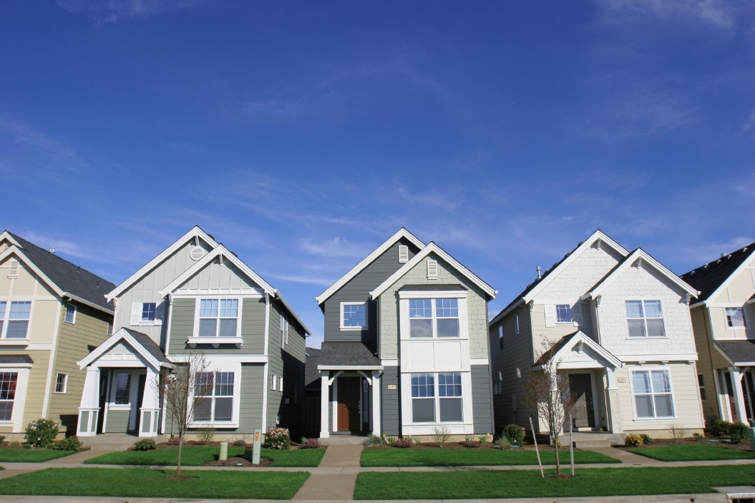
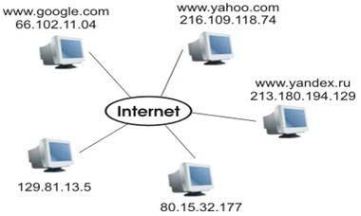
Internet Addresses Demystified: What is an IP Address and Port, Explained Simply
Imagine the Internet as a Huge Network of Houses:
Think of the internet like a vast network of houses. Each house, or computer, has its own unique address to help messages and data find their way. This address is called an "IP address."
House == Computer
Address of the House == IP Address

Slide 2
Internet Addresses Demystified: What is an IP Address and Port, Explained Simply
IP Address: Your Computer's Home Address:
An IP address is like your computer's home address on the internet. It's a series of numbers that tells other computers where to find your computer in the huge internet neighborhood.
Each computer has its own IP address, just like every house has a unique street address.
House == Computer
Address of the House == IP Address

Slide 3

Internet Addresses Demystified: What is an IP Address and Port, Explained Simply
Ports: Different Doors at Your House:
Now, think of your computer as a house with many doors. Each door is like a "port." Ports are like entry points to your computer. They allow different types of information to come in and out.
Imagine one door is for emails.
Another door is for websites.
And a third door is for online games.
Each door, or port, has a specific number, like rooms in your house. So when data comes to your computer, it knows which door (port) to go to.
Each Door in the house == Port

Slide 4
Internet Addresses Demystified: What is an IP Address and Port, Explained Simply
Example: Sending an Email:
Let's say you want to send an email. Your computer uses the email door (port) to send it. When the email arrives at its destination, the other computer knows to go to the email door (port) to receive it.
In a Nutshell:
So, an IP address is your computer's address on the internet, and ports are like different doors for specific types of data. Together, they help all the data on the internet reach the right house (computer) and find the right door (port) to enter.
Each Door in the house == Port

Slide 5
Internet Addresses Demystified: What is an IP Address and Port, Explained Simply
IP Address Examples:
IPv4 Address: An example of an IPv4 address is 192.168.1.1. This is a common format for IP addresses and consists of four sets of numbers, each ranging from 0 to 255.
IPv6 Address: An example of an IPv6 address is 2001:0db8:85a3:0000:0000:8a2e:0370:7334. IPv6 is a newer format with a longer address to accommodate the growing number of devices on the internet.
House == Computer
Address of the House == IP Address

Slide 6
Internet Addresses Demystified: What is an IP Address and Port, Explained Simply
Port Examples:
Port 80: Port 80 is commonly used for HTTP (Hypertext Transfer Protocol) traffic, which is the protocol used for web browsing. When you enter a website address in your browser, it often connects to port 80 to fetch the web page.
Port 25: Port 25 is used for sending email using the SMTP (Simple Mail Transfer Protocol). When you send an email, your email client connects to port 25 of your email server to send the message.
Port 22: Port 22 is commonly used for SSH (Secure Shell) connections. It allows for secure remote access to a computer over a network.
Port 443: Port 443 is used for secure web browsing using HTTPS (Hypertext Transfer Protocol Secure). When you visit a website with a padlock icon in the address bar, it often connects to port 443 for secure communication.
Port 21: Port 21 is used for FTP (File Transfer Protocol) connections, which are often used to upload and download files to and from a server.
These examples showcase the diversity of IP addresses and ports and how they are used for different types of communication on the internet.

