Slide 1
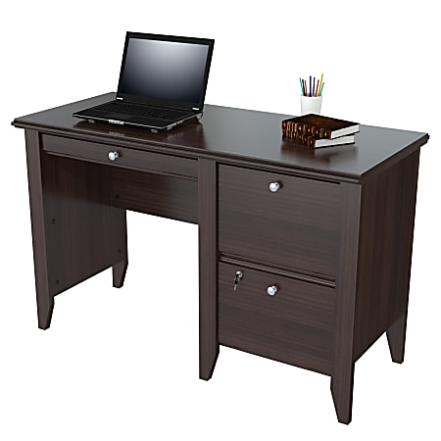
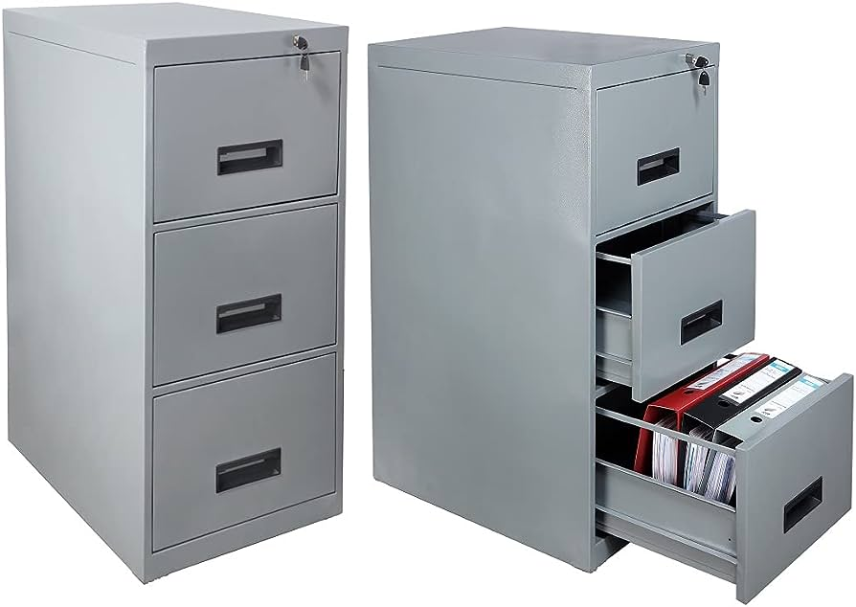

Caching Simplified: Your Quick Data Shortcut
What Is a Cache?
Think of a cache as a super-fast storage area that keeps things you need frequently right at your fingertips. Cache is like having a small drawer on your desk where you keep important documents you use all the time instead of having to get up and go to a filing cabinet each time you need them.
Small drawer on your desk
File Cabinet

Slide 2
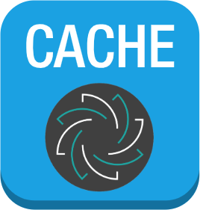

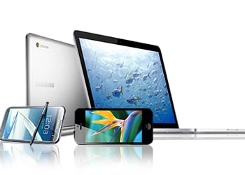
Caching Simplified: Your Quick Data Shortcut
How Does Cache Work?
Imagine you're using a computer or a smartphone to visit a website or run an app. Sometimes, the data needed for these websites or apps is stored in a cache. When you visit a website or use an app, your device checks this cache first before going out to the internet to get the information.
If the needed data is in the cache (like a webpage you visited recently), it's super quick because your device can grab it instantly from there instead of waiting for it to load from the internet, which can take longer.

Slide 3

Caching Simplified: Your Quick Data Shortcut
Why Do We Use Caches?
Caches are used to make things faster and more efficient. They save time and resources because your device doesn't have to fetch data from faraway servers every time you need it. Instead, it's right there, ready to go.
Think of it like a chef who keeps the most commonly used spices right next to the stove. It's quicker and easier to reach for them than to walk across the kitchen to get them from the pantry each time.

Slide 4
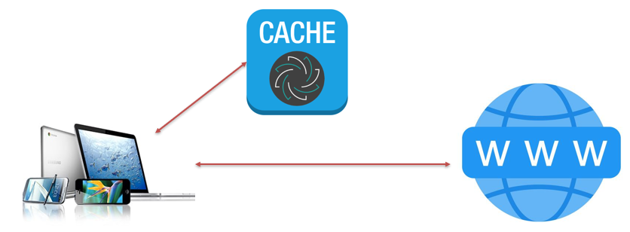
Caching Simplified: Your Quick Data Shortcut
Examples of Caches:
Web Browser Cache: When you visit a website, your browser stores images and files from that site in its cache. If you visit the same site again, the browser can load it faster because it doesn't have to download everything from scratch.
App Cache: Many apps on your phone use caches to store data like images, so they can show you content quickly, even if you're offline.
Computer Memory Cache: Inside your computer, there are small, super-fast memory caches that store frequently used data to speed up processing.

Slide 5
Caching Simplified: Your Quick Data Shortcut
In summary, a cache is like a fast, easily accessible storage space that helps your devices work more efficiently by keeping commonly used data close at hand, so you don't have to wait for it to load from slower sources like the internet or a hard drive. It's all about making things faster and smoother for you as a user.

