Slide 1
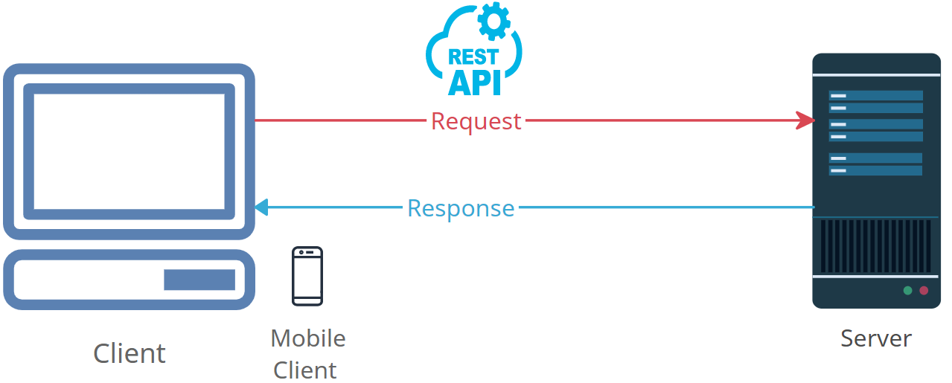
Demystifying the Internet: What is an HTTP Response in Simple Terms?
HTTP: Think of it like the language computers use to talk to each other over the internet. It's how they share information.
Response: This is what happens when you ask for something. When you send a letter, you wait for a reply. In the digital world, when you ask a website for something, the website sends you a response.

Slide 2


Demystifying the Internet: What is an HTTP Response in Simple Terms?
HTTP Response: So, when you visit a website (like YouTube or Google) or do something on an app, your computer or phone asks the website's computer for information. The website's computer then sends back a response. This response can be a web page, a video, a picture, or any kind of information you requested.
In simple terms, an "HTTP Response" is like getting a reply from a website when you ask for something on the internet. It's how you see the web pages, images, videos, and all the content online!

