Slide 1
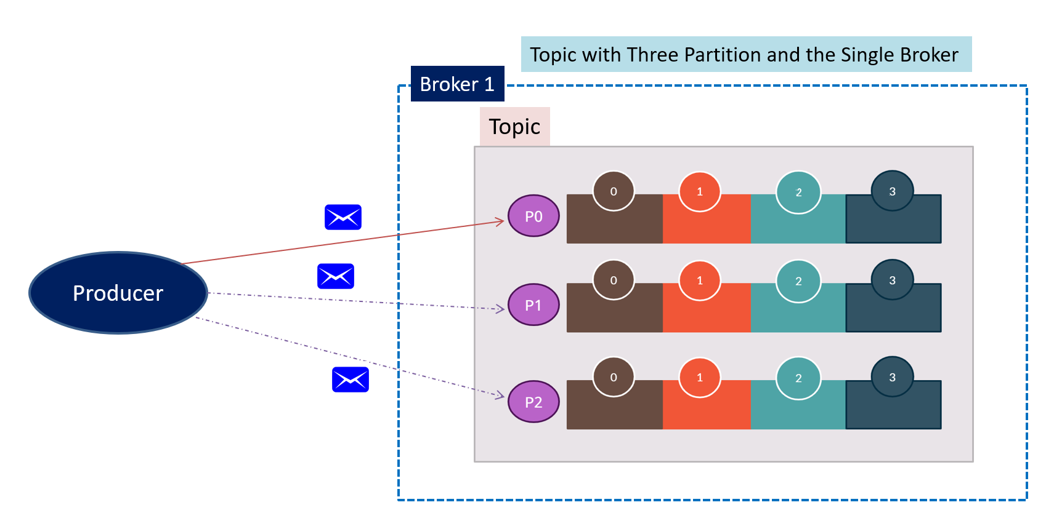
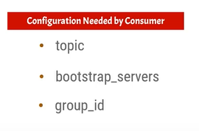
Consumer group in Kafka with 3 partition 1 consumer
The message will be published to partition randomly.
The message will be consumed by “Consumer 1” in a round-robin
One consumer can consume messages from more than one partition
Consumer Group
Consumer 1

