Slide 1
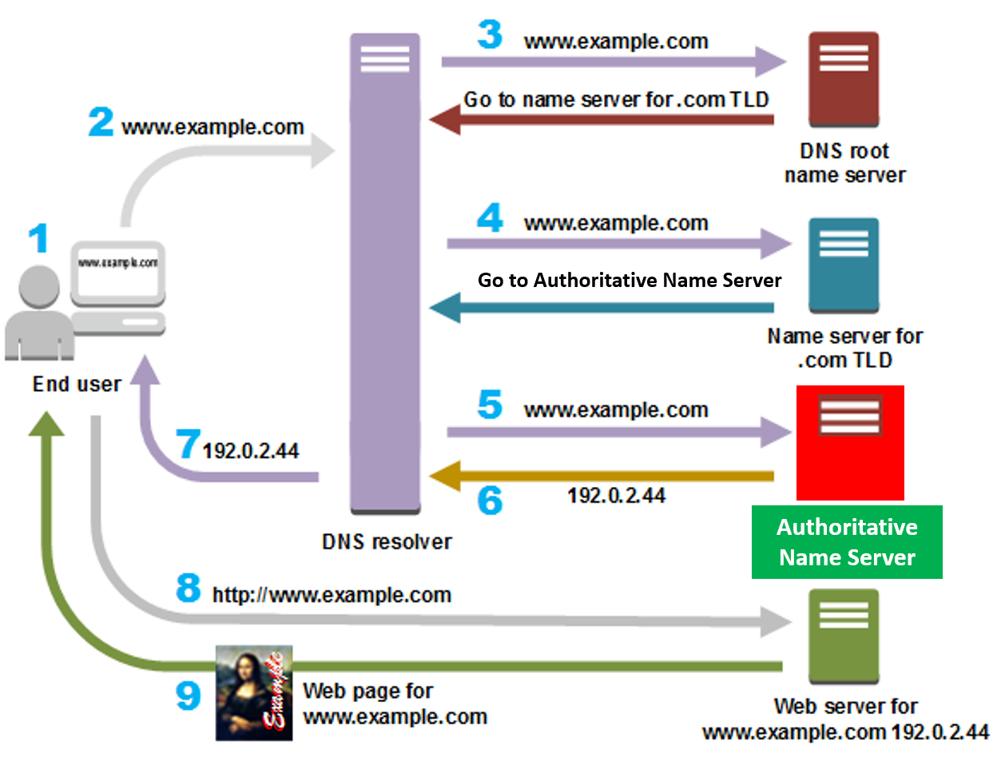
Understanding DNS: A Beginner's Guide
What is DNS?
DNS, or Domain Name System, is a fundamental part of the internet that acts like a phonebook for the web. It translates human-readable domain names, like "google.com" or "facebook.com," into numerical IP addresses that computers use to identify each other on the internet.

Slide 2
Understanding DNS: A Beginner's Guide
How does DNS work?
1. User Input: When you type a domain name (e.g., "example.com") into your web browser and press Enter, your device needs to find the
IP address associated with that domain to load the website.
2. DNS Query: Your device sends a request called a DNS query to a DNS resolver (usually provided by your internet service provider or configured manually). The DNS resolver is like a librarian who knows where to look for the information you need.

Slide 3
Understanding DNS: A Beginner's Guide
How does DNS work?
3. DNS Lookup: The DNS resolver checks its cache to see if it already knows the IP address for the requested domain. If not, it begins the process of finding the IP address by querying other DNS servers.
Root DNS Servers: If the DNS resolver doesn't have the information in its cache, it contacts a root DNS server. These servers store the information for the top-level domains (like .com, .org, .net) and direct queries to the appropriate top-level domain server.

Slide 4
Understanding DNS: A Beginner's Guide
How does DNS work?
4. Top-Level Domain (TLD) Servers: The root DNS server directs the DNS resolver to the TLD server responsible for the specific domain extension (e.g., .com). The TLD server provides the IP address of the authoritative name server for the domain.
5. Authoritative Name Server: The DNS resolver contacts the authoritative name server for the domain (provided by the domain registrar or hosting provider). This server holds the DNS records for the domain, including the IP address associated with the requested domain name.

Slide 5
Understanding DNS: A Beginner's Guide
How does DNS work?
6&7. Response: The authoritative name server sends the IP address back to the DNS resolver, which caches the information for future use and forwards it to your device.
8&9. Accessing the Website: Armed with the IP address, your device can now establish a connection with the web server hosting the requested website. Your browser retrieves the web page content, and you see the website displayed in your browser window.

Slide 6
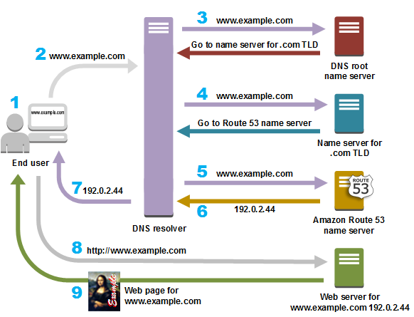

Understanding DNS: A Beginner's Guide
Go to Authoritative Name Server
Authoritative
Name Server

Slide 7
Understanding DNS: A Beginner's Guide
Summary
DNS operates in the background, making the internet more user-friendly by allowing us to use domain names instead of numerical IP addresses. It's a distributed system, with multiple servers working together to ensure efficient and accurate resolution of domain names to IP addresses.

