Slide 1



Unlocking Digital Doors: A Layman's Guide to Basic Authentication
Imagine you have a secret code to enter your clubhouse. This secret code is your way of proving to the clubhouse guard that you belong there. In the digital world, Basic Authentication is like having a simple
secret code to access certain websites, applications, or services.
Basic Authentication is a method used by websites or online services to ensure that only authorized people can access specific information or features. It works like a username and password combination.
Clubhouse

Slide 2
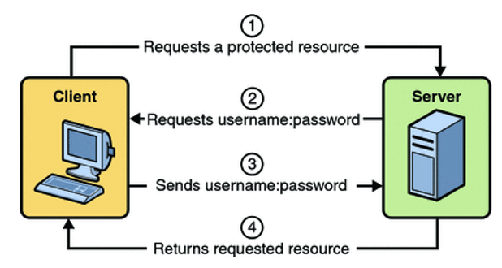
Unlocking Digital Doors: A Layman's Guide to Basic Authentication
Here's how it generally works:
Username and Password: When you visit a website or application that requires Basic Authentication, it asks you for a username and password.
Verification Process: You enter your username and password, similar to unlocking a door with a key. This information is sent to the website's server.
Authorization: The server checks if the username and password match those stored in its records. If they match, you're granted access to the website or specific parts of it. If they don’t match, access is denied.
Think of it as a simple lock-and-key system. Your username is like your username or ID card, while the password is your unique secret key that allows you to unlock and access your account or the website's services.
1
1
2
3

Slide 3
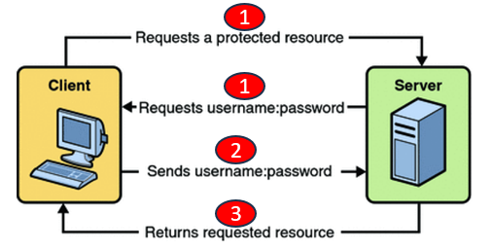
Unlocking Digital Doors: A Layman's Guide to Basic Authentication
However, while Basic Authentication is straightforward and easy to understand, it's considered less secure than more advanced authentication methods. This is because the username and password are sent over the internet without encryption, making it possible for someone with malicious intent to intercept and access these credentials.
In modern times, additional security measures like HTTPS (secure, encrypted communication), two-factor authentication (adding another layer of verification), and more robust authentication methods are often preferred for securing sensitive information online.

