Slide 1
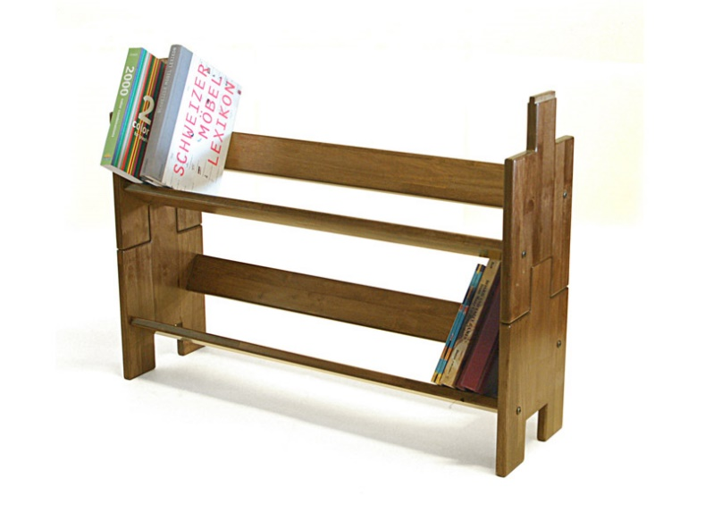


Caching Simplified: Your Quick Data Shortcut
Imagine you have a favorite book that you read often. Instead of going to the library every time you want to read it, you decide to keep a copy of it on a small shelf right next to your reading chair.
Now, whenever you want to read the book, you don't have to walk to the library, find the book on the shelf, and bring it back. Instead, you just reach for the book on your small shelf because it's right there, easily accessible.
Library

Slide 2
Caching Simplified: Your Quick Data Shortcut
In this analogy:
The book on your small shelf is like the "cache."
Your reading chair represents your computer or device.
Going to the library to get the book is like fetching data or information from a distant location, like a website or a server.
Library

Slide 3
Caching Simplified: Your Quick Data Shortcut
So, a cache is like a quick-access storage area that stores frequently used data or information, making it readily available when needed. It helps speed up tasks on your computer or device by saving time and effort that would otherwise be spent fetching data from a distant source.
Library

