Slide 1
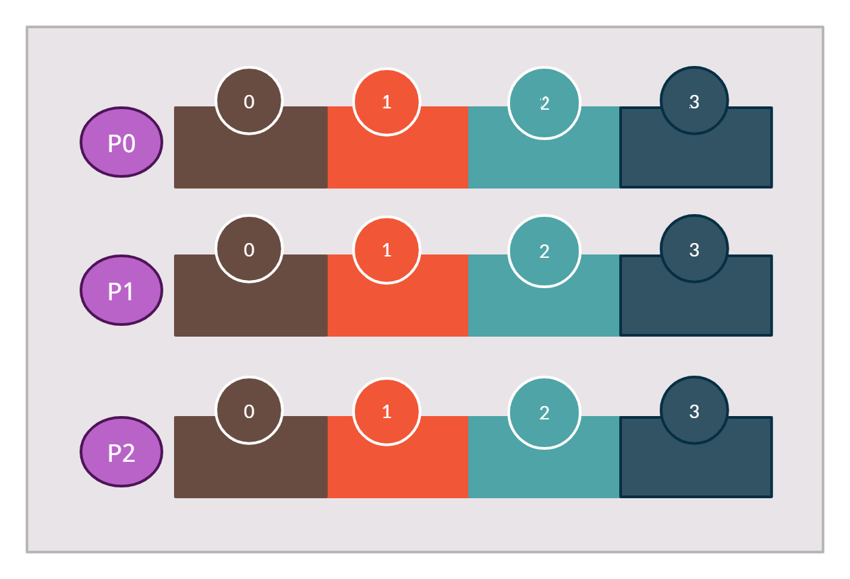

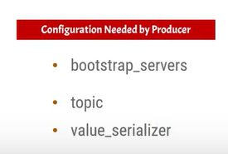
Kafka producer to single topic with three partition
Messages will be published to all three partitions in a random manner
Topic with Three Partition and the Single Broker
Broker 1
Topic
Producer

