Slide 1
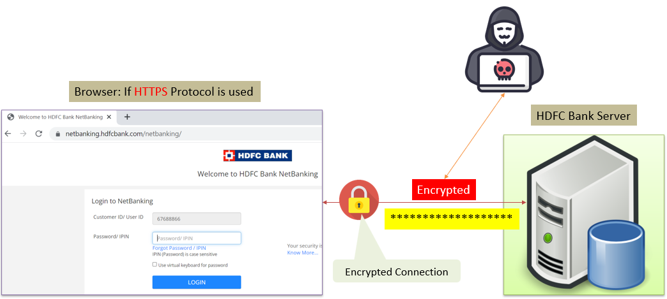
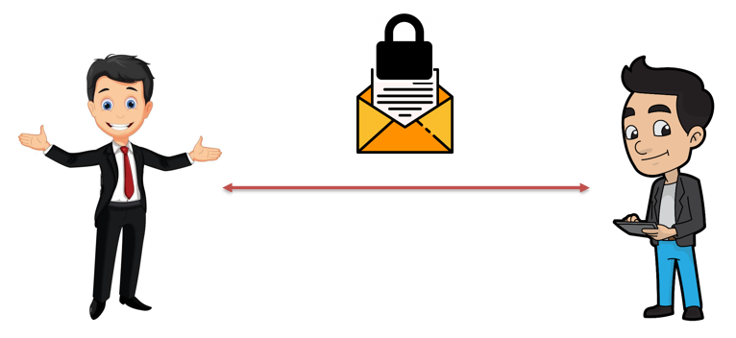

SSL, TLS, HTTPS Explained
SSL (Secure Sockets Layer) and TLS (Transport Layer Security):
Think of SSL and TLS as security guards for your internet communication. When you browse the internet, your web browser (like Chrome or Firefox) talks to web servers to display websites. SSL and TLS are protocols that encrypt this communication, making sure that the information exchanged between your browser and the server remains secure and private.
Imagine you are sending a secret message to your friend. Without SSL/TLS, it's like sending the message on a postcard, and anyone who intercepts it can read it easily. With SSL/TLS, it's like putting your message in a locked envelope before sending it. Only your friend (the intended recipient) can unlock the envelope and read the message.

Slide 2
SSL, TLS, HTTPS Explained
HTTPS (Hypertext Transfer Protocol Secure):
HTTPS is simply a combination of the regular HTTP (the protocol used to transfer web pages) and SSL/TLS. When you see "https://" at the beginning of a website address in your browser, it means that the connection between your browser and the server is secure and encrypted.

Slide 3
SSL, TLS, HTTPS Explained
Continuing with the analogy, HTTPS is like sending your secret message using a special courier service that ensures the message is put inside a locked envelope and securely delivered to your friend's mailbox.
In summary, SSL and TLS are security technologies that encrypt your internet communication, and HTTPS is a secure version of the regular HTTP used to access websites. They all work together to protect your data and ensure that your online interactions are safe from eavesdropping and tampering by malicious parties.

