Slide 1
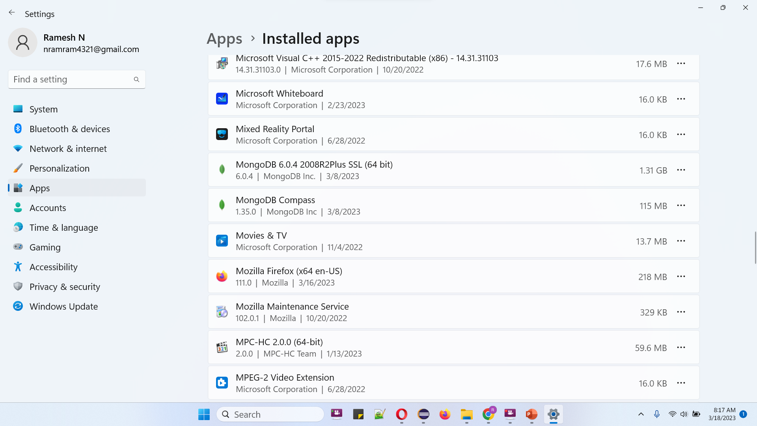
How to uninstall MongoDB 6.0.4 & MongoDB Compass on Windows 11?

