Slide 1
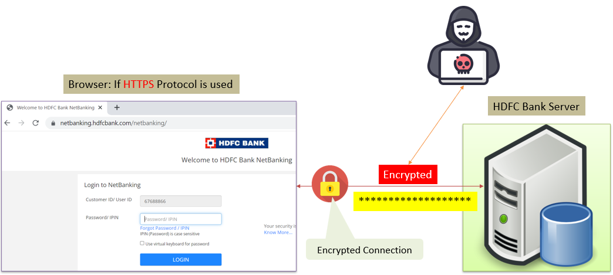

Understanding Encryption in Transit: Keeping Your Data Safe During its Journey
"Encryption in transit" refers to the process of securing information as it travels from one place to another over the internet or any network.
Imagine you're sending a secret message to your friend. You put that message inside a locked box before sending it. Only your friend has the key to open this box and read the message. During the journey, even if someone tries to peek inside the box, they can't understand the message because it's securely locked.

Slide 2
Understanding Encryption in Transit: Keeping Your Data Safe During its Journey
Similarly, in the digital world, when you send a message, browse a website, or share data online, it moves through different paths, like wires or wireless connections. Encryption in transit is like putting that information into a virtual locked box.
Before sending the information, it gets transformed into a secret code that only the intended receiver can decode. This coded information travels through the internet, staying safe and unreadable to anyone who might try to intercept it without the right key.
In simple terms, encryption in transit ensures that your data is protected and remains private while it's moving from one place to another across the internet, just like a secret message inside a locked box during its journey.

Slide 3
Understanding Encryption in Transit: Keeping Your Data Safe During its Journey
Encrypting data in transit means securing information as it moves from one place to another, such as sending data over the internet or within a network.
Understand Encryption Basics: Encryption is a way of encoding information in a manner that can only be decoded or understood by authorized recipients. It involves converting plain text or data into an encoded form using algorithms and cryptographic keys.
Use Secure Communication Protocols: Ensure you're using secure communication protocols like HTTPS (Hypertext Transfer Protocol Secure) for web browsing or SFTP (Secure File Transfer Protocol) for transferring files. These protocols encrypt data during transmission, providing a secure channel for communication.

Slide 4
Understanding Encryption in Transit: Keeping Your Data Safe During its Journey
Implement SSL/TLS Certificates: For websites and online services, use SSL/TLS certificates to encrypt data exchanged between a user's browser and the website's server. These certificates help establish secure connections, preventing unauthorized access to sensitive information.
Enable End-to-End Encryption: When communicating through messaging apps or email services, opt for platforms that offer end-to-end encryption. This ensures that messages are encrypted on the sender's device and can only be decrypted by the intended recipient.
Use Encrypted Networks: When connecting to public Wi-Fi or networks, choose networks that offer encryption (like WPA2 or WPA3 for Wi-Fi) to safeguard your data from unauthorized interception by others on the same network.

Slide 5
Understanding Encryption in Transit: Keeping Your Data Safe During its Journey
Utilize VPNs (Virtual Private Networks): VPNs create encrypted tunnels between your device and the internet, providing privacy and security by masking your IP address and encrypting all data transmitted through the VPN server.
Secure File Transfer: When transferring files or sensitive data, use encryption tools or services that offer secure file transfer capabilities (such as encrypted email attachments or secure cloud storage with encryption).
Keep Software Updated: Regularly update software, including operating systems, browsers, and security applications, to ensure you have the latest security patches and encryption protocols.

Slide 6
Understanding Encryption in Transit: Keeping Your Data Safe During its Journey
Practice Good Password Hygiene: Always use strong, unique passwords for different accounts and enable two-factor authentication (2FA) whenever possible to add an extra layer of security.
Remember, encryption in transit helps protect your data while it's on the move, making it much harder for unauthorized parties to access or intercept sensitive information. It's an essential practice for safeguarding your privacy and maintaining data security.

