Slide 1
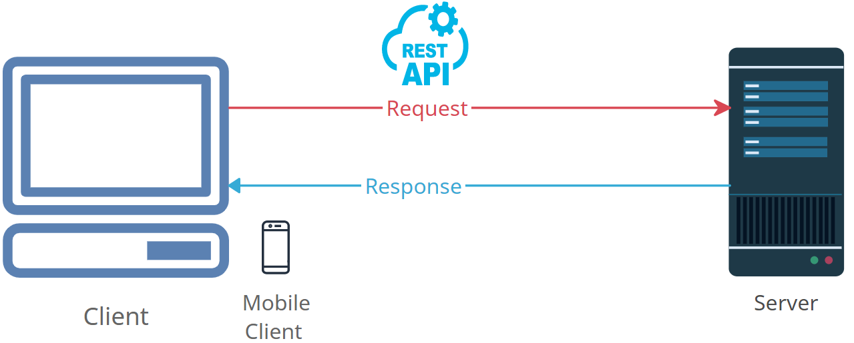


Demystifying HTTP Requests: How the Internet Fetches Web Pages
In simple terms, an HTTP request is like a message that your web browser (or any device with internet access) sends to a web server when you want to get information from a website. It's how your device asks the server to give you a particular web page or data.
Library

Slide 2
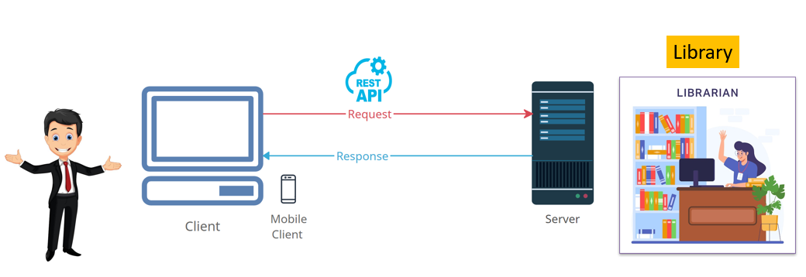
Demystifying HTTP Requests: How the Internet Fetches Web Pages
Here's a breakdown of what happens during an HTTP request:
You Want to See a Web Page: Let's say you're using your web browser and you decide to visit a website. You type in the website's address or click on a link, and that's when your request starts.
Your Request is Sent: When you do this, your browser sends a message to the server where that website is stored. This message is your HTTP request.
What You're Asking For: In your request, you're telling the server which web page or information you want. It's a bit like saying, "Hey, server, I'd like to see the homepage of 'example.com' please.“
Server Responds: The server, like a helpful librarian, receives your request. It looks up the information you asked for, and if it finds it, it packages it up and sends it back to your browser.
You See the Web Page: Your web browser then takes this information and displays it on your screen. You can now see the web page and all its content, just like you asked for.

Slide 3
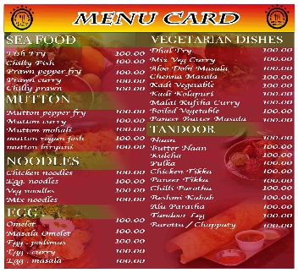



Demystifying HTTP Requests: How the Internet Fetches Web Pages
Think of it like ordering food at a restaurant: you tell the waiter (your browser) what you want from the menu (the website), and the kitchen (the web server) prepares your order and serves it to you.
So, an HTTP request is the way your device talks to a web server to get the web pages and data you want from the internet. It's how you navigate and interact with websites every day.

