Slide 1



Email Explained Simply: Sending Messages Online
Email, short for electronic mail, is a way of sending messages and information from one person to another using the internet.
Email is like sending a letter, but it's all done digitally on a computer or smartphone.

Slide 2
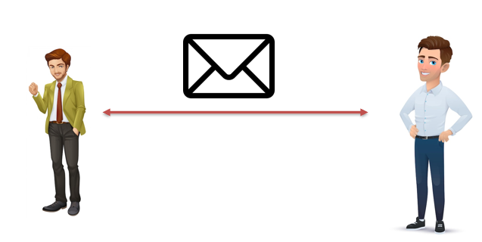
Email Explained Simply: Sending Messages Online
Here's how it works in simple terms:
Sender: This is the person who wants to send a message. They open their email program (like Gmail, Yahoo Mail, or Outlook) and create a new message.
Recipient: This is the person who will receive the message. The sender types in the recipient's email address, which is like their digital postal address.
Message: The sender writes their message in a special space, just like writing a letter. They can also attach pictures, documents, or other files.
Send: Once the message is ready, the sender hits the "send" button. The message travels through the internet and reaches the recipient's email program.
Recipient's Inbox: The message appears in the recipient's email inbox, like a digital mailbox. They can open and read it whenever they like.
Reply: If the recipient wants to respond, they can write a reply and hit "send." The reply goes back to the original sender in the same way.

Slide 3
Email Explained Simply: Sending Messages Online
Email is a fast and convenient way to communicate, whether it's for personal messages, work, or staying in touch with friends and family. Just like letters, it's a way to share thoughts, information, and even pictures with people, but it happens almost instantly through the internet.

