Slide 1
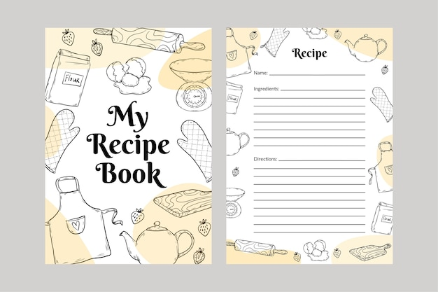
Managing Data Made Simple: A Layman's Guide to CRUD Operations
"CRUD" stands for Create, Read, Update, and Delete. It's a set of basic operations that can be performed on data in a computer system, typically associated with databases. Let's use a simple analogy to understand each part:
Create (C): Imagine you have a recipe book, and you decide to add a new recipe for your favorite dish. In the world of computer, "Create" is like adding new information or data. You're putting something new into the system, just like adding a new recipe to your book.
Read (R): Now, think about when you want to check the ingredients for a recipe in your book. You're not changing anything; you're just looking at what's already there. In computer, "Read" is like retrieving or viewing information that already exists in the system.
Update (U): Picture a scenario where you realize you want to tweak the recipe a bit—maybe add a new spice or change the cooking time. Similarly, in computer world, "Update" means modifying or changing existing data. You're making adjustments to something that's already in the system.
Delete (D): Lastly, consider if you want to remove a recipe from your book because you no longer like it. In the computer world, "Delete" means removing or getting rid of data. You're taking something out of the system.

Slide 2
Managing Data Made Simple: A Layman's Guide to CRUD Operations
So, in a nutshell:
Create (C): Adding new data.
Read (R): Viewing or retrieving existing data.
Update (U): Modifying or changing existing data.
Delete (D): Removing or getting rid of data.
CRUD provides a simple framework for understanding and managing data in computer systems, just like managing recipes in a cookbook.

