Slide 1
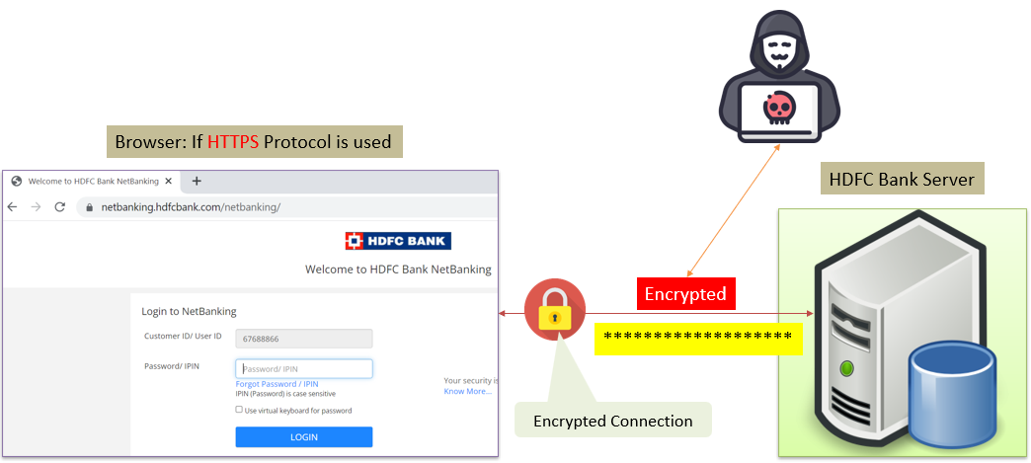

Keeping Messages Safe: How Encryption Protects Your Information During Travel
Imagine you're sending a secret message to your friend through a locked box. Encryption in transit is like making sure that box is securely locked while the message travels from you to your friend.
When you send information over the internet or any network (like a message, email, or data), it goes through different pathways, similar to traveling on roads or highways. Encryption in transit means that your message is jumbled up and locked in a special way before it leaves your device. It stays locked while it's traveling through these pathways, so even if someone tries to peek inside or intercept it, they won't be able to understand what the message says because it's all scrambled and protected.

Slide 2
Keeping Messages Safe: How Encryption Protects Your Information During Travel
When your friend receives the message, their device has the key to unlock and unscramble it, so they can read the original information. It's like your friend having the special key to open the locked box and read the secret message you sent.
In simple terms, encryption in transit keeps your messages and information safe while they're traveling from one place to another over the internet or any network, just like a locked box protects something valuable inside while it's being transported.

Slide 3
Keeping Messages Safe: How Encryption Protects Your Information During Travel
Implementing encryption in transit involves securing data while it moves between devices or over the internet. Here's a simplified explanation on how to implement it:
Use Secure Connections (HTTPS): For the layman, one of the easiest ways to implement encryption in transit is by ensuring you use secure connections while browsing websites. Look for the padlock icon and "https://" in the website address. This means the data between your browser and the website is encrypted.
Enable Encrypted Communication: When sending sensitive information or using messaging apps, opt for platforms that offer end-to-end encryption. This type of encryption ensures that only the sender and receiver can read the messages, keeping them private from any intermediaries.

Slide 4
Keeping Messages Safe: How Encryption Protects Your Information During Travel
Secure Email Communication: For emails, consider using email services that support encryption. Some email providers offer built-in encryption features or allow you to use third-party encryption tools to secure your email communication.
VPN for Added Security: Another simple way to implement encryption in transit is by using a Virtual Private Network (VPN). A VPN encrypts your internet connection, providing an additional layer of security when accessing the internet, especially on public Wi-Fi networks.
Secure File Sharing Services: When sharing files, choose secure file-sharing services that use encryption. Cloud storage services like Dropbox, Google Drive, or OneDrive often employ encryption to protect files during transfer and storage.

Slide 5
Keeping Messages Safe: How Encryption Protects Your Information During Travel
Two-Factor Authentication (2FA): While not directly related to encryption in transit, enabling two-factor authentication (2FA) on your accounts adds an extra layer of security by requiring an additional verification step when logging in.
For a layman, the essential idea is to use services and platforms that prioritize security and encryption. Look for indicators like HTTPS, end-to-end encryption, or VPNs to ensure your data is encrypted while it's moving between devices or over the internet. This helps keep your information safe from unauthorized access or interception by third parties.

