Slide 1



Spring Boot Kafka Consumer Example
Apache Kafka Ecosystem
Consume Messages
Send Messages
Kafka Cluster
Broker 1
Topic A
Topic B
Broker 2
Producer
Consumer
Topic X
Topic Z
SpringbootKafkaProducerDemo
SpringbootKafkaConsumerDemo
Zookeeper

Slide 2
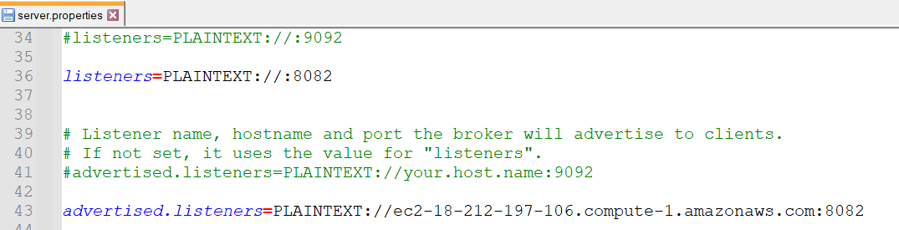
Spring Boot Kafka Consumer Example

Slide 3
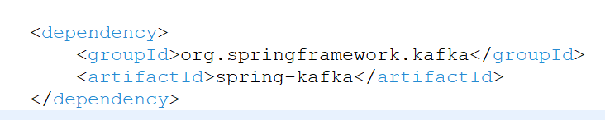
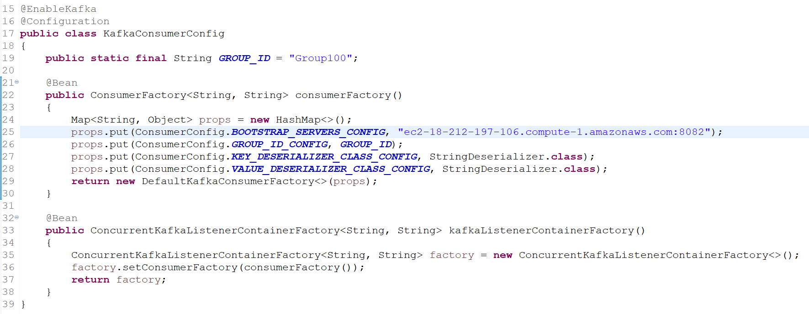
Spring Boot Kafka Consumer Example
To consume messages, we need to write a Consumer configuration class file like this.

Slide 4
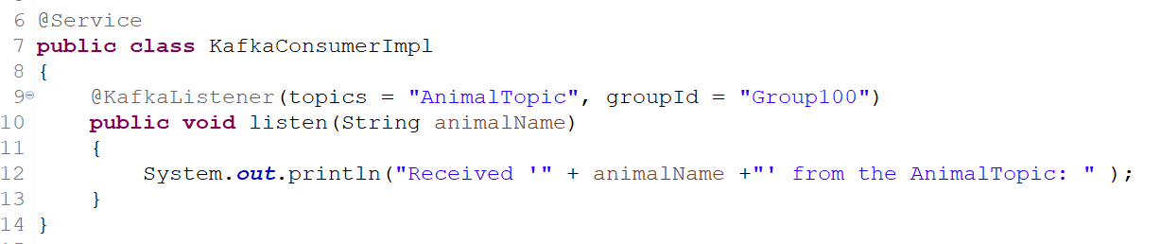
Spring Boot Kafka Consumer Example
Next, write a Listener to listen to the messages.

Slide 5
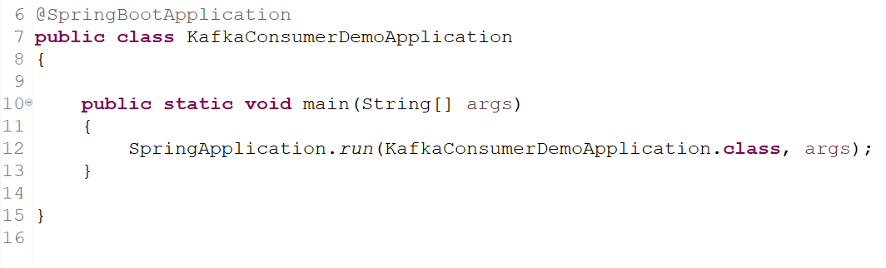
Spring Boot Kafka Consumer Example

