Slide 1

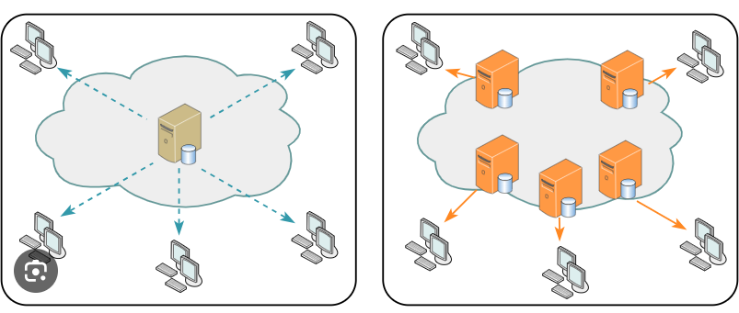
CDN Explained Simply: How the Internet's 'Delivery System' Speeds Up Websites
Imagine you ordered a package online, and instead of the seller sending it directly to your home, they first send it to a local distribution center closer to your neighborhood. This distribution center holds many products and is strategically located to quickly deliver items to your doorstep.
In the world of the internet, a CDN (Content Delivery Network) is somewhat like that distribution center. When you visit a website, like watching videos or viewing images, the content doesn't always come directly from the website's main server, which could be located far away. Instead, the CDN acts as a network of many servers spread across different locations worldwide.
Local Distribution center == CDN

Slide 2
CDN Explained Simply: How the Internet's 'Delivery System' Speeds Up Websites
So, when you access a website that uses a CDN, the content (like images, videos, or even the website itself) is stored on these various servers in the CDN network.
When you request to view something, the CDN figures out which server is closest to you, and instead of fetching the data from the website's main server (which might be far away), it retrieves it from the nearest server in the CDN. This process makes the content load faster and more efficiently.
Local Distribution center == CDN

Slide 3
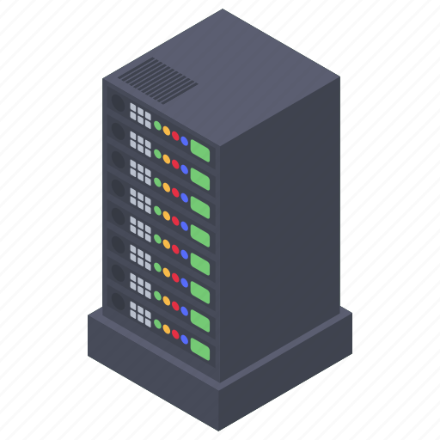


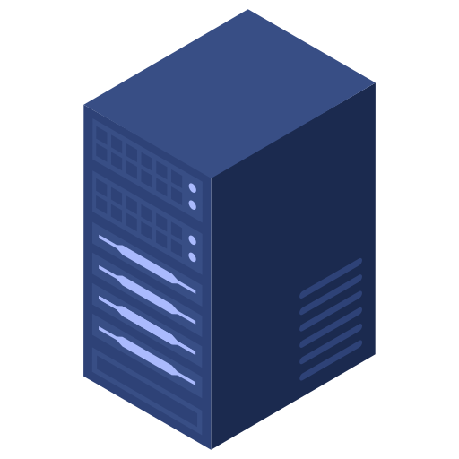

CDN Explained Simply: How the Internet's 'Delivery System' Speeds Up Websites
In simple terms, a CDN is like a network of super-fast delivery centers for internet content, ensuring that when you browse or use a website, the stuff you want to see loads quickly because it's stored closer to you in these server centers.
USA
India
India

