Slide 1
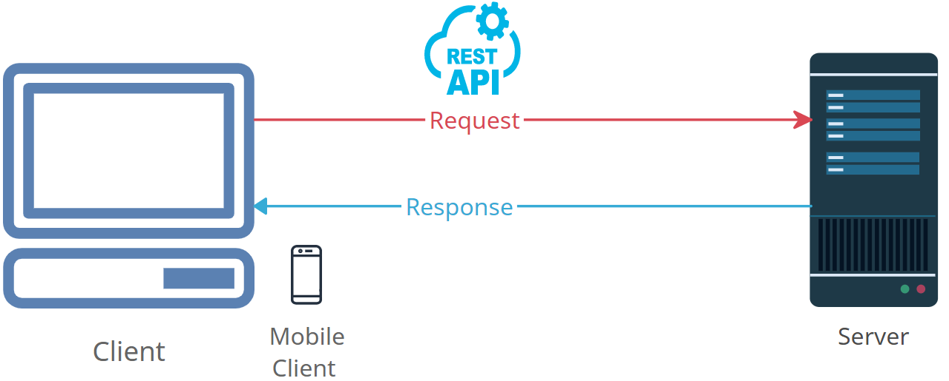

Demystifying HTTP Requests: How the Internet Fetches Web Pages
HTTP Request is like asking for a webpage on the internet. It's how your computer (or phone) talks to other computers (servers) to get information from websites.

Slide 2

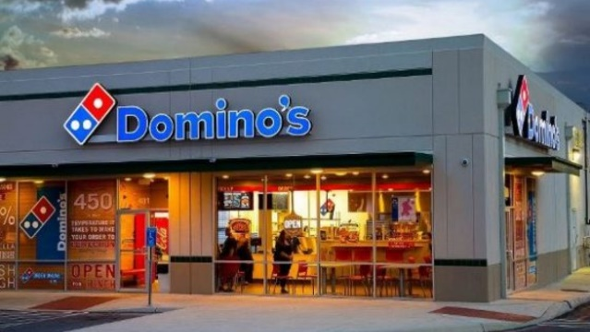
Demystifying HTTP Requests: How the Internet Fetches Web Pages
Here's a simple way to think about it:
You Want Information: Let's say you're hungry for a pizza. You decide which pizza you want, and you need to tell the pizza shop what you want.
You Place an Order: So, you call the pizza shop and say, "I want a Margherita pizza with extra cheese, please."
They Respond: The pizza shop takes your order, makes your pizza, and then they deliver it to your door.
In the online world, it works the same way:
You Want Web Content: You're on your computer, and you want to see a website, like "www.google.com."
You Send a Request: You send a message (an HTTP request) to that website, saying, "I want to see your homepage."
The Website Responds: The website's computer gets your message, prepares the webpage, and then sends it back to your computer.
That's how you get to see web pages, videos, pictures, and all sorts of stuff on the internet – by making requests and getting responses. It's like ordering pizza but for information on the web!

