Slide 1
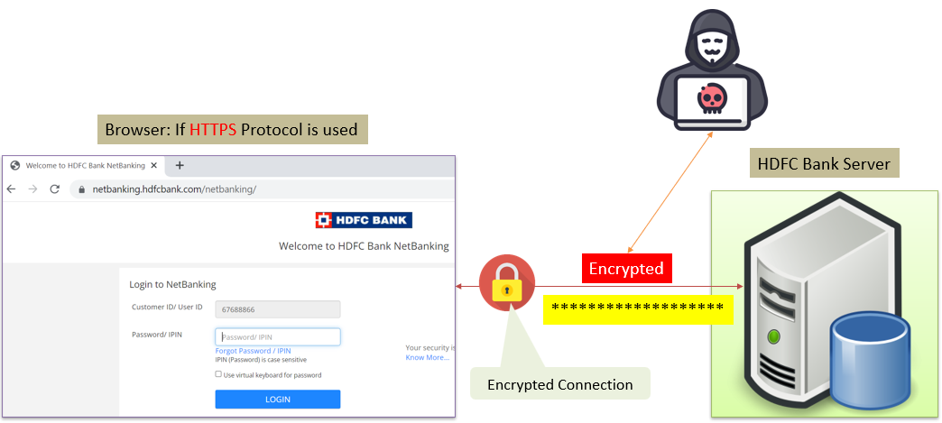
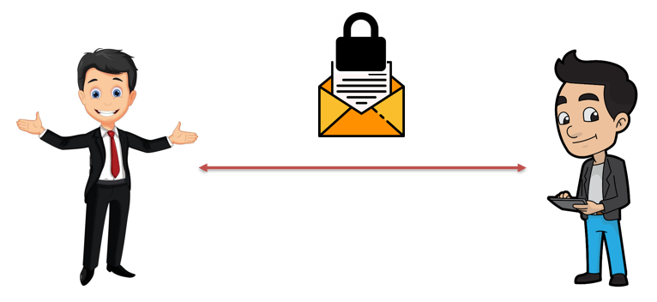
SSL, TLS, HTTPS Explained
SSL (Secure Sockets Layer) and TLS (Transport Layer Security):
Imagine you want to send a secret message to your friend, but you're worried someone might intercept it and read its contents. SSL and TLS are like special envelopes that help keep your message safe while it travels from you to your friend.
When you visit a website or send data online, your computer and the server hosting the website need a secure way to communicate. SSL and TLS provide that security by encrypting the data you send and receive. Encryption is like putting your message in a secret code that only your friend (the server) can decode. This way, even if someone tries to intercept your message, they won't be able to understand what's inside.

Slide 2
SSL, TLS, HTTPS Explained
HTTPS (Hypertext Transfer Protocol Secure):
Now, imagine that websites are like houses on the internet. When you visit a house, you want to make sure it's safe and not a fake or dangerous place. HTTPS is like a sign outside the house that tells you it's a safe place to enter.
When a website uses HTTPS, it means it has implemented SSL or TLS to secure the communication between your computer and the website's server. It ensures that the data you send, like passwords, credit card information, or personal details, is encrypted and protected from prying eyes. You can spot a website using HTTPS by looking at the web address: it starts with "https://" instead of just "http://".

Slide 3
SSL, TLS, HTTPS Explained
So, in a nutshell:
SSL and TLS are like secure envelopes that protect your data as it travels over the internet.
HTTPS is a way to check if a website is safe and uses SSL/TLS to keep your information secure.
Using HTTPS is essential for safeguarding your privacy and ensuring that your online interactions are secure. It's especially crucial when dealing with sensitive information like passwords or financial transactions.

