Slide 1
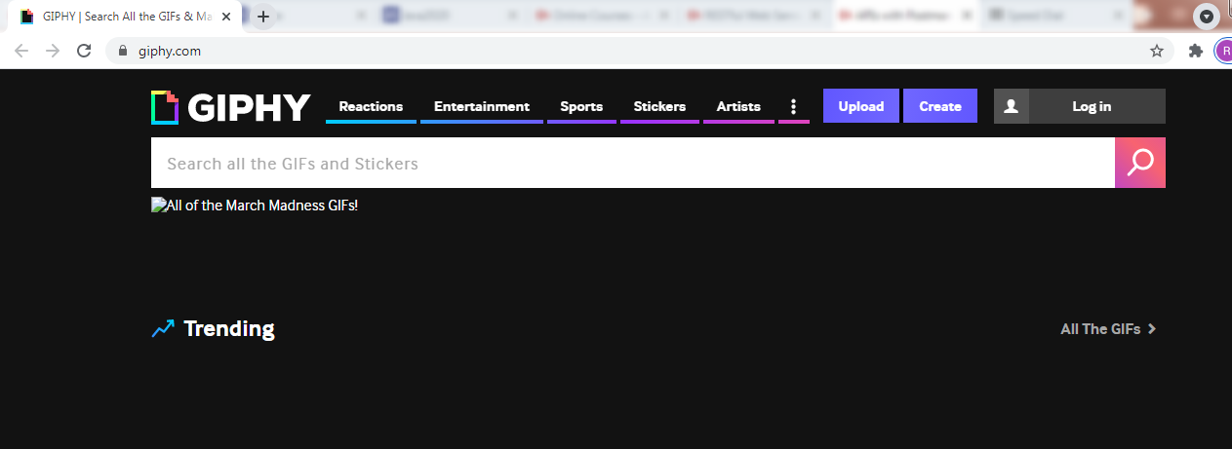
How to search for GIFs using the API? | How to get a GIF through the API? | How to upload a file through an API?
https://developers.giphy.com/docs/api/endpoint#upload
https://giphy.com/

