Slide 1


CDN Explained Simply: How the Internet's 'Delivery System' Speeds Up Websites
Imagine you're borrowing books from a library, but instead of going to one big library far away, there are many smaller libraries scattered around your neighborhood. That's similar to how a CDN (Content Delivery Network) works on the internet.
A CDN is like having multiple local libraries for internet content. When you visit a website, it's not always stored in just one place, but in different locations around the world. These locations, or servers, are part of the CDN.
Big Library
Local Small Library

Slide 2
CDN Explained Simply: How the Internet's 'Delivery System' Speeds Up Websites
So, when you request to see a website or watch a video, instead of everything coming from one distant place (like the main library), the content is delivered to you from a nearby server (or local library). This happens because the CDN stores copies of the website's files, images, videos, etc., in servers located closer to where you are.
This setup helps speed up how fast websites load, how quickly videos start playing, and how fast files download because the content is delivered from a server that's closer to you. Just like borrowing a book from the local library down the street is faster than going to the main library across town, using a CDN makes accessing internet content quicker and more efficient.
Big Library
Local Small Library

Slide 3
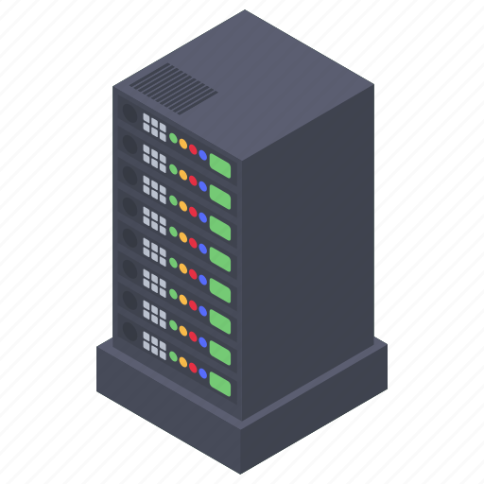


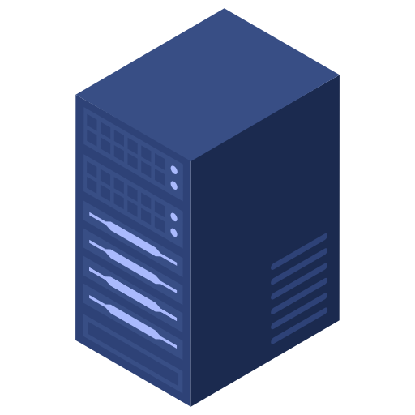

CDN Explained Simply: How the Internet's 'Delivery System' Speeds Up Websites
In simpler terms, a CDN helps websites load quickly by storing their content in different locations around the world, ensuring that when you visit the site, you receive the information from the nearest location, reducing the time it takes for the website to appear on your screen.
USA
India
India

