Slide 1

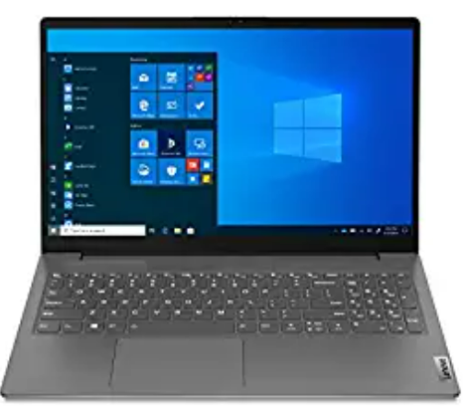
What are Microservices?
Client
Identity Provider
API Gateway
Service Registry & Discovery
Monitoring
Microservice A
Microservice B
Microservices
DB(A)
DB(B)

Slide 2
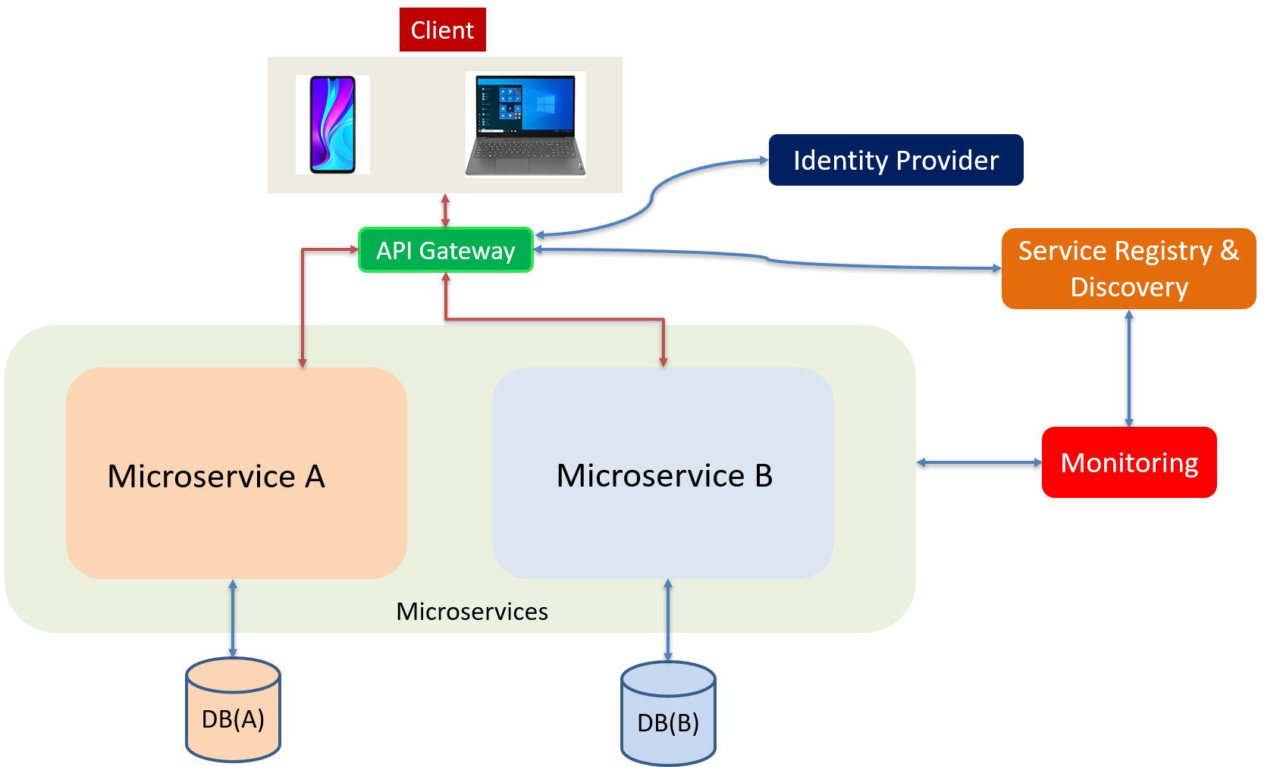
What are Microservices?
Microservices are loosely coupled. Each service handles a dedicated function inside a large-scale application.
Microservices architecture enables large teams to build scalable applications that are composed of many loosely coupled services.

Slide 3
What are Microservices?
Client
Identity Provider
Service Registry & Discovery
API Gateway
Microservices
User Microservice
Shopping Cart
Microservice
Billing
Microservice
Monitoring
Shopping Cart DB
Billing DB
User DB

Slide 4
What are Microservices?
Microservices talk to one another over a combination of remote procedure calls (RPC), Event Streaming, or message brokers.
RPC provides faster response, but the impact to other microservices, would be larger when the service was to go down.
Event streaming provides better isolation between services but they take longer to process.
Microservices
RPC
Shopping Cart
Microservice
Billing
Microservice
Event Streaming
Shopping Cart DB
Message Brokers
Billing DB

Slide 5
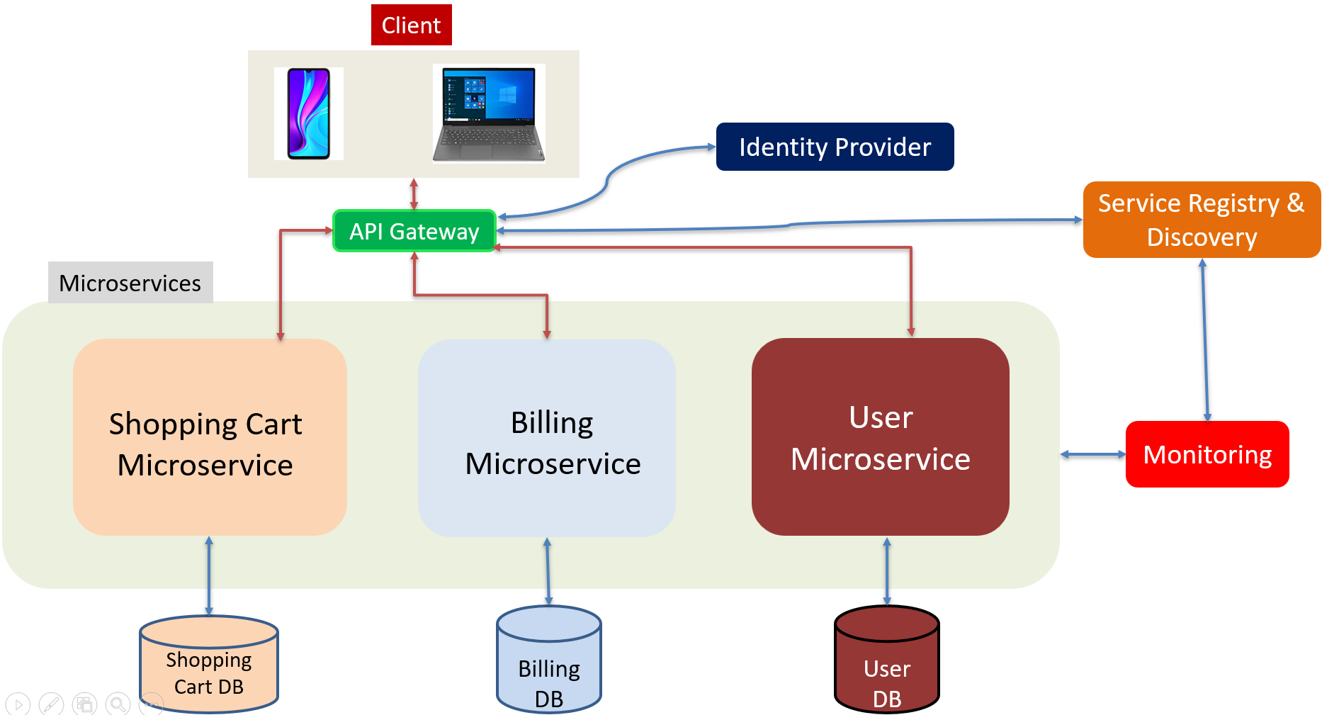
What are Microservices?
Microservices can be independently deployed.
Each microservice is small, easier to identify the issues, and has a smaller impact, this gives the operators peace of mind and confidence to deploy often.
Microservices provide more flexibility to scale up individual microservices independently. The operational flexibility is invaluable.

Slide 6
What are Microservices?
Client
Monolithic Application
(Shopping Cart, Billing and User functionalities)
Monolithic Database
(Shopping Cart, Billing and User Tables)

Slide 7
What are Microservices?
Well-architected microservices practice strong information hiding. This means breaking up a monolithic database into its logical components and keeping each logical component well hidden inside its corresponding microservice.
By logical component, it could mean a separate schema within a database cluster or an entirely separate physical database.
However, one big drawback of microservices is the breaking up of the database. By breaking up a database into separate logical units, the database can no longer maintain foreign key relationships and enforce referential integrity between these units. The burden of maintaining data integrity is now moved into the application layer.
Monolithic Database
(Shopping Cart, Billing and User Tables)
User
User_Id
Name
Age
Billing
Billing_Id
User_id Billing_Amount
Shopping Cart DB
Billing DB
User DB

Slide 8
What are Microservices?
API gateway handles incoming requests and routes them to the relevant microservices.
The API gateway relies on an identity provider service to handle the authentication and put authorization of each request coming through the API gateway.
To locate the microservice to route an incoming request to, the API gateway consults a ServiceRegistry & discovery service.
Microservices register with this ServiceRegistry and discover the location of other microservices through the discovery service.
There are other useful components in a microservices architecture like monitoring and alerting, DevOps tooling for deployment, and troubleshooting, for example.

Slide 9
What are Microservices?
Microservices cost money to build and operate. It really only makes sense for large teams. For large teams, it enables team independence. Each Microservice, can be independently maintained by a dedicated team.
In a well-designed microservices architecture, these independent teams can move fast, and the impact of failures is well-contained.
Each service could be independently designed, deployed, and scaled.

Slide 10
What are Microservices?
Microservices implementation is usually not a good fit for small startup company. What startup company can do is to design each function in the application with a well-defined interface.
One day if the business and team are growing fast then microservices architecture starts to make sense, it would be more manageable to migrate.

