Slide 1
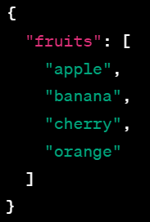
Demystifying JSON: Data Simplified for Everyone
JSON, which stands for "JavaScript Object Notation," is a way to organize and store data in a simple and easy-to-read format. Think of it like a universal language that computers and programs use to talk to each other. Imagine you have to send a message to a friend, but you both speak different languages. You could use drawings or symbols that everyone can understand. JSON is a bit like those symbols.
Imagine you have a collection of information, like a list of your favorite fruits:
In this case, JSON is like a structured way of writing down that you like apples, bananas, cherries, and oranges. It uses curly braces `{}` to group related information and colons `:` to connect labels (like "fruits") to their values (the list of fruits). The square brackets `[]` are used to represent lists.

Slide 2
Demystifying JSON: Data Simplified for Everyone
So, JSON is like a simple and standardized language that helps computers understand and share data with each other, making it easier for different programs and systems to communicate and work together.
JSON is not just for JavaScript, despite its name – it's used all over the digital world to exchange information efficiently.

