Slide 1


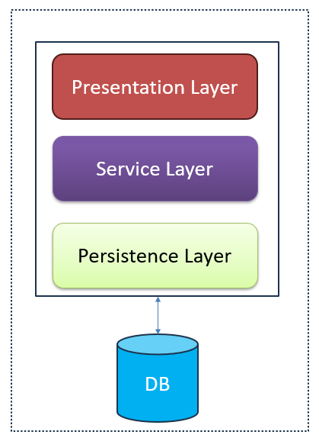
Monolithic vs Microservices architecture
If all the functionalities of a project exist in a single codebase, then that application is known as a monolithic application
Designing a monolithic application typically involves creating various layers such as presentation, service, and persistence.
The entire codebase is usually deployed as a single jar or war file.
In this context, "mono" refers to the single codebase containing all necessary functionalities.
Monolithic Architecture

Slide 2
Monolithic vs Microservices architecture
Disadvantages of Monolithic applications
Over time, a monolithic application grows too big, making it hard to handle.
Even minor changes require redeploying the entire application.
As the application gets bigger, it takes longer to start up and deploy.
New developers find it challenging to understand a large monolithic application, even if they're only responsible for a small part of it.
If one part of the application is heavily used, we have to deploy the whole application on multiple servers, which is inefficient and wastes resources. This makes horizontal scaling impractical.
Introducing new technology suited for specific functionalities is difficult and impacts the entire application
in terms of time and cost.
A single bug in any module can crash the entire monolithic application, making it unreliable.

Slide 3
Monolithic vs Microservices architecture
Advantages of monolithic applications:
Developing a monolithic application is easier compared to working with microservices because you don't need highly skilled developers to figure out and build different parts.
Deployment is simpler too because you only need to deploy one jar or war file.
Monolithic applications are generally easier and simpler to develop than microservices.
Network delays and security issues are less of a problem with monolithic applications compared to microservices.
Developers don't have to learn multiple applications; they can focus on just one.

Slide 4
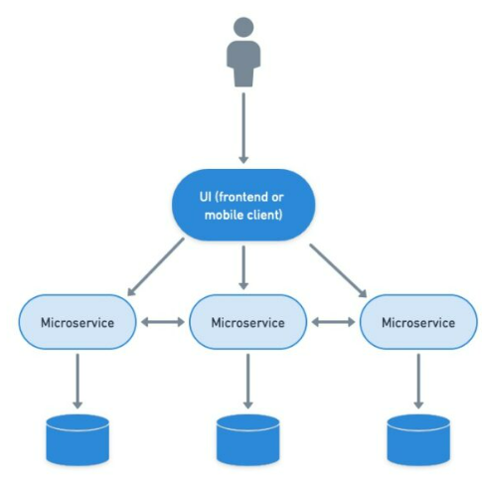
Monolithic vs Microservices architecture
Microservices is an architectural development style.
Applications are built using smaller services.
Each service handles a small portion of functionality and data.
Services communicate with each other directly.
Lightweight protocols like HTTP are used for communication.
Sam Newman defines microservices as "small services that work together."
Microservices Architecture

Slide 5
Monolithic vs Microservices architecture
In Microservice architecture, the way applications interact with databases changes significantly. Instead of sharing one database, each microservice gets its own. This might mean having some duplicate data, but it's necessary for keeping things separate and flexible.
Having one database per microservice lets each microservice choose the best database type for what it does.
Each service has its own secure boundary, so they can be written in different programming languages.
Microservice architecture involves various patterns like finding services, caching, handling communication, keeping an eye on what's happening, and making sure things are secure.
Microservices Architecture

Slide 6
Monolithic vs Microservices architecture
Principles of microservices
The single responsibility principle, part of the SOLID design pattern, dictates that each unit—be it a class, method, or microservice—should have one clear responsibility. In the context of microservices, this means each microservice handles a single functionality. In other words, the number of microservices should match the number of functions needed. Additionally, microservices typically have their own databases, contributing to decentralization.
Building around business capabilities means leveraging the most suitable technologies for specific functionalities within an application. Unlike monolithic applications, where using different technologies for various functions was limited, microservices allow flexibility in adopting appropriate technology stacks or backend databases for each microservice. This ensures that each microservice can utilize different technologies based on the specific needs of the business.
"Design for failure" in microservices means anticipating and preparing for potential failures within individual services. Unlike monolithic applications, where the failure of one module can bring down the entire system, microservices are designed to withstand failures. This architecture ensures that if one microservice goes down, other functionalities remain accessible to users, leveraging the resilience of microservices and minimizing disruption to the overall system.

Slide 7
Monolithic vs Microservices architecture
Advantages of microservices:
Microservice is easy to manage as it is relatively smaller.
If there’s any update in one of the microservices, then we need to redeploy only that microservice.
Microservices are self-contained and, hence, deployed independently. Their start-up and deployment times are relatively less.
It is very easy for a new developer to onboard the project as he needs to understand only a particular microservice providing the functionality he will be working on and not the whole system.
If a particular microservice is facing a large load because of the users using that functionality in excess, then we need to scale out that microservice only. Hence, the microservices architecture supports horizontal scaling.
Each microservice can use different technology based on the business requirements.
If a particular microservice goes down due to some bug, then it doesn’t affect other microservices and the whole system remains intact and continues providing other functionalities to the users.

Slide 8
Monolithic vs Microservices architecture
Disadvantages of microservices
Distributed systems, like this one, are more complex compared to monolithic applications, especially as the number of microservices increases.
Skilled developers are needed to work with microservices, as they must understand and manage how the microservices communicate with each other.
Deploying microservices independently is challenging.
Microservices can be expensive in terms of network usage because they need to interact with each other, leading to network latency.
Microservices are generally less secure than monolithic applications due to the communication between different services over the network.
Debugging is challenging because control flows through multiple microservices, making it difficult to pinpoint exactly where and why an error occurred.

Slide 9
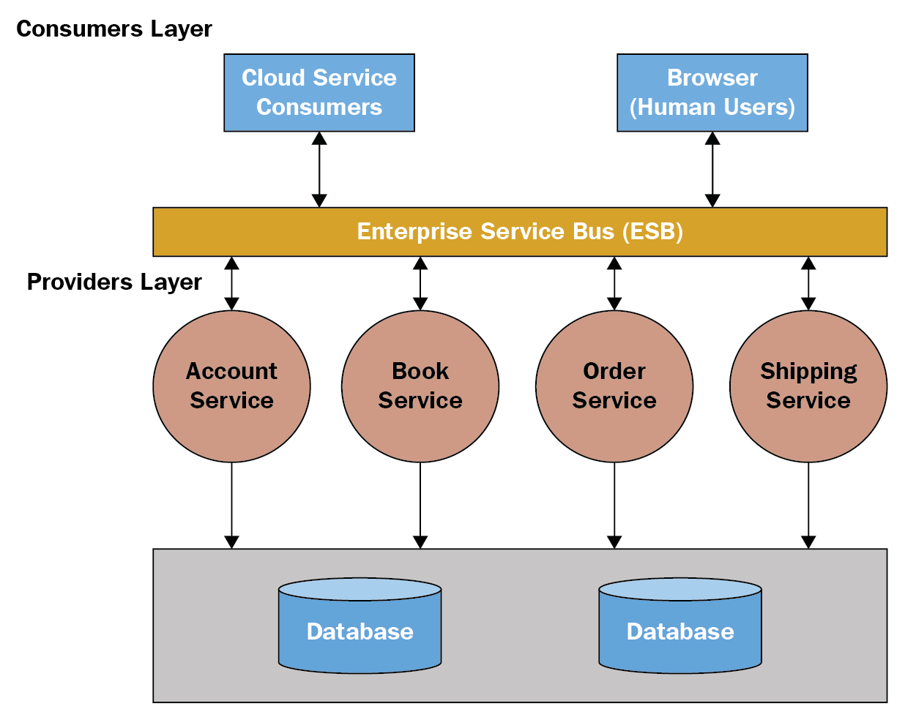
Service-oriented architecture (SOA) vs Microservices architecture
SOA emerged in response to issues with monolithic architecture and gained popularity in the early 2000s.
In SOA, a large application is divided into smaller services deployed independently, but these services don't directly communicate with each other.
SOA typically involves an Enterprise Service Bus (ESB), acting as middleware or a server facilitating communication between services using various protocols or message standards.
There wasn't a strict guideline for each service to have its own independent database in SOA.
Service-Oriented Architecture
(SOA)

Slide 10
Service-oriented architecture (SOA) vs Microservices architecture
Microservices architecture is an evolution of SOA. People also consider SOA as a superset of microservices. In simple terms, microservices is a fine-grained SOA.
Unlike SOA, microservices involve direct communication between the services, eliminating the need for a central dependency like an Enterprise Service Bus (ESB).
There is a guideline in microservices to maintain separate databases for each individual microservice.
The core concept behind evolving from SOA to microservices is to reduce dependency between services, promoting loose coupling according to the specified guidelines.
Service-Oriented Architecture
(SOA)

Slide 11
Monolithic vs Microservices architecture
Presentation Layer
Service Layer
Persistence Layer
DB

