Slide 1




SSL, TLS, HTTPS Explained
SSL (Secure Sockets Layer):
Imagine you want to send a secret message to your friend, but you don't want anyone else to be able to read it. SSL is like a special lock that you put on the message envelope.
When you send the message, it gets wrapped up securely so that only your friend can unlock and read it with their special key.

Slide 2
SSL, TLS, HTTPS Explained
TLS (Transport Layer Security):
TLS is like an upgraded version of SSL. It works in a similar way by providing a secure layer for your messages, but it's more modern and secure.
Think of TLS as a super-strong lock that not only protects the message but also makes sure it can't be tampered with during its journey to your friend.

Slide 3
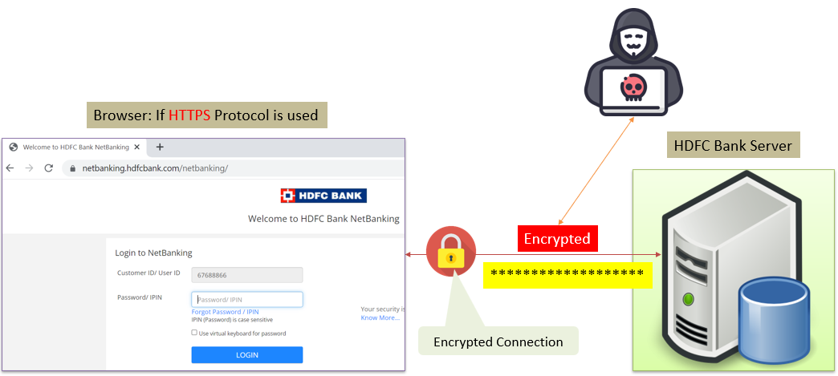
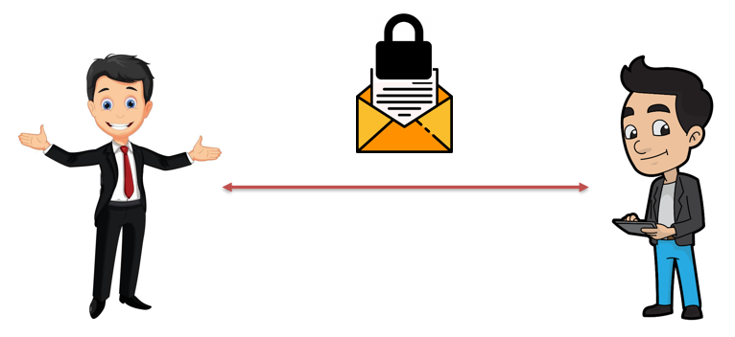
SSL, TLS, HTTPS Explained
HTTPS (Hypertext Transfer Protocol Secure):
Now, imagine you want to send not just one secret message but a whole bunch of them to your friend. HTTPS is like a special service that uses TLS to protect all the messages you send between your web browser and a website.
So, when you visit a website with HTTPS, all the information exchanged between your browser and the website is secured with that super-strong lock (TLS), ensuring your data stays private and safe from prying eyes.

Slide 4
SSL, TLS, HTTPS Explained
In summary, SSL and TLS are like locks that keep your online communication secure
HTTPS is the combination of TLS with the regular web browsing protocol (HTTP), making sure your data is safe and encrypted while you browse the internet. This security is crucial, especially when you're entering sensitive information like passwords or credit card details on websites.

