Slide 1
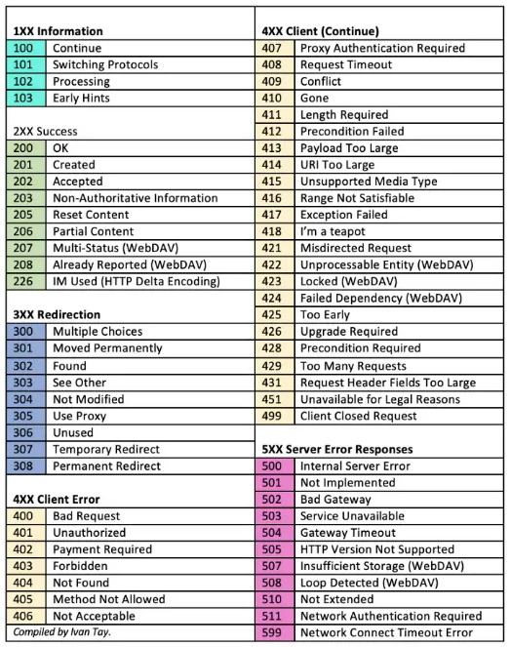
HTTP response status codes
When a browser request a service from a
web service, a response code will be given. These are the list of HTTP Status Code that might be returned.
Below are the list of status codes. They are classified into 5 classes :
1xx Informational — the request was received, continuing process
2xx Successful — the request was successfully received, understood, and accepted
3xx Redirection — further action needs to be taken in order to complete the request
4xx Client error — the request contains bad syntax or cannot be fulfilled
5xx Server error — the server failed to fulfil a valid request

Slide 2
HTTP response status codes
HTTP status codes are three-digit response codes, These codes enable servers to communicate with users on the internet. When a request is placed to view a specific website or Web page, these codes inform the user whether the server is working or not.
Status code is a response received by the server to a browser’s request. When you key in a web address on the browser, the browser sends a request to that particular site’s server. The server then responds to the browser with a three-digit HTTP status code.

Slide 3
HTTP response status codes
When a browser requests a service from a web server, an error might occur, and the server might return an error code like "404 Not Found".
It is common to name these errors HTML error messages. But these messages are something called HTTP status messages. In fact, the server always returns a message for every request. The most common message is 200 OK.

Slide 4
HTTP response status codes
1xx: Information
Message: | Description
100 Continue | This interim response indicates that the client should continue the request or ignore the response if the request is already finished.
101 Switching Protocols | The requester has asked the server to switch protocols and the server has agreed to do so.
102 Processing | This means that the server has received and accepted the request sent by the browser but has sent an interim response to the browser because it has not completed the request yet and the server is processing the request, but no response is available yet.
103 Early Hints | Used with the Link header to allow the browser to start preloading resources while the server prepares a response

Slide 5
HTTP response status codes
2xx: Successful
Message: | Description:
200 OK | The request is OK (this is the standard response for successful HTTP requests)
201 Created | The request has been fulfilled, and a new resource is created
202 Accepted | The request has been accepted for processing, but the processing has not been completed
203 Non-Authoritative Information | This status code informs users that the request submitted to the server was successful, but the meta-information, is collected from a third-party or a local copy instead of from the origin server.
204 No Content | The request has been successfully processed, but is not returning any content
205 Reset Content | This status code tells the user at the browser end to reset the content in the document that sent the request. Consider the example of filling a form online. In case of error, the server asks for the form to be cleared and reset so that the information can be entered again.
206 Partial Content | The server is delivering only part of the resource due to a range header sent by the client

Slide 6
HTTP response status codes
2xx: Successful
Message: | Description:
207 Multi-Status | The 207 HTTP status code displays data and information from multiple resources in response to several operations and multiple HTTP status codes at once.
208 Already Reported | The 208 HTTP status code is for those users who use DAV to create and manage files collaboratively with others. It is used in the DAV:propstat response to prevent internal members from repetitive enumeration of multiple bindings in the same collection.
226 IM Used | The 226 status code means the server has completed the user request, or Get request, for a given resource. The response represents the result of one or multiple instance manipulations, which is applied to the current instance.

Slide 7
HTTP response status codes
3xx: Redirection
Message: | Description:
300 Multiple Choices | The request has more than one possible response. The user agent or user should choose one of them. (There is no standardized way of choosing one of the responses, but HTML links to the possibilities are recommended so the user can pick.)
301 Moved Permanently | The URL of the requested resource has been changed permanently. The new URL is given in the response.
302 Found | The requested page has moved temporarily to a new URL
303 See Other | The requested page can be found under a different URL
304 Not Modified | This is used for caching purposes. It tells the client that the response has not been modified, so the client can continue to use the same cached version of the response.
307 Temporary Redirect | The server sends this response to direct the client to get the requested resource at another URI with same method that was used in the prior request. This has the same semantics as the 302 Found HTTP response code, with the exception that the user agent must not change the HTTP method used: if a POST was used in the first request, a POST must be used in the second request.
308 Permanent Redirect | This means that the resource is now permanently located at another URI, specified by the Location: HTTP Response header. This has the same semantics as the 301 Moved Permanently HTTP response code, with the exception that the user agent must not change the HTTP method used: if a POST was used in the first request, a POST must be used in the second request.

Slide 8
HTTP response status codes
4xx: Client Error
Message: | Description:
400 Bad Request | The 400 status code indicates an error at the client or user end and lets them know that the server could not understand the request due to bad syntax (spelling, punctuation, and other errors).
401 Unauthorized | This indicates that the request sent by the browser could not be authenticated. The authentication may have been provided by the client, but the client is not permitted to access the requested resource.
402 Payment Required | The 402 status code was created for directing the user to complete digital payments. After the payment, the server was supposed to display the requested content. However, this status code is reserved for future use.
403 Forbidden | The server understood the request however, it refuses to authorize it. This code is returned when the user attempts to access something that they do not have permission to access.
404 Not Found | The requested page could not be found but may be available again in the future
405 Method Not Allowed | A request method is not supported for the requested resource; for example, a GET request on a form that requires data to be presented via POST, or a PUT request on a read-only resource.
406 Not Acceptable | The requested resource is capable of generating only content not acceptable according to the Accept headers sent in the request

Slide 9
HTTP response status codes
4xx: Client Error
Message: | Description:
407 Proxy Authentication Required | This is similar to 401 Unauthorized but authentication is needed to be done by a proxy.
408 Request Timeout | The server timed out waiting for the request
409 Conflict | Indicates that the request could not be processed because of conflict in the current state of the resource, such as an edit conflict between multiple simultaneous updates.
410 Gone | The requested page is no longer available
411 Length Required | Server rejected the request because the Content-Length header field is not defined and the server requires it.
412 Precondition Failed | The server does not meet one of the preconditions that the requester put on the request header fields.
413 Request Too Large | The 413 status code indicates that the server refuses to process the user request because the request payload is larger than the server can process. The server then closes the connection or generates a retry-after header field for the user.

Slide 10
HTTP response status codes
4xx: Client Error
Message: | Description:
414 Request-URI Too Long | The server will not accept the request, because the URI is too long. Occurs when you convert a POST request to a GET request with a long query information
415 Unsupported Media Type | The server will not accept the request, because the media type is not supported
416 Range Not Satisfiable | The client has asked for a portion of the file, but the server cannot supply that portion
417 Expectation Failed | The server cannot meet the requirements of the Expect request-header field

Slide 11
HTTP response status codes
4xx: Client Error
Message: | Description:
418 I'm a teapot | This code was defined in 1998 as one of the traditional IETF April Fools' jokes, in RFC 2324, Hyper Text Coffee Pot Control Protocol, and is not expected to be implemented by actual HTTP servers. The RFC specifies this code should be returned by teapots requested to brew coffee.[22] This HTTP status is used as an Easter egg in some websites, such as Google.com's "I'm a teapot" easter egg.[23][24][25] Sometimes, this status code is also used as a response to a blocked request, instead of the more appropriate 403 Forbidden.[26][27]
421 Misdirected Request | The request was directed at a server that is not able to produce a response (for example because of connection reuse).
422 Unprocessable Entity | The request was well-formed but was unable to be followed due to semantic errors
423 Locked | The resource that is being accessed is locked
424 Failed Dependency | The request failed because it depended on another request and that request failed
425 Too Early | Indicates that the server is unwilling to risk processing a request that might be replayed.

Slide 12
HTTP response status codes
4xx: Client Error
Message: | Description:
426 Upgrade Required | The client should switch to a different protocol such as TLS/1.3, given in the Upgrade header field.
428 Precondition Required | The origin server requires the request to be conditional. Intended to prevent the 'lost update' problem, where a client GETs a resource's state, modifies it, and PUTs it back to the server, when meanwhile a third party has modified the state on the server, leading to a conflict.
429 Too Many Requests | The user has sent too many requests in a given amount of time. Intended for use with rate-limiting schemes
431 Request Header Fields Too Large | The server is unwilling to process the request because either an individual header field, or all the header fields collectively, are too large
451 Unavailable For Legal Reasons | A server operator has received a legal demand to deny access to a resource or to a set of resources that includes the requested resource

Slide 13
HTTP response status codes
5xx: Server Error
Message: | Description:
500 Internal Server Error | The server has encountered a situation it does not know how to handle.
501 Not Implemented | The server either does not recognize the request method, or it lacks the ability to fulfill the request
502 Bad Gateway | The server was acting as a gateway or proxy and received an invalid response from the upstream server
503 Service Unavailable | The server is currently unavailable (overloaded or down)
504 Gateway Timeout | The server was acting as a gateway or proxy and did not receive a timely response from the upstream server
505 HTTP Version Not Supported | The server does not support the HTTP protocol version used in the request
506 Variant Also Negotiates | The server has an internal configuration error: the chosen variant resource is configured to engage in transparent content negotiation itself, and is therefore not a proper end point in the negotiation process.

Slide 14
HTTP response status codes
5xx: Server Error
Message: | Description:
507 Insufficient Storage | The 507 status code is another WEBDAV response code. It indicates to users that the server cannot store the representation needed to complete the request and process the resource.
508 Loop Detected | The server detected an infinite loop while processing the request
510 Not Extended | Further extensions to the request are required for the server to fulfill it
511 Network Authentication Required | The client needs to authenticate to gain network access

