Slide 1
REST - Good Practices for API Design
What is REST?
In 2000, Roy Fielding, one of the principal authors of the HTTP specification, proposed an architectural approach for designing web-services known as Representational State Transfer (REST).
REST API’s are implemented for a “resource” [e.g. User, Product] which could be an entity or service.
REST API’s provide way to identify a resource by its URI, which can be used to transfer a representation of a resource’s current state over HTTP.

Slide 2
REST - Good Practices for API Design
Why Is API Design So Important?
REST APIs are the face of any service, So REST API Should be easy to understand so that integration is straightforward.
REST API should be well documented.
REST API should follow accepted standards such as HTTP

Slide 3
REST - Good Practices for API Design
1.Use Nouns in URI
REST API’s should be designed for Resources, which can be entities or services, etc., therefore URI must always be nouns. For example, instead of /createProduct use /products

Slide 4
REST - Good Practices for API Design
2. Plurals or Singulars
Generally, we prefer to use plurals but there is no hard rule that one can’t use singular for resource name. Why we are using plurals is:
We are operating on one resource from the collection of resources so to depict collection we use plural
For example, in the case of…
GET /products/200
The client is asking to retrieve a resource from products collection with id 200. While creating a resource we want to add one resource to current collection of resources, so the API looks like the below…
POST /products

Slide 5
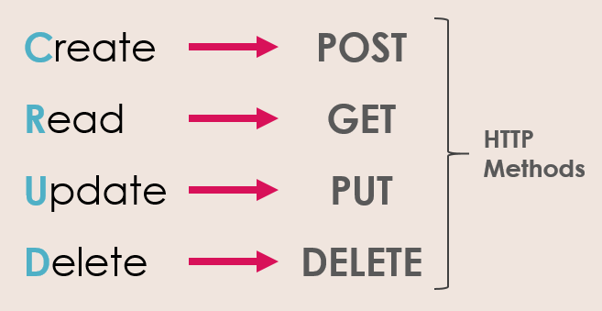
REST - Good Practices for API Design
3. Let the HTTP Verb Define Action
As per point #1, API’s should only provide nouns for resources and let the HTTP verbs (GET, POST, PUT, DELETE) define the action to be performed on a resource.
A POST request means we want to create a new resource.
A GET means we want to read the data about an existing resource.
A PUT is for updating an existing resource.
A DELETE is for removing an existing resource.

Slide 6
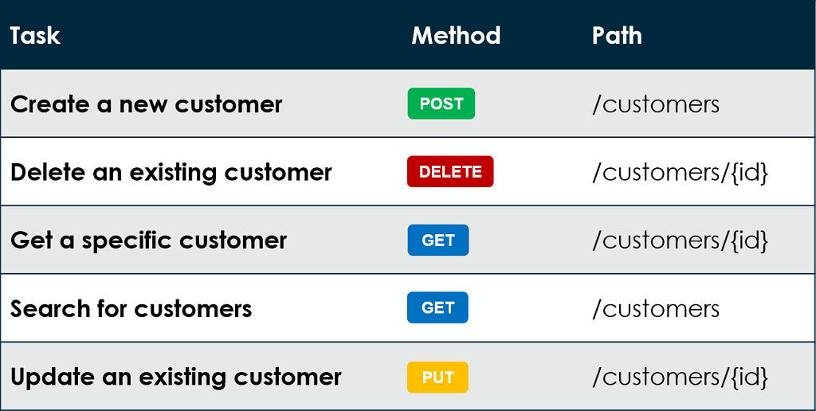
REST - Good Practices for API Design
3. Let the HTTP Verb Define Action
As per point #1, API’s should only provide nouns for resources and let the HTTP verbs (GET, POST, PUT, DELETE) define the action to be performed on a resource.

Slide 7
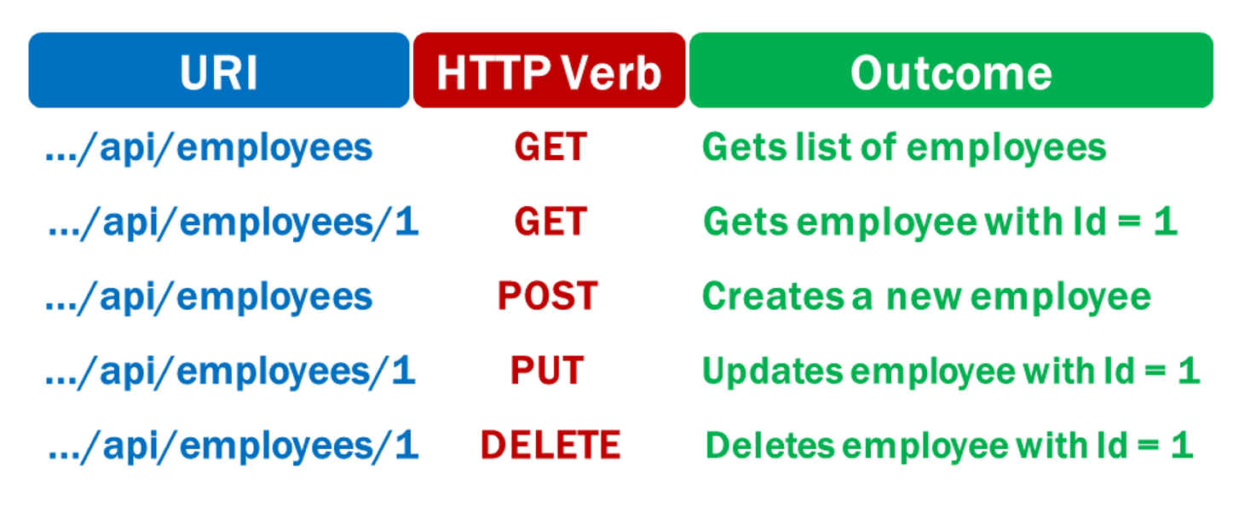
REST - Good Practices for API Design
3. Let the HTTP Verb Define Action
As per point #1, API’s should only provide nouns for resources and let the HTTP verbs (GET, POST, PUT, DELETE) define the action to be performed on a resource.

Slide 8
REST - Good Practices for API Design
4. Don’t Misuse Safe Methods (Idempotency)
Safe methods are HTTP methods which return the same resource representation irrespective of how many times are called by client.
GET, HEAD, OPTIONS and TRACE methods are defined as safe, meaning they are only intended for retrieving data and should not change a state of a resource on a server. Don’t use GET to delete content, for example…
GET /products/200/delete
It’s not like this can’t be implemented, but HTTP specification is violated in this case.
Use HTTP methods according to the action which needs to be performed.

Slide 9
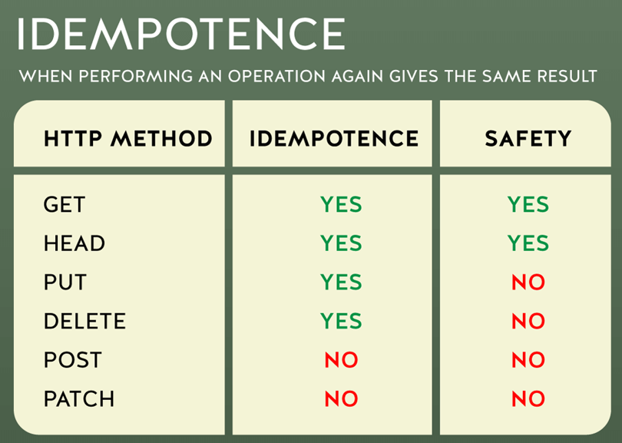
REST - Good Practices for API Design
When an API is idempotent, making multiple identical requests has the same effect as making a single request. This is usually not the case for a POST request because it will create a new resource.

Slide 10
REST - Good Practices for API Design
5. Depict Resource Hierarchy Through URI
If a resource contains sub-resources, make sure to depict this in the API to make it more explicit.
For example, if a user has posts and we want to retrieve a specific post by user, API can be defined as GET /users/200/posts/99 which will retrieve Post with id 99 by user with id 200

Slide 11
REST - Good Practices for API Design
6. Version Your APIs
Versioning APIs always helps to ensure backward compatibility of a service while adding new features or updating existing functionality for new clients.
There are many ways to version an API. The most straight forward is to prefix the version before the resource on the URI
/v1/products
/v2/products
/v3/products

Slide 12
REST - Good Practices for API Design
7. Return Representation
POST, PUT or PATCH methods, used to create a resource or update fields in a resource, should always return updated resource representation as a response with appropriate status code.
POST if successful to add new resource should return HTTP status code 201 along with URI of newly created resource in Location header (as per HTTP specification)

Slide 13
REST - Good Practices for API Design
8. Filter, Search and Sort
Don’t create different URIs for fetching resources with filtering, searching, or sorting parameters.
keep the URI simple, and add query parameters to depict parameters or criteria to fetch a resource (single type of resource)
Filtering:
Use query parameters defined in URL for filtering a resource from server. For example, if we would like to fetch all published posts by user we can design an API such as:
GET /users/200/posts?state=published
In the example above, state is the filter parameter

Slide 14
REST - Good Practices for API Design
8. Filter, Search and Sort
Searching:
To get the results with powerful search queries instead of basic filters, one could use multiple parameters in a URI to request to fetch a resource from server.
GET /users/123/posts?state=published&tag=java
The above query searches for posts which are published with the Java tag.
Sorting:
ASC and DESC sorting parameters can be passed in URL such as:
GET /users/123/posts?sort=created_at
Returns posts sorted with descending order of created date time.

Slide 15
REST - Good Practices for API Design
9. HATEOAS
Hypermedia As Transfer Engine Of Application State is a constraint of the REST application architecture that distinguishes it from other network application architectures.
HATEOAS provides ease of navigation through a resource and its available actions. This way a client doesn’t need to know how to interact with an application for different actions, as all the metadata will be embedded in responses from the server.

Slide 16
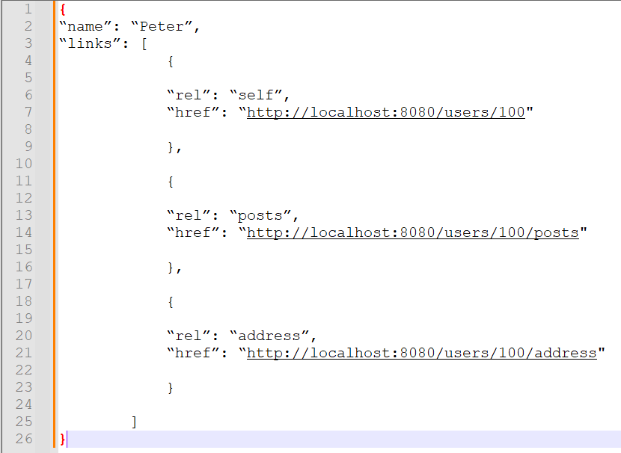
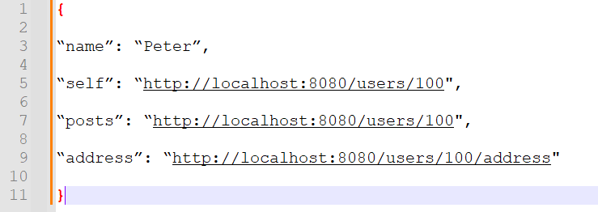
REST - Good Practices for API Design
http://localhost:8080/users/100
Or

Slide 17
REST - Good Practices for API Design
10. Stateless Authentication & Authorization
REST APIs should be stateless. Every request should be self-sufficient and must be fulfilled without knowledge of the prior request.
Previously, developers stored user information in server-side sessions, which is not a scalable approach. For that reason, every request should contain all the information of a user (if it’s a secure API), instead of relying on previous requests.
This doesn’t limit APIs to a user as an authorized person, as it allows service-to-service authorization as well. For user authorization, JWT (JSON Web Token) with OAuth2 provides a way to achieve this. Additionally, for service-to-service communication, try to have the encrypted API-key passed in the header.

Slide 18
REST - Good Practices for API Design
11. Swagger for Documentation
Swagger is a widely-used tool to document REST APIs that provides a way to explore the use of a specific API, therefore allowing developers to understand the underlying semantic behavior.
Swagger is a declarative way of adding documentation using annotations which further generates a JSON describing APIs and their usage.
Example: https://petstore.swagger.io/

Slide 19
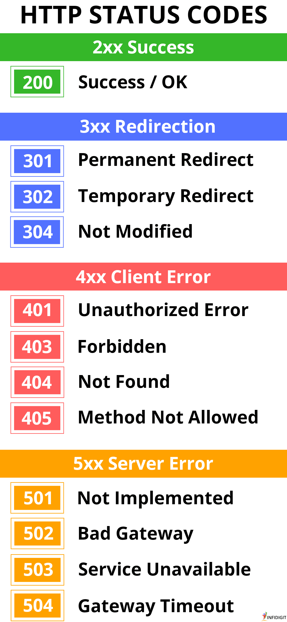
REST - Good Practices for API Design
12. HTTP Status Codes
Use HTTP status codes to provide the response to a client. It could be a success or failure response, but it should define what the respective success or failure means from a server perspective.
200 OK: Returned by a successful GET or DELETE operation. PUT or POST can also use this, if the service does not want to return a resource back to the client after creation or modification.
201 Created: Response for a successful resource creation by a POST request.

Slide 20
REST - Good Practices for API Design
304 Not Modified: Used if HTTP caching header is implemented.

Slide 21
REST - Good Practices for API Design
400 Bad Request: When an HTTP request body can’t be parsed. For example, if an API is expecting a body in a JSON format for a POST request, but the body of the request is malformed.
401 Unauthorized: Authentication is unsuccessful (or credentials have not been provided) while accessing the API.
403 Forbidden: If a user is not Authorized to perform an action although authentication information is correct.
404 Not Found: If the requested resource is not available on the server.
405 Method Not Allowed: If the user is trying to violate an API contract, for example, trying to update a resource by using a POST method.

Slide 22
REST - Good Practices for API Design
These errors occur due to server failures or issues with the underlying infrastructure.

