Slide 1
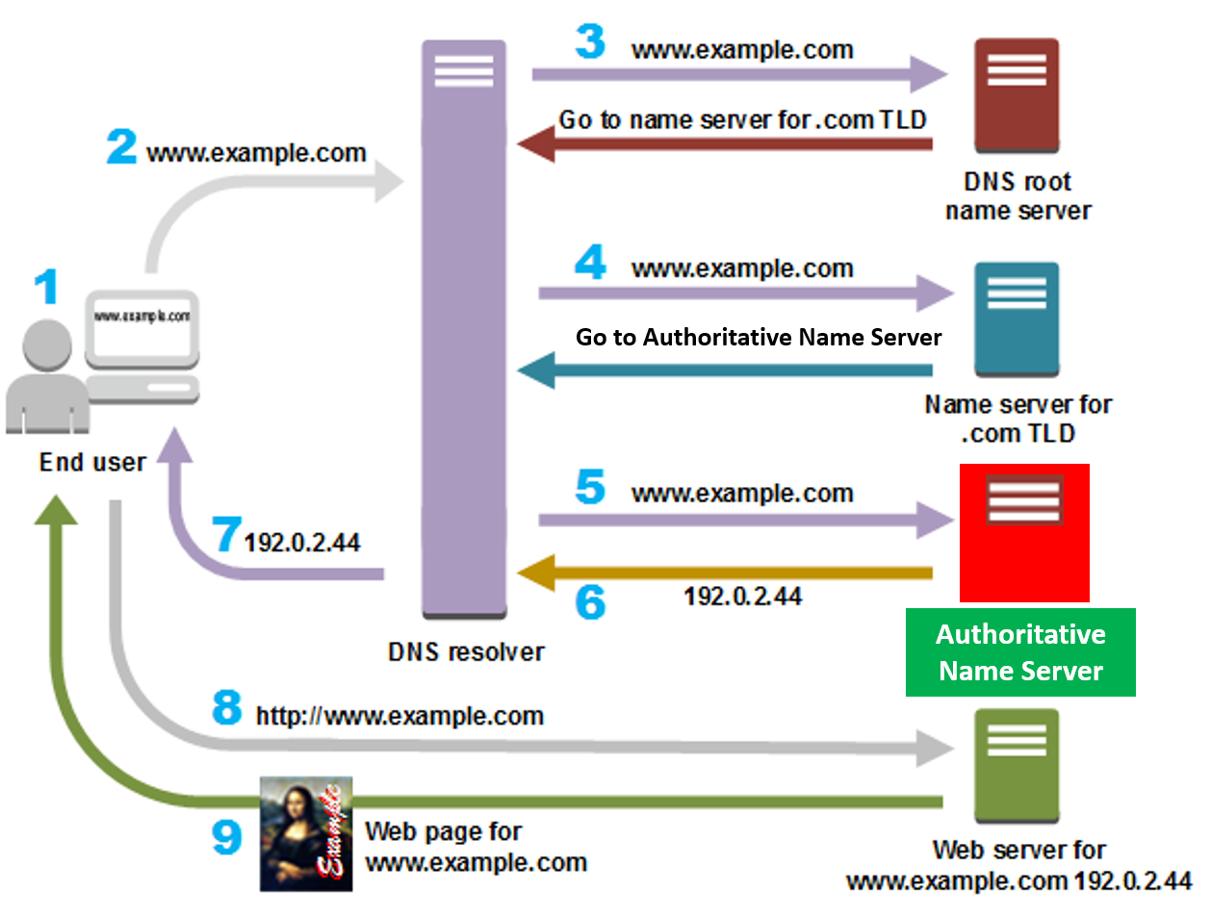
Understanding DNS: A Beginner's Guide
What is DNS?
DNS lookup, or Domain Name System lookup, is the process of translating a domain name (like www.example.com) into an IP address (like 192.0.2.1) that computers use to communicate with each other over a network.

Slide 2
Understanding DNS: A Beginner's Guide
Steps involved in a DNS lookup:
Local Cache Check: When you enter a domain name into your web browser, your computer first checks its local DNS cache to see if it has recently looked up the domain name. If the IP address is found in the cache and has not expired, the lookup process ends here, and your browser can connect to the website using the cached IP address.
Operating System Resolver: If the domain name is not found in the local cache or has expired, your computer's operating system resolver takes over. It sends a query to the configured DNS resolver, typically your Internet Service Provider's (ISP) DNS server.

Slide 3
Understanding DNS: A Beginner's Guide
Steps involved in a DNS lookup:
3. DNS Resolver Query: The DNS resolver then sends a query to the root DNS servers, asking them to provide the IP address of the
DNS server responsible for the top-level domain (like .com, .net, etc.) of the requested domain name.
Root DNS Servers: The root DNS servers respond to the resolver's query with the IP addresses of the top-level domain (TLD) DNS servers responsible for the requested domain name's TLD.

Slide 4
Understanding DNS: A Beginner's Guide
Steps involved in a DNS lookup:
4. TLD DNS Servers: The DNS resolver then sends a query to the TLD DNS servers, asking them to provide the IP address of the authoritative DNS server responsible for the second-level domain (like example.com) of the requested domain name.
Authoritative DNS Server Query: The TLD DNS servers respond with the IP address of the authoritative DNS server for the requested domain name.

Slide 5
Understanding DNS: A Beginner's Guide
Steps involved in a DNS lookup:
5.Authoritative DNS Server: Finally, the DNS resolver sends a query to the authoritative DNS server, asking it to provide the IP address associated with the requested domain name.
6. Response: The authoritative DNS server responds to the DNS resolver with the IP address of the requested domain name.
Cache Update: The DNS resolver caches the IP address locally for future use, reducing the need for repeated DNS lookups for the same domain name.

Slide 6
Understanding DNS: A Beginner's Guide
Steps involved in a DNS lookup:
7 & 8 & 9. Connection: With the IP address obtained from the DNS lookup process, your computer can establish a connection to the web server hosting the website associated with the domain name.

Slide 7
Understanding DNS: A Beginner's Guide
Summary
These steps are crucial in ensuring that users can access websites on the internet using domain names rather than complex IP addresses. DNS lookup is a fundamental part of how the internet functions, enabling seamless communication between devices across the globe.

