Slide 1
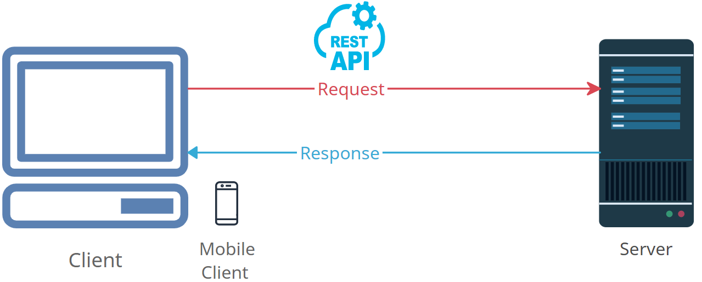


Demystifying HTTP Requests: How the Internet Fetches Web Pages
Imagine the internet is like a gigantic library, and the websites you visit are like different books on the library shelves. When you want to read a book or get information from it, you need to ask the librarian for that book.
Now, think of your computer as a library visitor, and the website you want to access as the book you want to read. When you type a web address (like www.example.com) into your web browser and press "Enter," your computer is making an HTTP request to the web server where that website is stored.
Library

Slide 2
Demystifying HTTP Requests: How the Internet Fetches Web Pages
Here's how it works:
Request: Your computer sends a message to the web server, saying, "Hey, I want to see the contents of the book (website) located at www.example.com.“
Web Server Response: The web server, acting like a helpful librarian, receives your request and goes to fetch the book (website) you asked for.
Delivery: The web server then sends the book's pages (website's data) back to your computer, which your web browser displays on your screen.
Library

Slide 3
Demystifying HTTP Requests: How the Internet Fetches Web Pages
So, in a nutshell, an HTTP request is like politely asking for a specific book in a library, and the web server, acting as the librarian, provides you with the book's content so you can read it on your computer.
HTTP Request is the fundamental communication process that happens every time you visit a website or click on a link online. Your computer asks, the server fetches, and you get to read or interact with the web page.
Library

