Slide 1
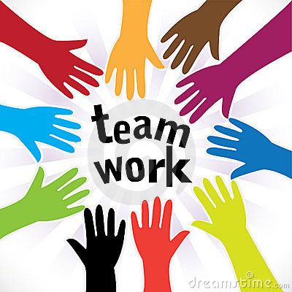
Mastering Scrum: Agile Framework Essentials for Professionals
What is Scrum?
Scrum is a widely adopted agile framework used primarily in software development but also applied across various industries to manage complex projects effectively.
Scrum is based on iterative and incremental principles, enabling teams to deliver value to customers faster and adapt to changing requirements efficiently.
Scrum is characterized by its structured framework of roles, events, artifacts, and principles.

Slide 2
Role
Artifacts
Key Components of Scrum
Events (or Ceremonies)
Mastering Scrum: Agile Framework Essentials for Professionals
Product Owner
Scrum Master
Development Team
Product Backlog
Sprint Backlog
Increment
Sprint Planning
Daily Scrum (Stand-up)
Sprint Review
Sprint Retrospective

Slide 3
Mastering Scrum: Agile Framework Essentials for Professionals
Role:
Product Owner: Represents the voice of the customer and stakeholders. Responsible for defining the product vision, managing the product backlog, and prioritizing work items based on business value.
Scrum Master: Facilitates the Scrum process. Acts as a servant-leader to the team, ensuring adherence to Scrum principles, removing impediments, and fostering a collaborative environment.
Development Team: A self-organizing, cross-functional team responsible for delivering increments of working product during each sprint.

Slide 4
Mastering Scrum: Agile Framework Essentials for Professionals
Artifacts:
Product Backlog: An ordered list of all desired work items (user stories, features, bug fixes, etc.) for the product. Managed and prioritized by the Product Owner.
Sprint Backlog: A subset of the Product Backlog items selected for implementation during a sprint. Owned by the Development Team.
Increment: The sum of all completed and potentially releasable Product Backlog items at the end of a sprint.

Slide 5
Mastering Scrum: Agile Framework Essentials for Professionals
Events (or Ceremonies):
Sprint Planning: A collaborative session at the start of each sprint where the Development Team and Product Owner agree on what to deliver and how to achieve it.
Daily Scrum (Stand-up): A brief (15-minute maximum) daily meeting for the Development Team to synchronize activities, discuss progress, and identify any obstacles.
Sprint Review: Held at the end of each sprint to inspect the increment and gather feedback from stakeholders.
Sprint Retrospective: A reflection session at the end of each sprint where the team discusses what went well, what could be improved, and creates actionable items for the next sprint.

Slide 6
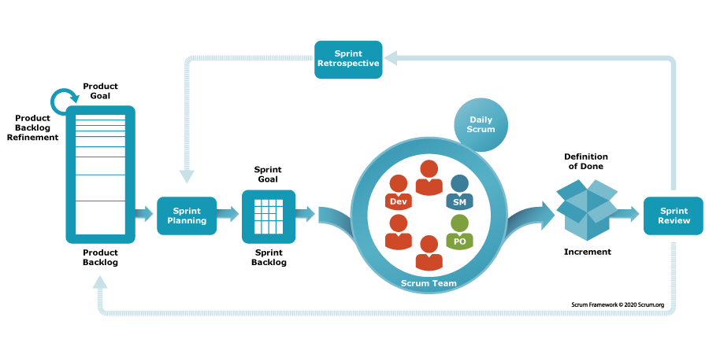
Mastering Scrum: Agile Framework Essentials for Professionals

Slide 7
Mastering Scrum: Agile Framework Essentials for Professionals
Core Principles of Scrum:
Empirical Process Control: Scrum is based on transparency, inspection, and adaptation. Progress is measurable, and decisions are based on observed outcomes.
Iterative Development: Work is divided into short, time-boxed iterations (sprints) that typically last 1-4 weeks, allowing for continuous feedback and adaptation.
Self-Organizing Teams: Teams are empowered to make decisions and collaborate to achieve their goals, fostering creativity and ownership.

Slide 8
Mastering Scrum: Agile Framework Essentials for Professionals
Benefits of Scrum:
Customer Satisfaction: Focus on delivering value to customers early and frequently.
Adaptability: Ability to respond to changing requirements and market conditions.
Continuous Improvement: Regular reflection and adaptation lead to improved processes and products over time.

Slide 9
Mastering Scrum: Agile Framework Essentials for Professionals
Summary
In summary, Scrum provides a structured framework for teams to collaborate, deliver
high-quality products iteratively, and respond effectively to customer needs and market changes. By embracing its principles and practices, organizations can enhance productivity, innovation, and overall project success.

