Slide 1
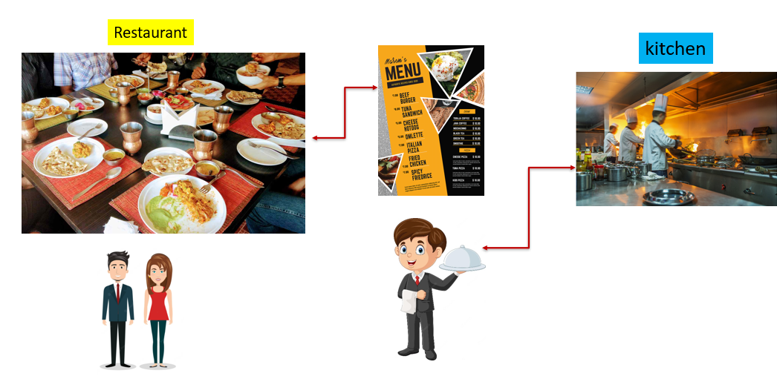
What is API gateway?
Imagine you're at a super fancy restaurant and you want to order some delicious food. But instead of going to the kitchen yourself, there's a waiter who takes your order at your table and brings your request to the kitchen. The waiter also brings the cooked food back to you when it's ready.
Now, think of this restaurant as a big computer system where different parts (like the kitchen, the cash register, and the dining area) need to talk to each other. However, they don't always speak the same language. This is where the "API Gateway" comes in.

Slide 2
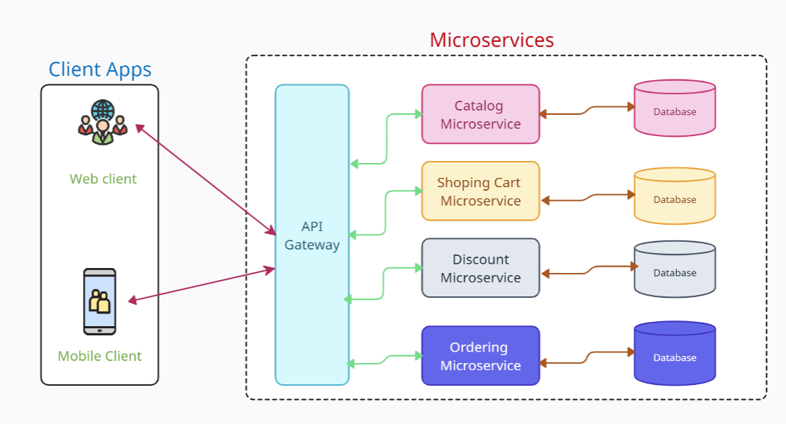
What is API gateway?
The API Gateway is like the super-smart waiter. It's a special part of the computer system that understands the language of each part and helps them communicate. When you want to use a certain service, like getting information from a website or using an app, you talk to the API Gateway. It takes your request and makes sure it gets to the right place in the system, just like the waiter taking your order to the kitchen.
Once the requested service is ready, the API Gateway brings the results back to you, just like the waiter bringing your yummy food. It's like a bridge that connects different parts of the computer system, making sure they understand each other and work together smoothly, without you needing to know all the technical stuff happening behind the scenes.
API Gateway
=
Waiter in the restaurant

