Slide 1




SSL, TLS, HTTPS Explained
Imagine you want to send a secret letter to your friend, but you're worried that someone might intercept and read it on its way to your friend's house.
To protect your letter, you put it inside a special, secure envelope with a lock that only your friend can open. This way, even if someone tries to peek inside, they won't be able to read the letter.

Slide 2
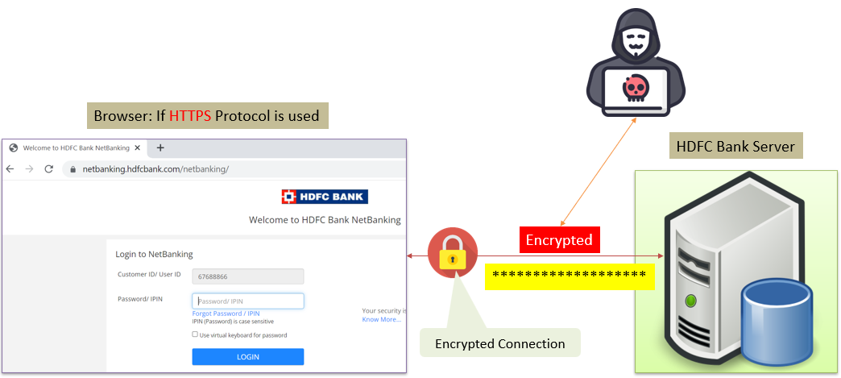
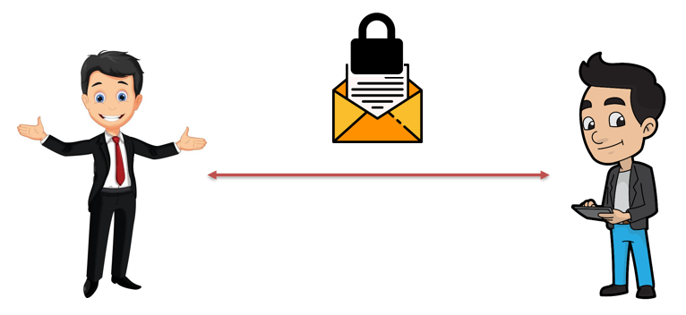
SSL, TLS, HTTPS Explained
In the digital world, SSL (Secure Socket Layer) and TLS (Transport Layer Security) are like those special envelopes with locks. They are technologies used to secure information when it travels over the internet.
When you visit a website, your computer and the website's server exchange information to load the web page you want to see. SSL and TLS make sure that this information is protected and can't be accessed or tampered with by unauthorized people.

Slide 3
SSL, TLS, HTTPS Explained
HTTPS is a term you might have seen in web addresses (URLs), like "https://www.example.com." The "S" in HTTPS stands for "secure." It's a combination of HTTP (Hypertext Transfer Protocol) and SSL/TLS. When a website uses HTTPS, it means that the information you send to the website (such as your login details, credit card information, or messages) is encrypted, just like the letter inside the secure envelope. This encryption keeps your data safe from hackers and eavesdroppers while it travels between your device and the website's server.
So, in simple terms: SSL and TLS are the technologies that create secure envelopes for your data, and HTTPS is the secure version of a website that uses those envelopes to protect your information as it moves through the internet.

