Slide 1
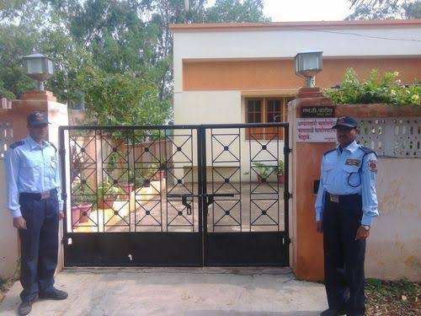
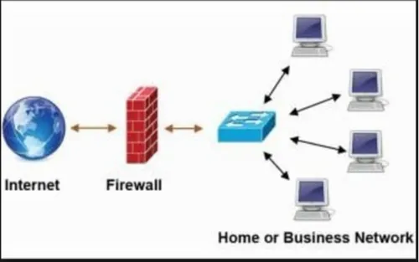
Firewall Explained: Your Digital Security Guard
Imagine you have a house with a gatekeeper. This gatekeeper checks everyone who wants to come inside your house. They ensure that only people you trust can enter, while keeping out strangers or anyone who might cause harm.
In the world of computers, a firewall is like that gatekeeper. It's a security system that acts as a barrier between your computer network and the internet. Its job is to monitor and control incoming and outgoing network traffic based on predetermined security rules.
House with Security Guard
Computer Network with Firewall

Slide 2
Here's how it works:
Firewall Explained: Your Digital Security Guard
Incoming Traffic: When data packets from the internet try to reach your computer or network, the firewall checks them against its set of rules. If the packets meet the criteria defined in the rules (such as coming from a trusted source or using an approved protocol), they're allowed to pass through. If not, they're blocked.
Outgoing Traffic: Similarly, when data packets from your computer or network attempt to communicate with the internet, the firewall examines them against its rules. It ensures that sensitive information isn't being sent out without authorization and that any outgoing connections are safe.
House with Security Guard
Computer Network with Firewall

Slide 3
Firewall Explained: Your Digital Security Guard
Firewalls can be implemented in different ways:
Software Firewalls: These are programs installed on individual computers or devices. They monitor and filter traffic specific to that device.
Hardware Firewalls: These are standalone devices installed between your network and the internet. They provide a centralized point of control for all incoming and outgoing traffic.
Network Firewalls: These are usually implemented at the boundary of a network, such as between a company's internal network and the internet. They protect the entire network from external threats.
House with Security Guard
Computer Network with Firewall

Slide 4
Firewall Explained: Your Digital Security Guard
Summary
Overall, a firewall acts as a crucial line of defense against unauthorized access, malicious software, and other cyber threats, helping to keep your computer and network safe and secure.
House with Security Guard
Computer Network with Firewall

