Slide 1
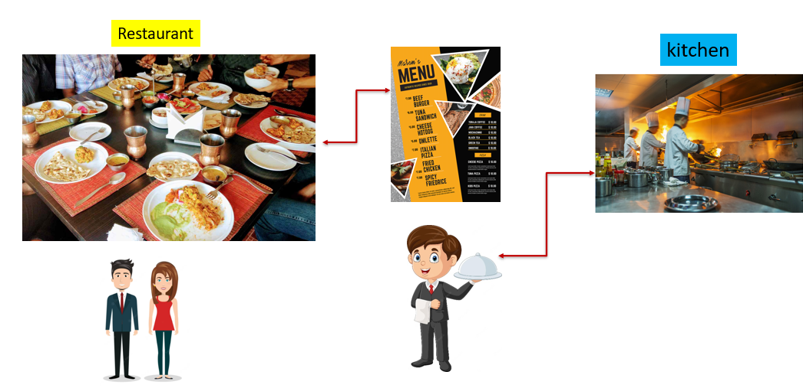
Demystifying the Internet: What is an HTTP Response in Simple Terms?
Imagine you're at a restaurant, and you've just placed an order for your favorite meal. The waiter takes your order to the kitchen, and after a little while, Waiter come back to your table with a delicious plate of food. That moment when the waiter brings your meal to you is like an "HTTP Response."

Slide 2
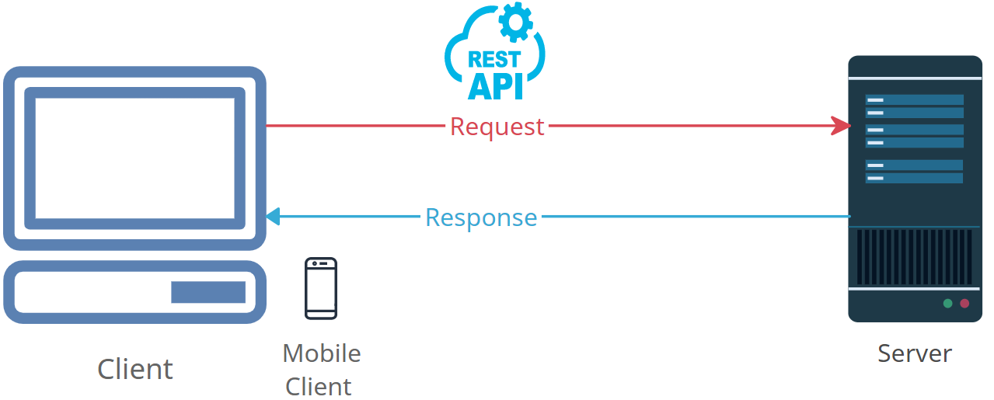
Demystifying the Internet: What is an HTTP Response in Simple Terms?
Here's how it works on the internet:
You, the user, make a request. Just like ordering your food.
Your request goes to a server, which is like the kitchen in the restaurant.
The server processes your request, which might involve getting data, images, or other things you asked for.
Once the server is ready, it sends back a response. This is like the waiter bringing your meal.

Slide 3
Demystifying the Internet: What is an HTTP Response in Simple Terms?
In the case of the internet, the response can be a webpage, an image, a video, or any other information you asked for. It's the server's way of saying, "Here you go, here's what you wanted.“
So, in simple terms, an "HTTP Response" is like the moment you get your order served at a restaurant, but on the internet, it's the server giving you the information or content you requested.

