Slide 1
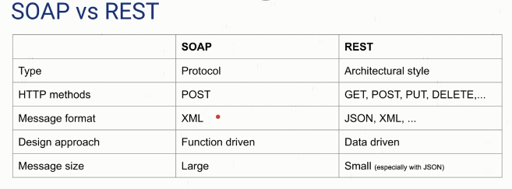

REST Vs. SOAP

Slide 2
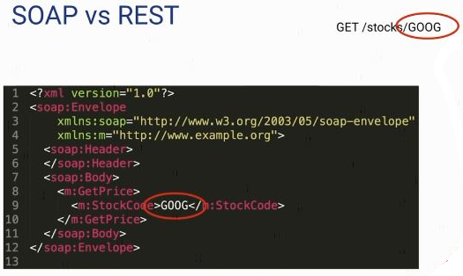
REST Vs. SOAP

Slide 3
REST Vs. SOAP

