Slide 1

Software Development Life Cycle (SDLC)
Imagine you're planning a big project, like building a house. You wouldn't just start hammering nails and laying bricks randomly, right? You'd have a plan—a step-by-step process to guide you from the idea stage all the way to a finished house.
That's kind of what the Software Development Life Cycle, or SDLC, is like for creating software. It's a structured approach to building software that ensures it's done efficiently, correctly, and meets the needs of the people who will use it.

Slide 2
Software Development Life Cycle (SDLC)
Planning
Design
Development
Testing
Deployment
Maintenance
Stages in the SDLC

Slide 3
Software Development Life Cycle (SDLC)
Planning: Just like you'd plan the layout of rooms and features for your house, in the planning stage of SDLC, you figure out what the software needs to do. You gather requirements, set goals, and make a roadmap for the project.
Planning
Design
Development
Testing
Deployment
Maintenance

Slide 4
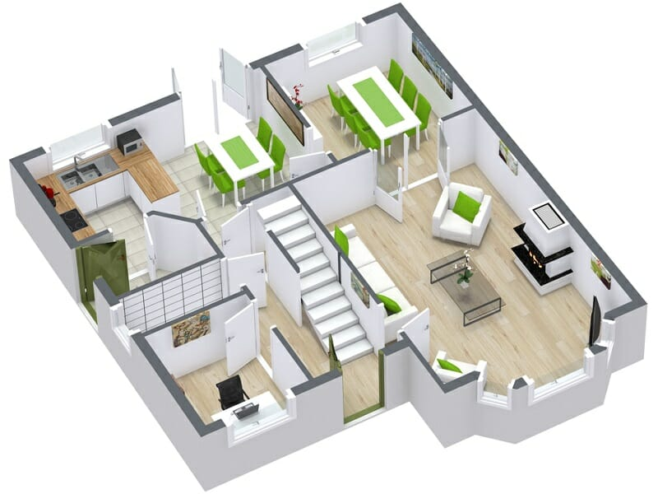
Software Development Life Cycle (SDLC)
Design: This is where you sketch out the blueprints for your house. In software development, you design the user interface, class and sequence diagrams and architecture of the software. You decide how everything will work together.
Planning
Design
Development
Testing
Deployment
Maintenance

Slide 5
Software Development Life Cycle (SDLC)
Development: Time to start building! Developers write the code based on the designs. It's like the construction phase of your house project—putting up walls, installing plumbing and wiring, and so on.
Planning
Design
Development
Testing
Deployment
Maintenance

Slide 6
Software Development Life Cycle (SDLC)
Testing: You wouldn't move into a house without making sure everything works properly, right? Similarly, in software development, testers check the software to find and fix any bugs or issues. They make sure it does what it's supposed to do and works smoothly.
Planning
Design
Development
Testing
Deployment
Maintenance

Slide 7
Software Development Life Cycle (SDLC)
Deployment: This is when the software is ready to be released to users. It's like moving into your new house and inviting guests over to see it. The software is installed on servers or devices so people can start using it.
Planning
Design
Development
Testing
Deployment
Maintenance

Slide 8
Software Development Life Cycle (SDLC)
Maintenance: After you've moved into your house, you might need to do repairs or upgrades over time. Similarly, software needs regular maintenance. Developers release updates, fix bugs, and make improvements to keep the software running smoothly and up-to-date.
Planning
Design
Development
Testing
Deployment
Maintenance

Slide 9
Software Development Life Cycle (SDLC)
SDLC is like a roadmap that guides software developers through the entire process of creating, testing, deploying, and maintaining software, ensuring that it's done efficiently and effectively, just like building a house!
Planning
Design
Development
Testing
Deployment
Maintenance

