Slide 1
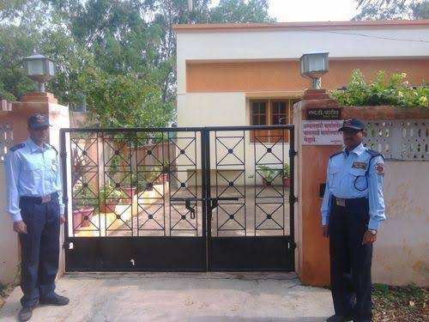
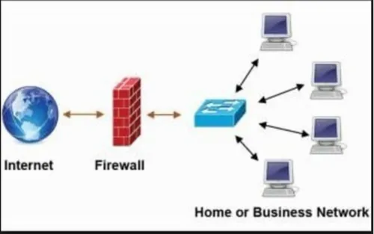
Firewall Explained: Your Digital Security Guard
Imagine your house is your computer network. You want to control who comes in and out, right? A firewall acts like a security guard for your network. Here's how it works:
Gateway: The firewall sits at the entrance to your network, kind of like your front door.
Traffic control: It checks all incoming and outgoing data, like mail or visitors at your door.
Good vs. Bad: The firewall has rules set by you (like who has a key or who can bring cookies!). It lets safe traffic through, like your mail carrier or friends.
Block the bad: If something suspicious tries to enter (like a stranger trying to pick the lock), the firewall blocks it, keeping your network safe from hackers and malware (viruses).
House with Security Guard
Computer Network with Firewall

Slide 2
Firewall Explained: Your Digital Security Guard
Here are some things a firewall can block:
Unwanted programs trying to sneak in and mess with your computer.
Hackers trying to steal your information like passwords or pictures.
Bad websites that might try to infect your computer with viruses.
Think of it this way: Your house (network) has valuable things inside (data). The firewall is the guard who makes sure only authorized people and information come in and out, keeping your home (network) safe and secure.
Most computers and even Wi-Fi routers actually have a built-in firewall! It's like a silent bodyguard working in the background to protect you.
House with Security Guard
Computer Network with Firewall

