Slide 1
RESTful Web Services, Spring Boot and JPA
Implementing User Sign up
Spring Security for User Sign-up
Spring Security for User Sign-in
Implementing Get User Details API Call
Adding XML Support & JSON Support
Exceptions Handling
Update User Details API Call
Delete User API Call
Pagination and Get Users API Call
Deploying App
Object Relationships @OneToMany Relationship
HATEOAS
Implementing Password Reset Feature
Testing Code with JUnit 5 & Mockito
JUnit Integration Test. Testing JWT Tokens and UserId
Testing RESTful Web Services with Rest Assured
Using Native SQL Queries and Java Persistence Query Language(JPQL)
Cross Origin AJAX HTTP Requests. CORS
API Documentation for your REST API with Swagger
Deploying to Amazon Cloud. AWS EC2
Implement Email Verification Feature with AWS SES (Simple Email Service)

Slide 2
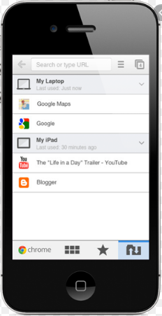

Introduction to Web Service Application Layers
Presentation Layer
Service Layer
Data Layer
UsersRESTController
UsersService
UsersRepository
UserDetailsRequestModel
UserDTO
UserDTO
UserEnitity
UserREST

Slide 3
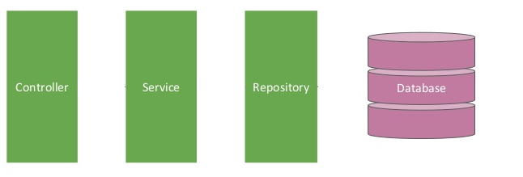

Implementing User Sign up
Postman client
User Sign-up Request
User Sign-up Response
UserController.java
UserServiceImpl.java
UserRepository.java
@RestController
@Service
@Repository

Slide 4
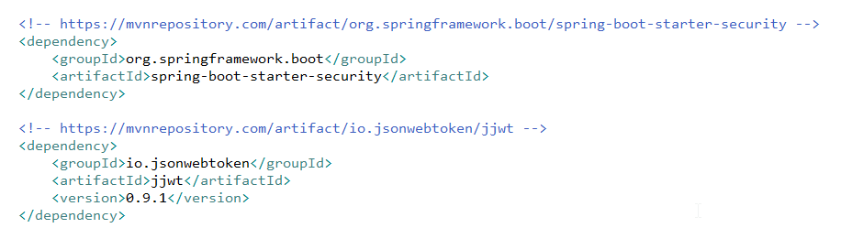
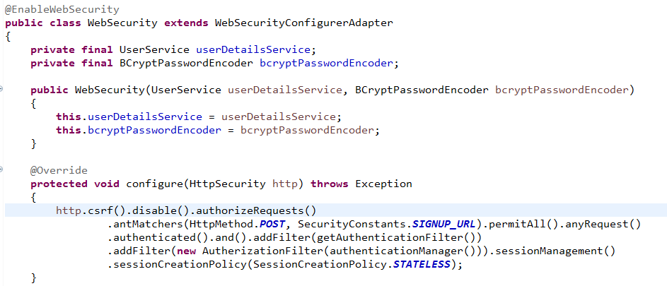
Spring Security for User Sign-up
/users - No Authentication
Other URLs – Authentication is needed

Slide 5
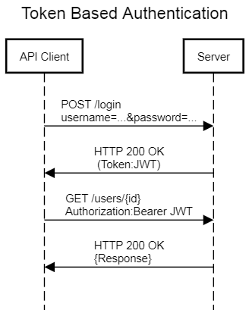
Spring Security for User Sign-in

Slide 6

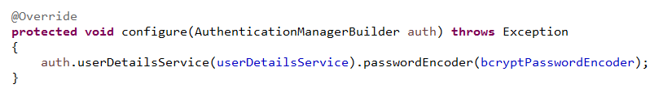
Spring Security for User Sign-in
UserDetailsService is used to load user details from the database

Slide 7

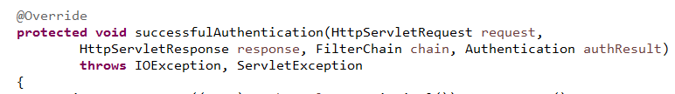
Spring Security for User Sign-in
Get the Username and password from the incoming request and check incoming username and password is matching against the database username and password and if matches then successfulAuthentication method will be called
Generate the JWT token and add JWT token and Public UserID to the response Header

Slide 8

Spring Security for User Sign-in
Check “Authorization” header is there and if present then get the
JWT token and check it is valid, if valid allow the user to proceed with the protected endpoint else do not allow the user to proceed with protected endpoint.

Slide 9
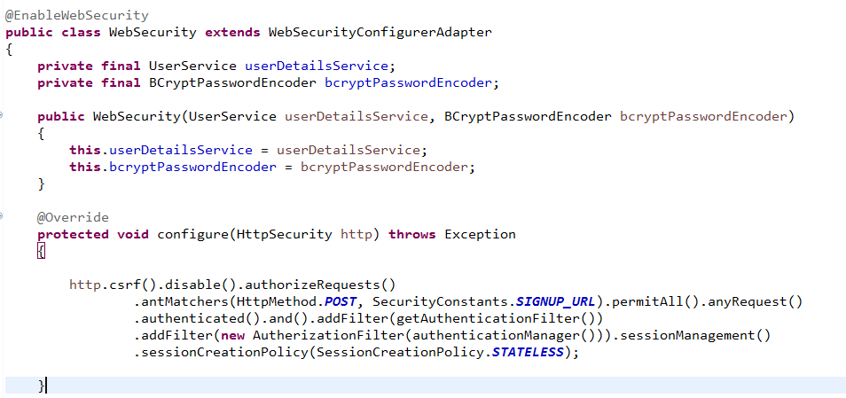
Spring Security for User Sign-in
To avoid “Authorization” header being cached need to set the SessionCreationPolicy as STATELESS.

Slide 10
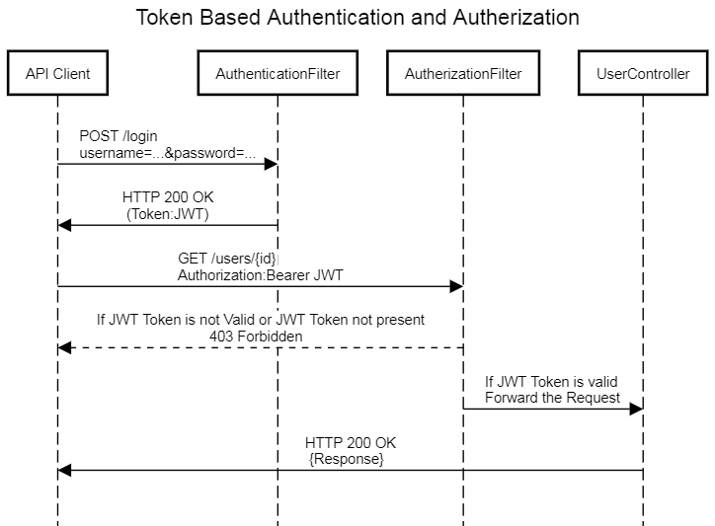
Spring Security for User Sign-in

Slide 11
Spring Security for User Sign-in
Sessions can cache some of the information about the request, So even Authorization header also will be cached.
To avoid Authorization header to be cached, Web Security need to tell spring not to create the HTTP Session and this will make REST API Stateless
API Client1
Session for API Client1
Server
API Client2
Session for API Client2
Session for API Client3
API Client3

Slide 12
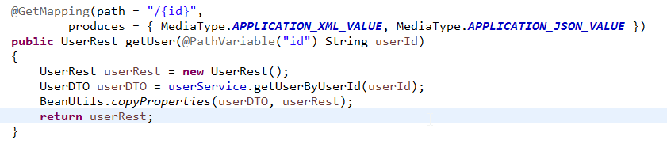
Implementing Get User Details Web Service Endpoint

Slide 13
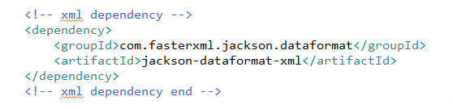
Adding XML Support & JSON Support

Slide 14
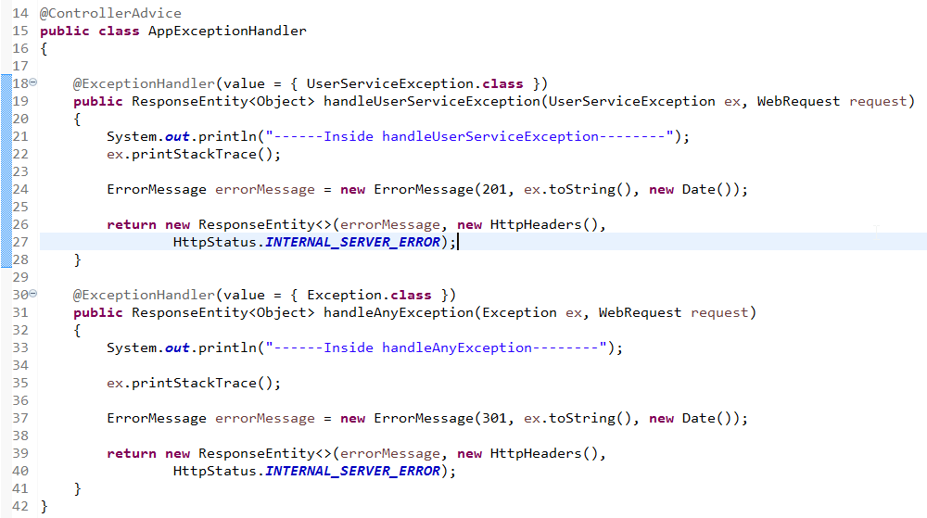
Exceptions Handling

Slide 15
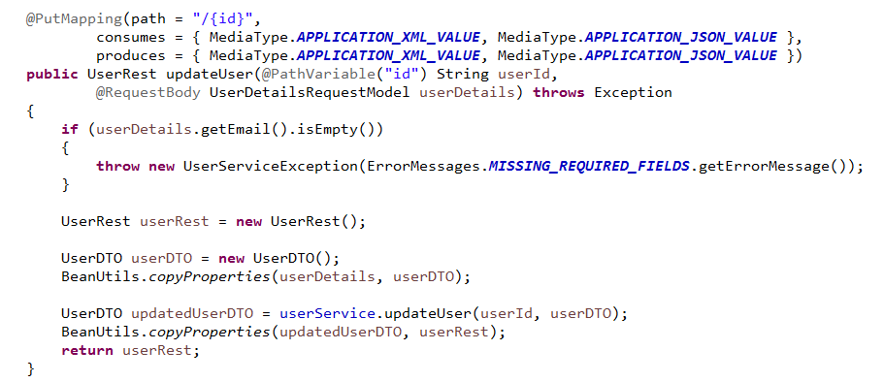
Update User Details API Call

Slide 16
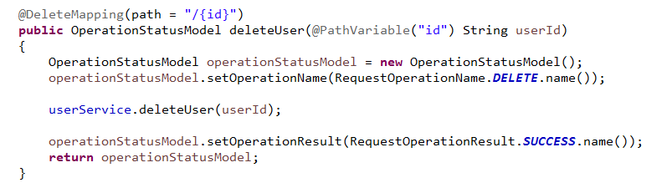
Delete User API Call

Slide 17
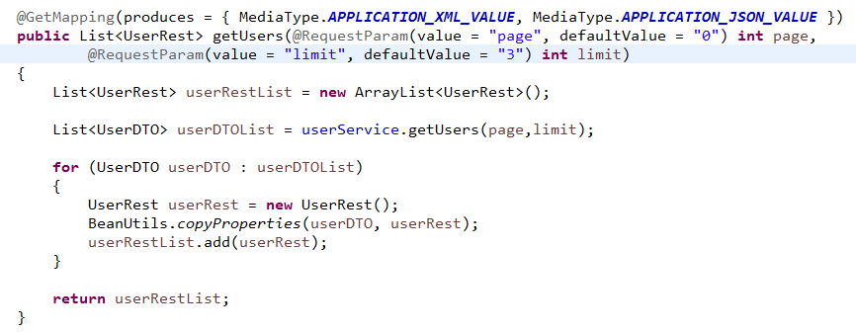
Pagination and Get Users API Call

Slide 18
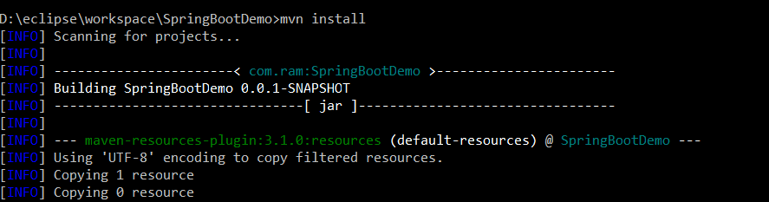
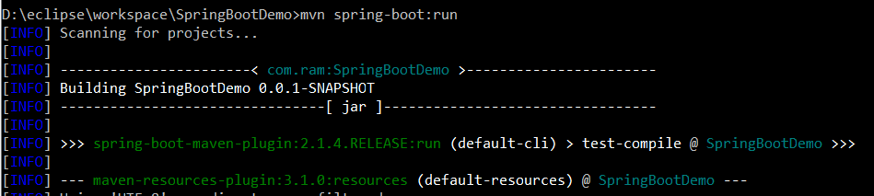
Running Your Web Services App without Eclipse
D:\eclipse\workspace\SpringBootDemo>mvn install
D:\eclipse\workspace\SpringBootDemo>mvn spring-boot:run

Slide 19
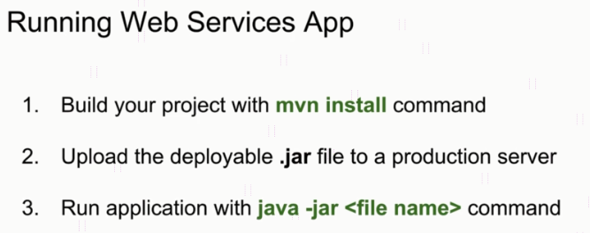
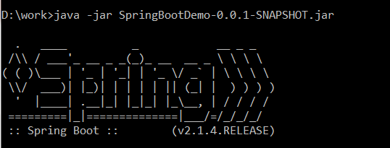

Run Your Spring boot Application as a stand-alone Java application

Slide 20



How to Create Context Path to Your Web Service?
http://localhost:8080/users
Context Path= ‘ ’
Tomcat Server
user-app-ws-0.0.1-snapshot.war
Context Path= ‘ ’
http://localhost:8080/users
http://localhost:8080/payments
payment-app-ws-0.0.1-snapshot.war

Slide 21
How to Create Context Path to Your Web Service?
Context Path= ‘/user-app-ws’
Tomcat Server
user-app-ws-0.0.1-snapshot.war
http://localhost:8080/user-app-ws/users
payment-app-ws-0.0.1-snapshot.war
http://localhost:8080/payment-app-ws/payments
Context Path= ‘/payment-app-ws’

Slide 22
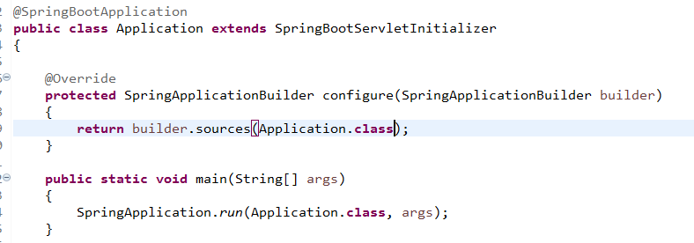
How to Generate a WAR file and deploy in Apache Tomcat Server?
Tomcat Server
employee-app-ws.war
payment-app-ws.war
user-app-ws.war

Slide 23
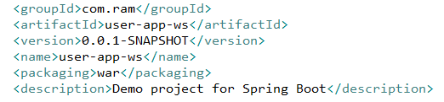
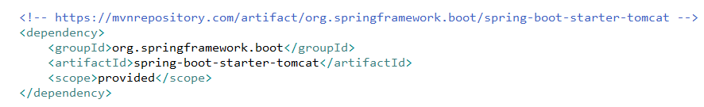
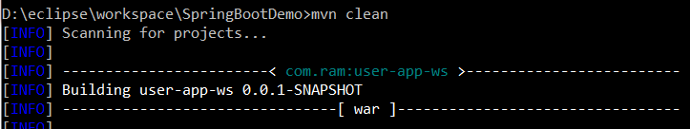
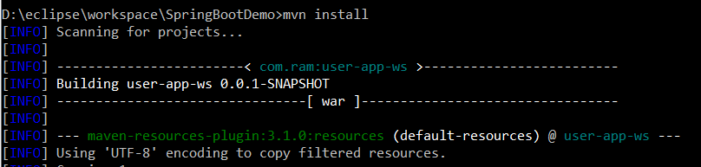
How to Generate a WAR file and deploy in Apache Tomcat Server?

Slide 24
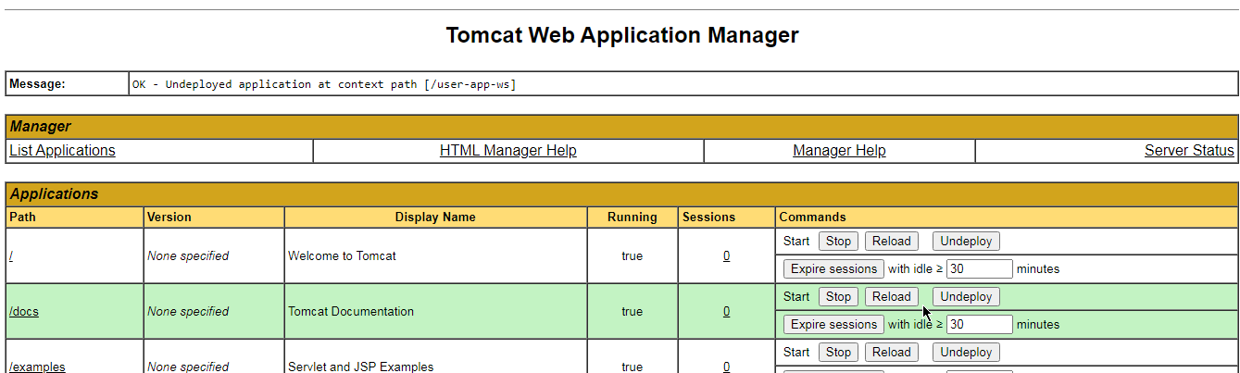
How to Generate a WAR file and deploy in Apache Tomcat Server?

Slide 25
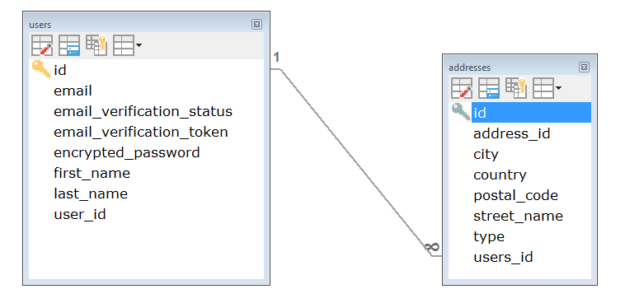
Web Service End point for Create User and addresses? - Object Relationships @OneToMany Relationship

Slide 26
Web Service End point for Get User with addresses? - Object Relationships @OneToMany Relationship

Slide 27
Web Service End point for Update User and addresses? - Object Relationships @OneToMany Relationship

Slide 28
Web Service End point for Delete User and addresses? - Object Relationships @OneToMany Relationship

Slide 29
Web Service End point for Get All the Users and each user addresses? - Object Relationships @OneToMany Relationship

Slide 30
Web Service End point for Get List of Addresses for a Specific User? - Object Relationships @OneToMany Relationship

Slide 31
Web Service End point for Get a Single Address Details for a Specific User? - Object Relationships @OneToMany Relationship

Slide 32
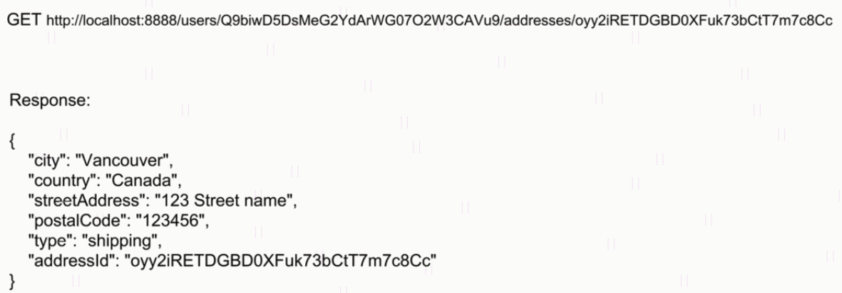
HATEOAS Introduction
The term HATEOAS stands for the phrase Hypermedia As The Engine Of Application State. It is the way to provide links to the resources which client API can use. It works the same way web links work when we browse page in the internet.
Without HATEOAS

Slide 33
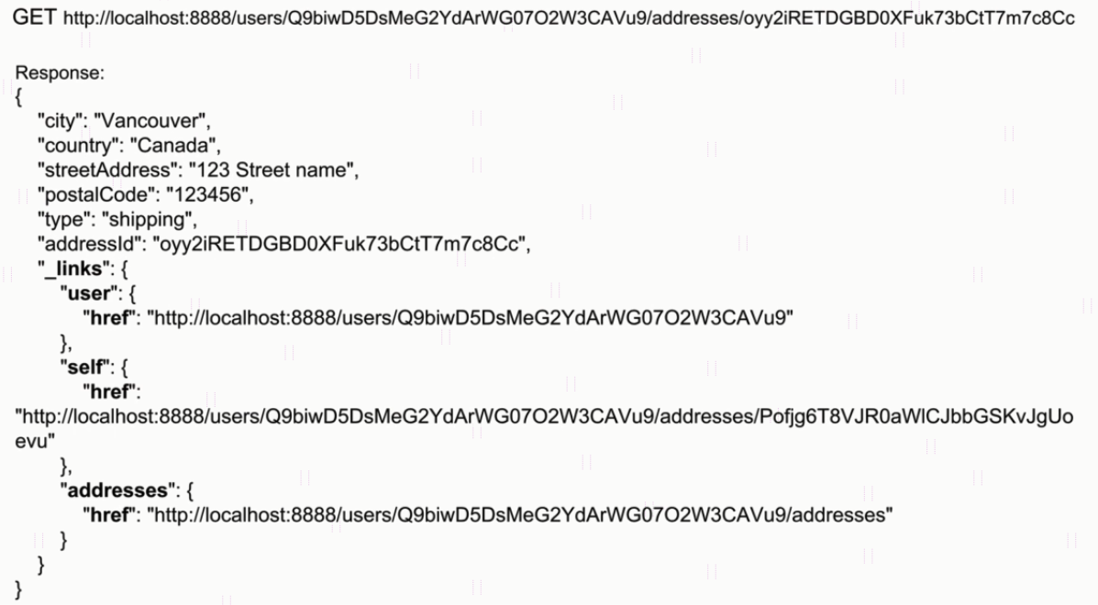
HATEOAS Introduction
With HATEOAS

Slide 34
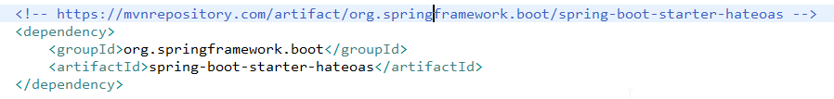
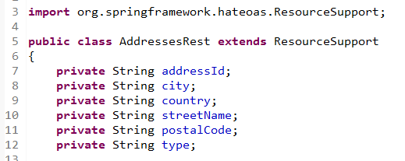
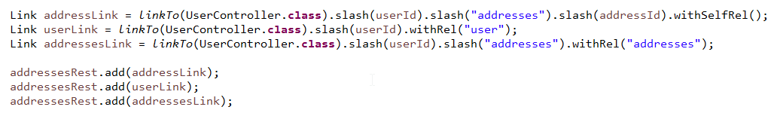
HATEOAS - Adding Links to a Get User Address API Call

Slide 35
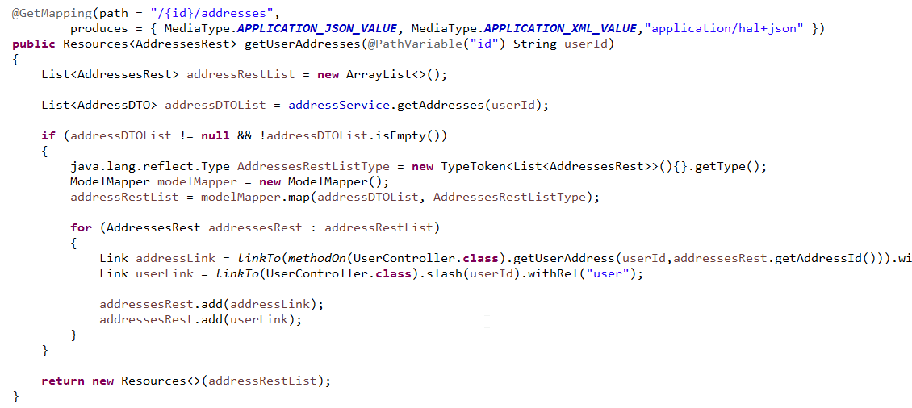
HATEOAS - Applying HAL Format
A HAL Document uses the format described in [RFC4627] and has the media type "application/hal+json". Its root object MUST be a Resource Object.
https://stateless.group/hal_specification.html

Slide 36
Spring Security for User Sign-in

Slide 37
Spring Security for User Sign-in

Slide 38
Spring Security for User Sign-in

Slide 39
Spring Security for User Sign-in

