Slide 1
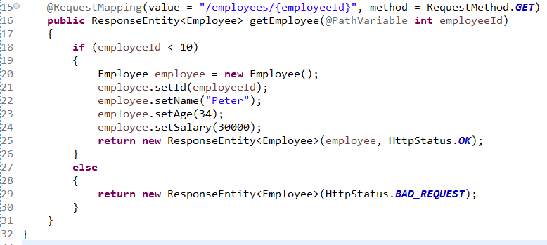
Spring Boot – Set Response Status Code

