Slide 1
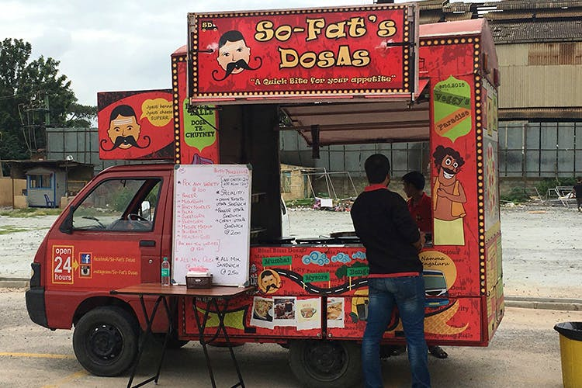
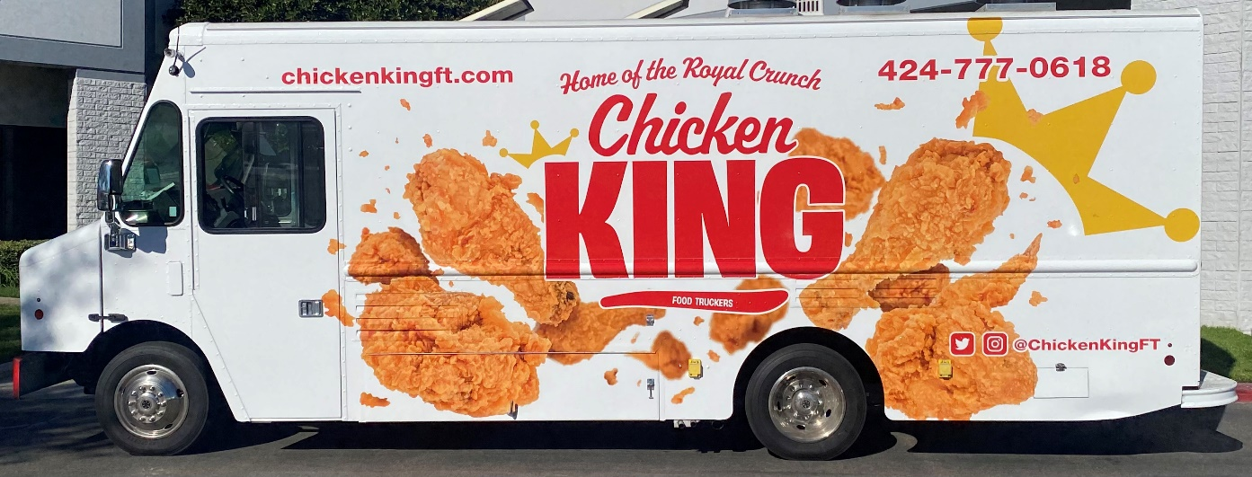
REST API Best Practices
Imagine you're at a food truck festival. Each food truck is like a different computer system that wants to share information with others. But they can't just start talking any way they want – they need some rules to follow so everyone understands each other. That's where REST API best practices come in.
Dosa Food Truck
Chicken Food Truck

Slide 2
REST API Best Practices
Clear Menu Board (Use Descriptive URLs): Just like a food truck needs a clear menu board, a computer system should have easy-to-understand web addresses (URLs) for its information. This helps others know what they're going to get when they visit.
Order Format (Use HTTP Methods): When you want food from a truck, you use words like "I'll have a burger, please." In computer talk, we use "GET," "POST," "PUT," and "DELETE" to say what we want to do with the information. It's like telling the computer system what action you're taking.
Dosa Food Truck
Chicken Food Truck

Slide 3
REST API Best Practices
Fresh Ingredients (Use Caching): Food trucks don't cook everything from scratch every time. They keep some ingredients ready to serve quickly. Similarly, computer systems can store some information temporarily so they don't have to fetch it from the start every time someone asks.
Single Tray, Single Purpose (Single Responsibility): Imagine if a food truck tried to serve Mexican, Italian, and Chinese food all at once. Confusing, right? Similarly, a computer system should focus on doing one thing well instead of trying to do too many things.
Dosa Food Truck
Chicken Food Truck

Slide 4
REST API Best Practices
Enough Information, Not Too Much (Use Pagination): When you order, you don't get a year's supply of ketchup, just a small packet. Similarly, when a computer system has lots of information, it's better to get it in manageable chunks instead of everything at once.
Specials Board (Versioning): Sometimes, food trucks change their menu. To avoid surprising customers, they put up a specials board. Computer systems can do something similar by letting others know when they've changed how things work.
Dosa Food Truck
Chicken Food Truck

Slide 5
REST API Best Practices
Queue System (Use Asynchronous Operations): At a busy festival, you might have to wait a bit for your order. Similarly, sometimes computer systems need some time to finish a big task. They can let you know when it's done instead of making you wait.
Secure Cash Register (Security Measures): Food trucks keep their money safe, and computer systems need to keep their data safe too. They use locks and codes to protect information from bad guys.
Dosa Food Truck
Chicken Food Truck

Slide 6
REST API Best Practices
Friendly Staff (Error Handling): Mistakes happen. If a food truck gets your order wrong, they apologize and fix it. Computer systems should also be helpful and explain what went wrong when something doesn't work as expected.
Closing Time (API Deprecation): Just like a food truck might close when it's not popular anymore, a computer system might stop using an old way of sharing information when it's not used much.
Dosa Food Truck
Chicken Food Truck

Slide 7
REST API Best Practices
So, "REST API Best Practices" are like the good manners and smart strategies that computer systems follow to share information with each other smoothly, just like food trucks follow certain rules to serve delicious food to their customers without any confusion!
Dosa Food Truck
Chicken Food Truck

