Slide 1
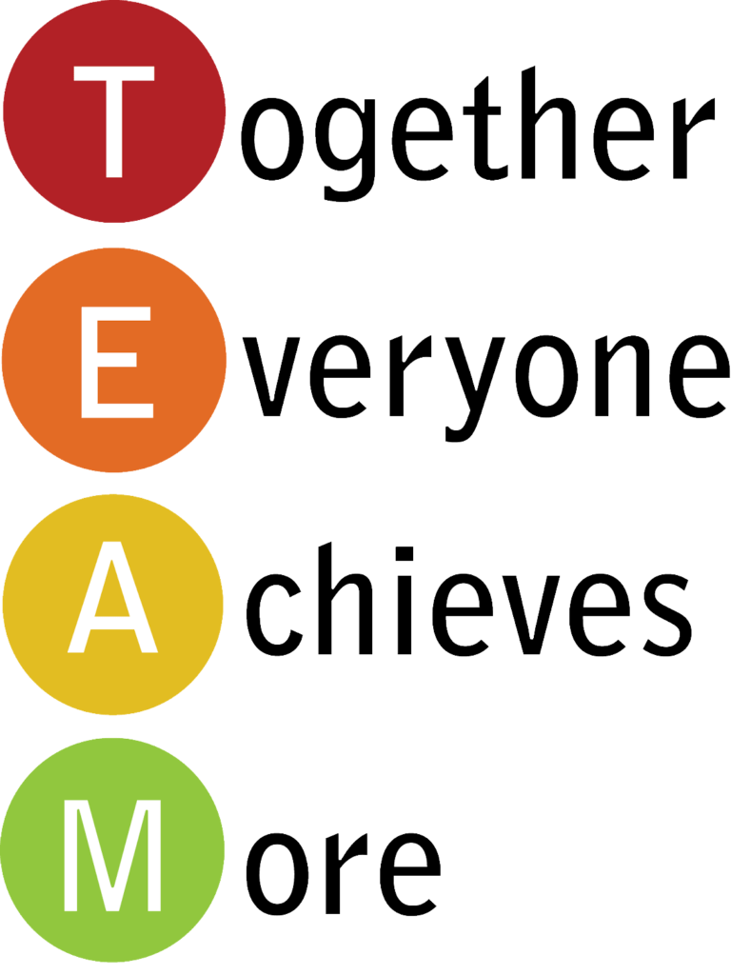
Scrum Demystified: Simplifying Teamwork for Project Success
What is Scrum?
Scrum is a popular framework used by teams to manage projects, especially in software development. It's designed to help teams work together efficiently and adapt to changing requirements.

Slide 2
Scrum Demystified: Simplifying Teamwork for Project Success
Key Concepts:
Team Collaboration: Scrum emphasizes teamwork. It's like playing on a sports team where each player has a role but works together towards a common goal.
Sprints: Scrum breaks work into short cycles called "sprints," typically lasting 1-4 weeks. During a sprint, the team focuses on completing specific tasks or goals. This allows for frequent feedback and adaptation.
Product Backlog: This is a prioritized list of features or tasks that need to be completed. The Product Owner manages the backlog, ensuring it reflects the priorities of the stakeholders.
Sprint Planning: At the beginning of each sprint, the team meets to plan the work. They select tasks from the backlog and commit to completing them by the end of the sprint.
Daily Stand-ups: Every day, the team holds a quick meeting called a "daily stand-up." Each member shares:
  What they did yesterday
  What they plan to do today
  Any obstacles or challenges they're facing

Slide 3
Scrum Demystified: Simplifying Teamwork for Project Success
Key Concepts:
Sprint Review: At the end of each sprint, the team demonstrates the completed work to stakeholders and gathers feedback.
Retrospective: Also held at the end of each sprint, the retrospective is a meeting where the team reflects on what went well, what didn't go well, and how they can improve in the next sprint.
Roles:
Scrum Master: The Scrum Master is like a coach for the team. They facilitate meetings, remove obstacles, and ensure the Scrum framework is followed.
Product Owner: The Product Owner represents the stakeholders and communicates their requirements to the team. They prioritize tasks in the backlog based on business value.
Development Team: Cross-functional group responsible for delivering the product increment.

Slide 4
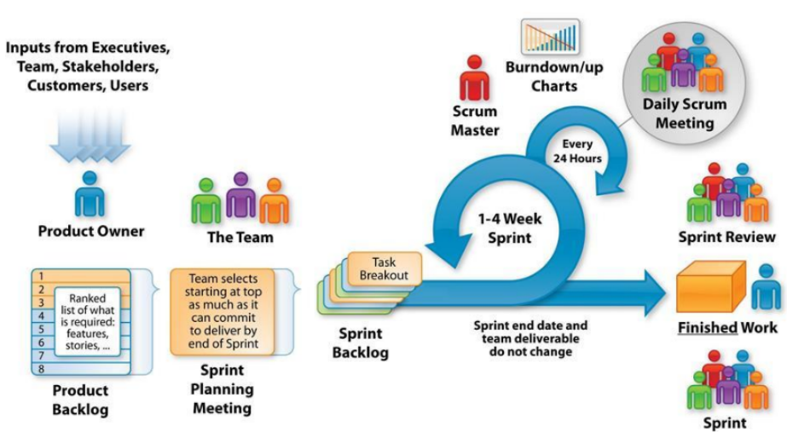
Scrum Demystified: Simplifying Teamwork for Project Success

Slide 5
Scrum Demystified: Simplifying Teamwork for Project Success
Benefits of Scrum:
Adaptability: Scrum allows teams to adapt quickly to changing requirements or priorities.
Transparency: Everyone knows what tasks are being worked on and the progress being made.
Continuous Improvement: Regular feedback and retrospectives help teams improve their processes over time.
Efficiency: By focusing on specific goals in short sprints, teams can deliver value incrementally.

Slide 6
Scrum Demystified: Simplifying Teamwork for Project Success
Summary
Scrum is a team-oriented approach to project management that promotes collaboration, adaptability, and continuous improvement. It's used across various industries to deliver
high-quality products and services efficiently.

