Slide 1
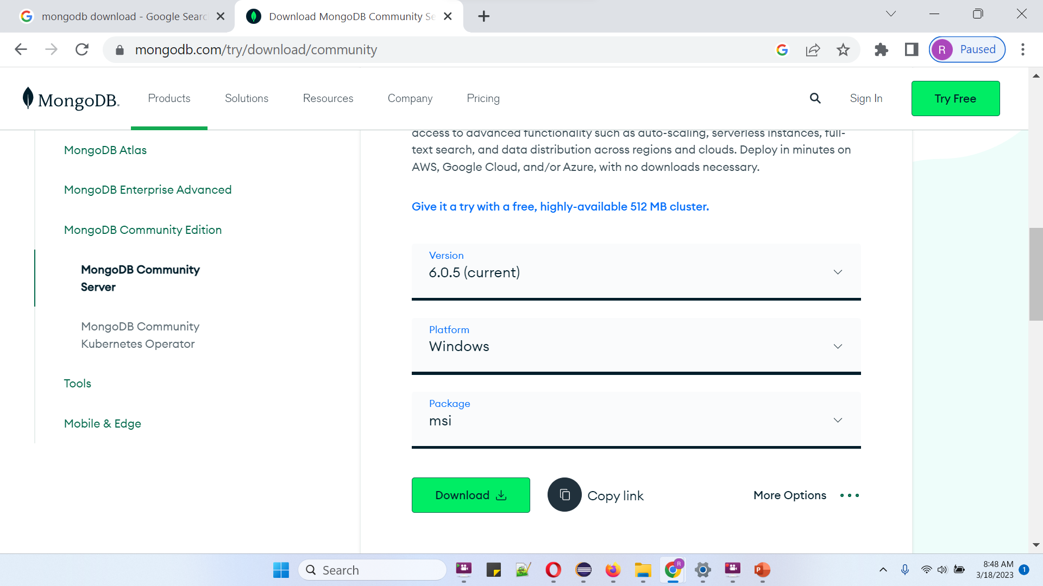
How to Download, Install MongoDB 6.0.5 on Windows 11| Complete Setup of MongoDB Server, Compass & Shell

