Slide 1





What is Single Sign-On (SSO) | Why do we need SSO?
Applications
User

Slide 2
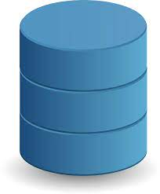
What is Single Sign-On (SSO) | Why do we need SSO?
Session Starts
User
Send Credentials
Send Credentials
Session Starts
Send Credentials
Session Starts

Slide 3
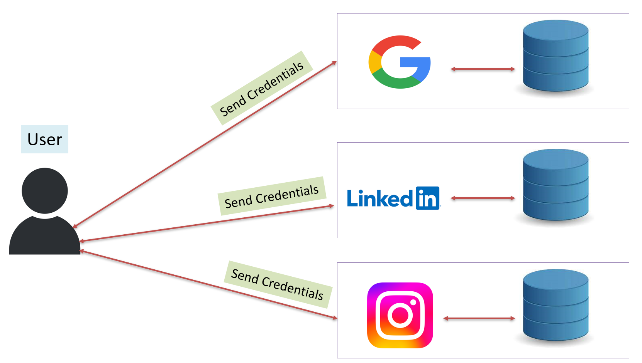
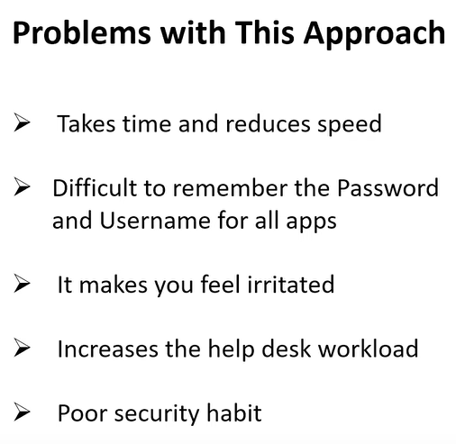
What is Single Sign-On (SSO) | Why do we need SSO?
Application 4
Application 5

Slide 4
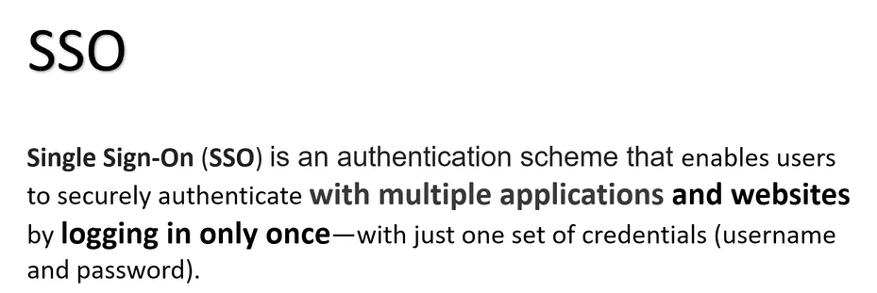
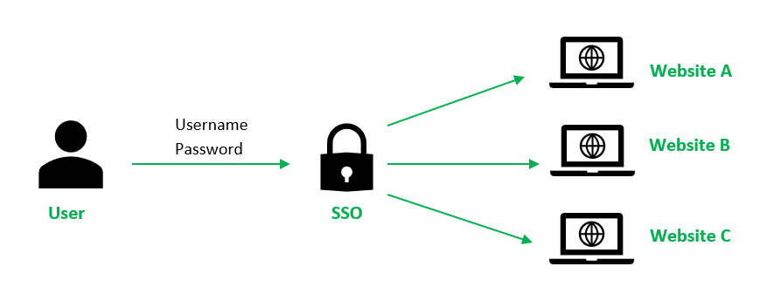
What is Single Sign-On (SSO) | Why do we need SSO?

Slide 5
What is Single Sign-On (SSO) | Why do we need SSO?
SSO Authentication Flow
User Agent
IDP
SP

Slide 6
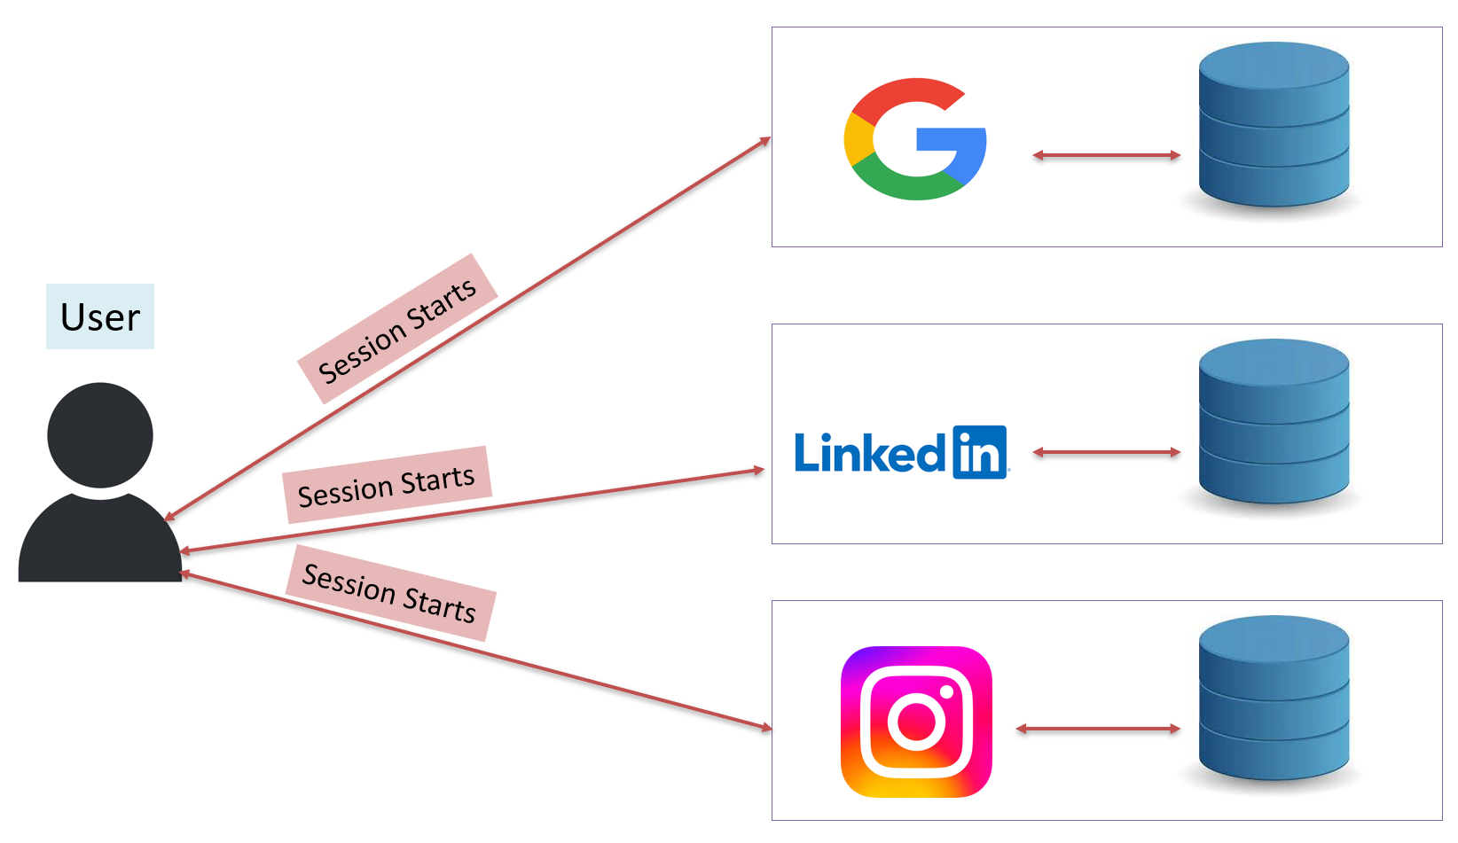
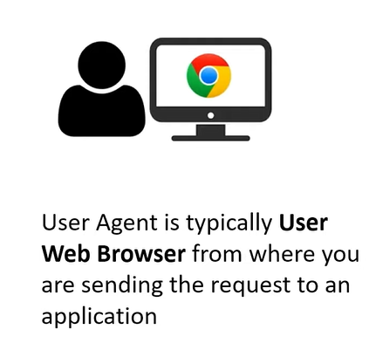
What is Single Sign-On (SSO) | Why do we need SSO?
User Agent

Slide 7
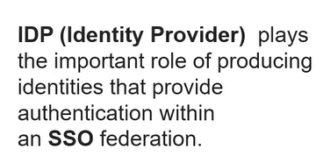
What is Single Sign-On (SSO) | Why do we need SSO?
IDP

Slide 8
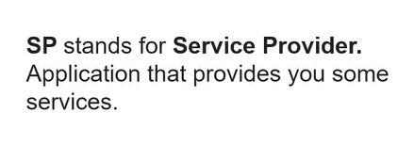
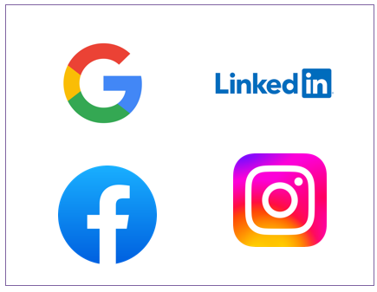
What is Single Sign-On (SSO) | Why do we need SSO?
SP

Slide 9
What is Single Sign-On (SSO) | Why do we need SSO?
SSO Authentication Flow
IDP
SAML Assertion
SAML Assertion
SAML Assertion
Send Credentials
User Agent
Trust Relationship
SP1
SP2

Slide 10
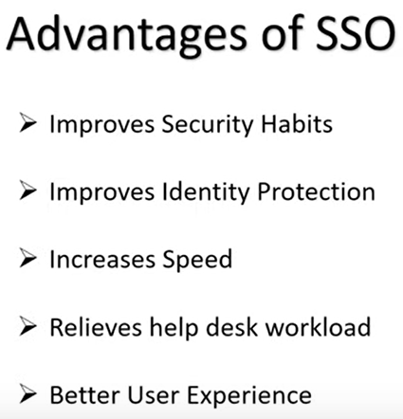
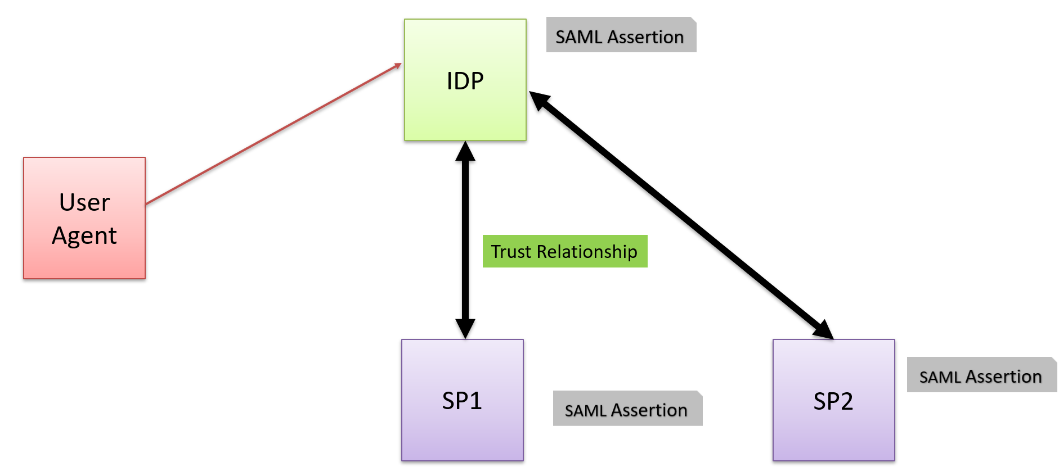
What is Single Sign-On (SSO) | Why do we need SSO?

Slide 11
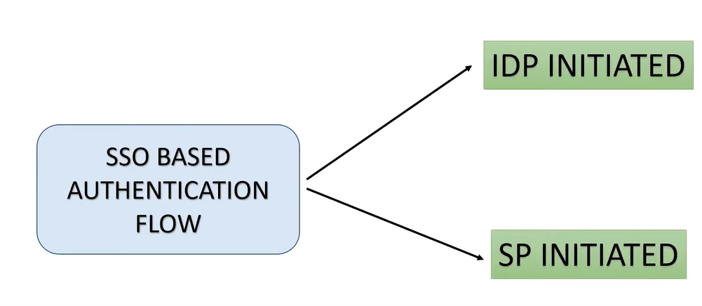
What is Single Sign-On (SSO) | Why do we need SSO?

Slide 12
What is Single Sign-On (SSO) | Why do we need SSO?
1. IDP Initiated
SAML Assertion
IDP
SAML Assertion
1
2
User Agent
3
4
Trust Relationship
SAML Assertion
5
Session Starts
SP
6

Slide 13
What is Single Sign-On (SSO) | Why do we need SSO?
2. SP Initiated
SAML Assertion
IDP
SAML Assertion
3
4
User Agent
5
6
Trust Relationship
1
SAML Assertion
7
2
Session Starts
SP
8

Slide 14
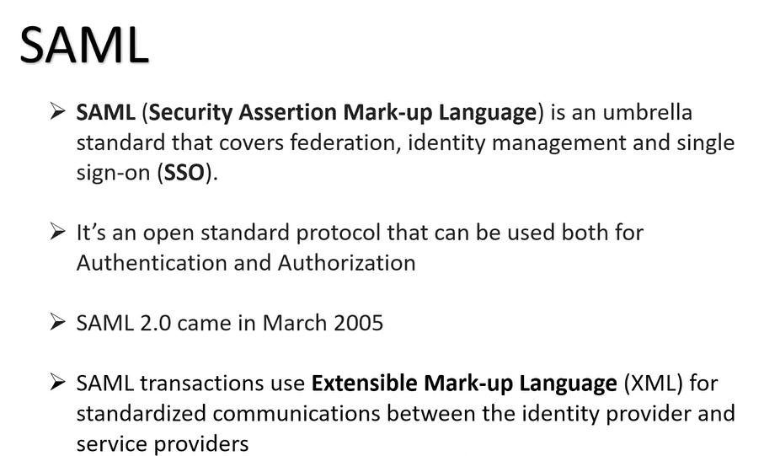
What is Single Sign-On (SSO) | Why do we need SSO?

