Slide 1
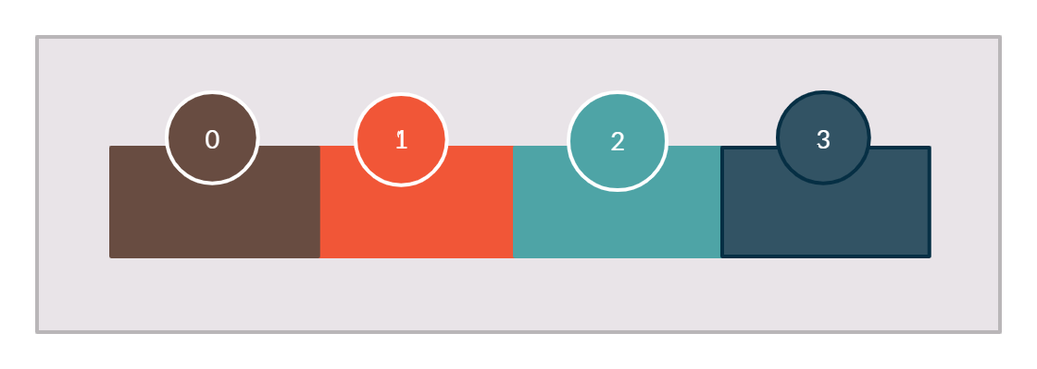
What is Kafka topic partition?
Kafka topic is divided into multiple parts and that is called partition
Partitions can be considered as a linear data structure just like arrays these are also called commit log
Messages are actually published to a Partition in the topic
Every partition has a partition number
Each partition has an increasing index called an offset.
New messages are always pushed at the rear end.
Data is immutable after publish
Partition Offset
Topic
Partition 0
M1
M2
M3
M4

Slide 2
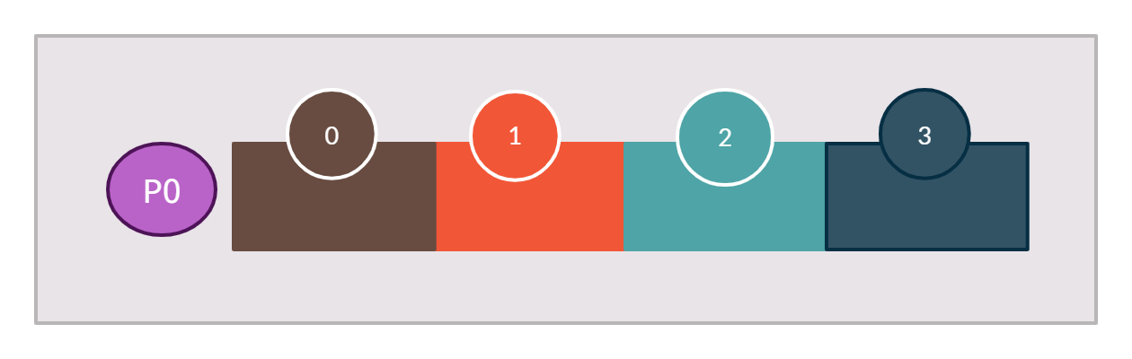
What is Kafka topic partition?
Topic with One Partition and the Single Broker
Broker 1
Partition Offset
Topic
Partition 0

Slide 3
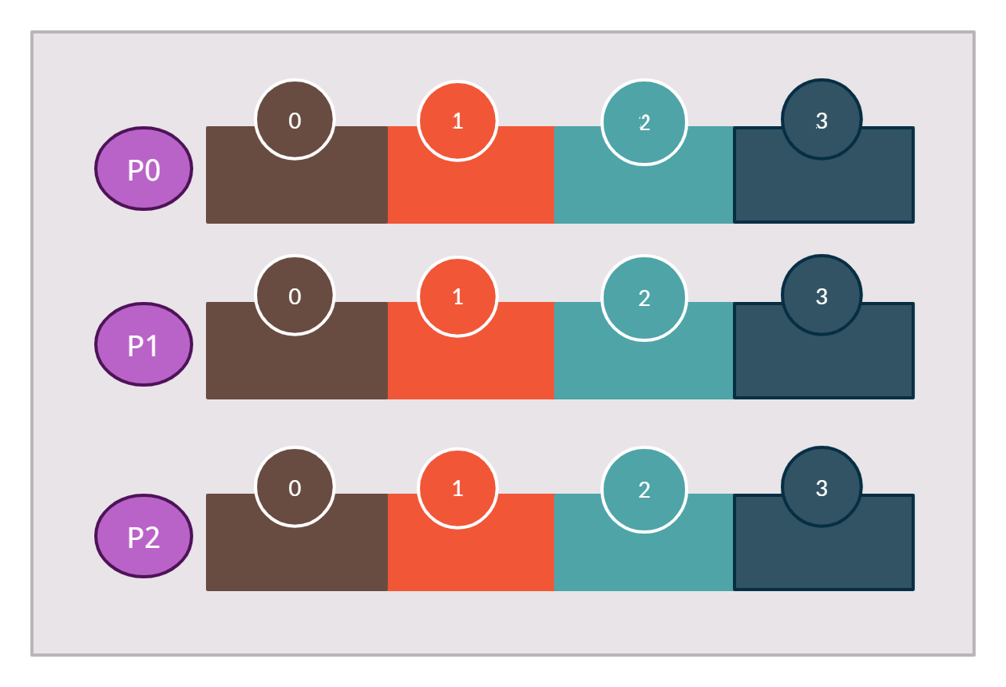
What is Kafka topic partition?
Topic with Three Partition and the Single Broker
Broker 1
Topic
Partition 0
Partition 1
Partition 2

Slide 4
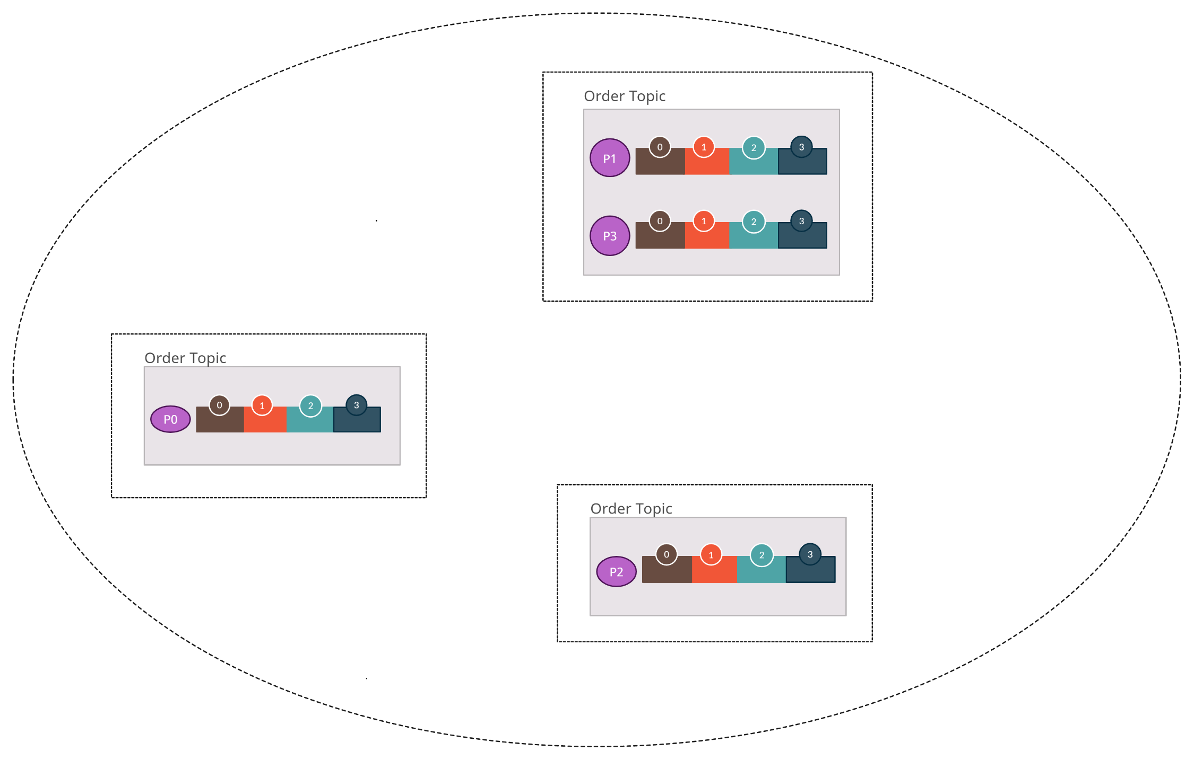
What is Kafka topic partition?
In a multi-broker Kafka cluster, Partitions for a topic are distributed across the whole cluster
Broker 2
Broker 1
Cluster
Broker 3
Topic with
4 partitions and
3 brokers

