Slide 1
What is an API?
API – Application Programing Interface
API stands for Application Programming Interface.
Think of it as a way for different software applications or services to talk to each other and work together.
Software Application (Java)
Software Application (.Net)

Slide 2
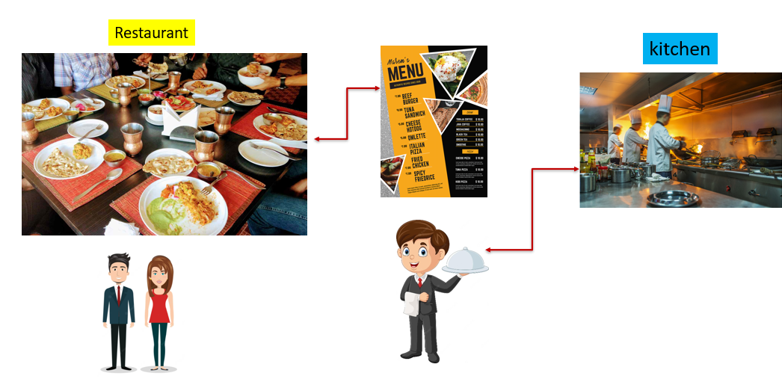
What is an API?
Let's start with a simple analogy. Imagine you're in a restaurant and you want to order food. You don't need to know how the kitchen works or what ingredients are used; you just need to communicate your order to the waiter, and they take care of the rest. In this scenario, the waiter acts as an intermediary between you and the kitchen, allowing you to request specific dishes without worrying about the details of how they are prepared.
In the world of technology, an API (Application Programming Interface) works in a similar way. It acts as a middleman, enabling different software applications to communicate and interact with each other, just like the waiter in the restaurant. APIs define a set of rules and protocols that allow different software systems to exchange information and perform certain tasks.

Slide 3
What is an API?
An API provides a simplified way for developers to access the functionality of another software application or service without needing to understand its internal workings. It exposes a set of clearly defined methods, functions, and data structures that developers can use to request specific actions or retrieve information from the application or service.
To put it simply, an API is like a menu in a restaurant. It provides a list of available options (functions or services) and specifies how to order (make requests) them. Developers can use these options to build their own applications or extend the functionality of existing ones, without needing to know all the intricate details of how the underlying software works.
In summary, an API is a way for software applications to communicate and interact with each other by providing a set of predefined rules and functions, just like a waiter in a restaurant facilitates communication between customers and the kitchen.

