Slide 1
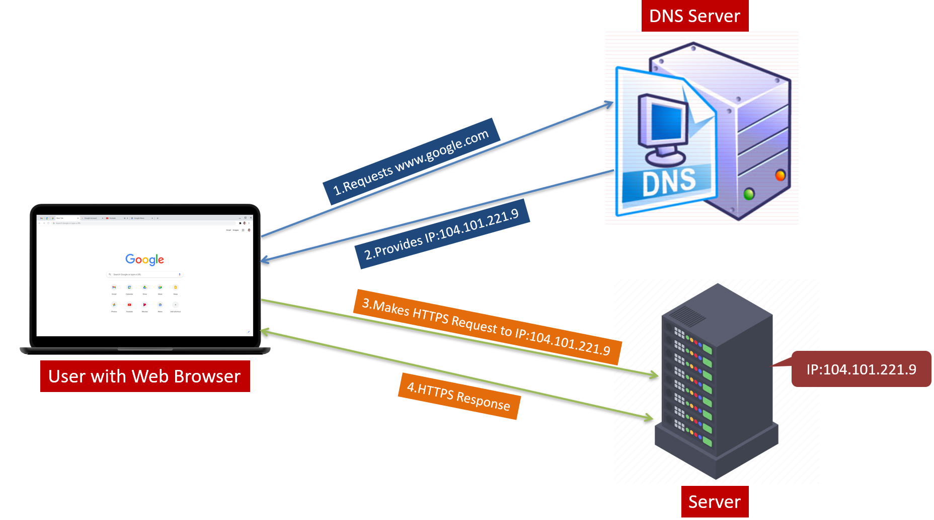
Demystifying DNS: Navigating the Internet's Address Book
Imagine you're trying to find someone's house in a city you've never been to before. You know the person's name, but you don't know their address. So, what do you do? You might ask someone who knows the area well for directions, right?
Well, DNS (Domain Name System) is a bit like that helpful person giving you directions, but for the internet

Slide 2
Demystifying DNS: Navigating the Internet's Address Book
How DNS Works?
1. Names to Numbers:
Every device connected to the internet, like computers, smartphones, and servers, has a unique identification number called an IP address. It's like a phone number for each device.
But remembering IP addresses for all the websites you want to visit would be really difficult. That's where DNS comes in.

Slide 3
Demystifying DNS: Navigating the Internet's Address Book
How DNS Works?
2. Translating Names to Numbers:
When you type a website name into your browser, like "www.google.com," your computer doesn't know where that website is located. It needs the IP address to connect.
So, your computer sends a request to a DNS server, asking, "Hey, what's the IP address for www. google.com?“
The DNS server knows the IP address for that website because it's like a giant directory that matches website names to their IP addresses.
It tells your computer the IP address, and then your computer can connect to the website.

Slide 4
Demystifying DNS: Navigating the Internet's Address Book
How DNS Works?
3. Fast and Efficient:
DNS is super fast and efficient. It's like having a massive address book for the entire internet, and it helps your computer find websites quickly and easily.
Just like how you can quickly find a friend's house with the right address, DNS helps your computer find websites with their IP addresses.

Slide 5
Demystifying DNS: Navigating the Internet's Address Book
In short, DNS is like the internet's address book, helping your devices find websites by translating human-friendly website names into computer-readable IP addresses. It's an essential part of how we navigate the internet every day!

Slide 6
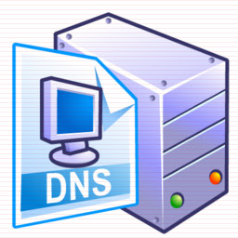
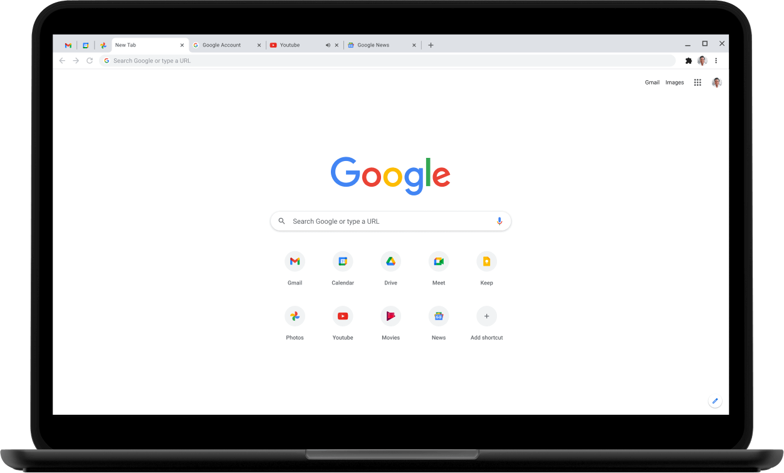
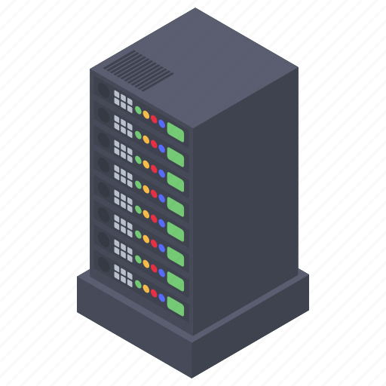
DNS Server
1.Requests www.google.com
2.Provides IP:104.101.221.9
3.Makes HTTPS Request to IP:104.101.221.9
User with Web Browser
IP:104.101.221.9
4.HTTPS Response
Server

