Slide 1
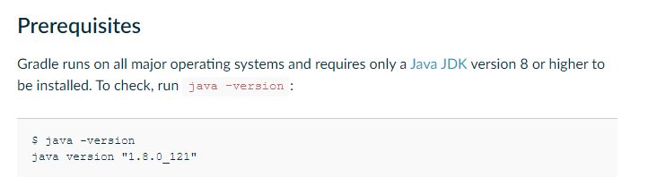
How to install Gradle in Linux Operating System or Amazon EC2 Instance?
https://gradle.org/install/

Slide 2
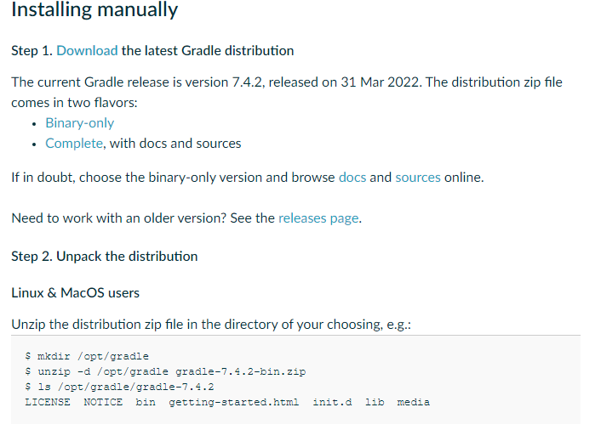
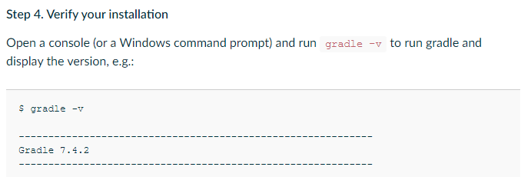
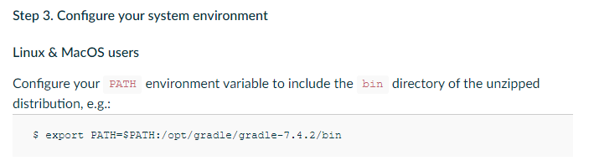
How to install Gradle in Linux Operating System or Amazon EC2 Instance?
$ vi ~/.bash_profile

