Slide 1
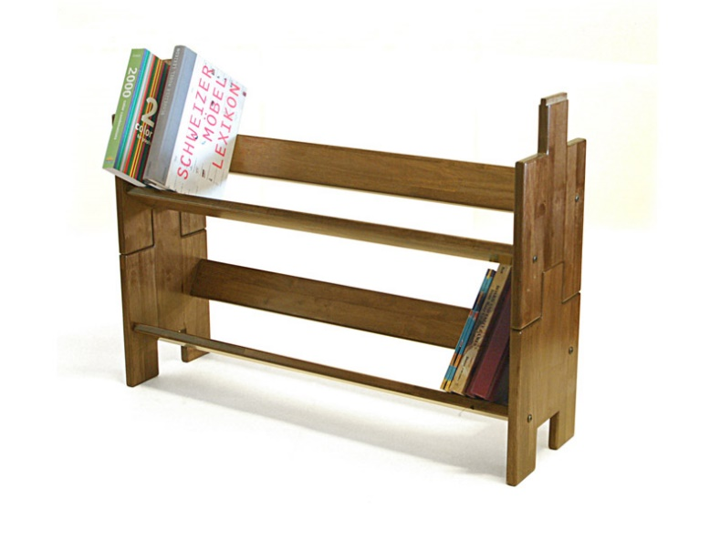
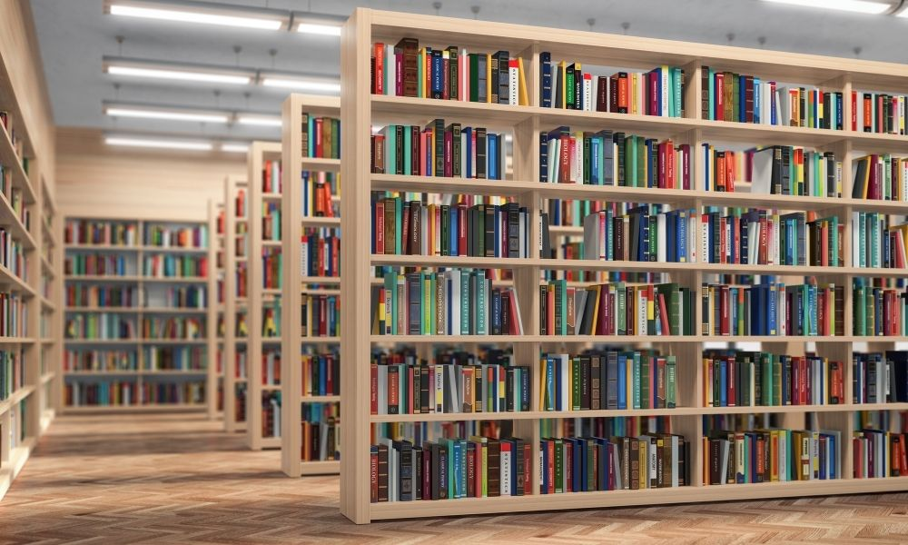

Caching Simplified: Your Quick Data Shortcut
Imagine you have a favorite book that you love to read over and over again. Instead of going to the library each time you want to read it, you decide to keep a copy of the book on a special shelf in your room. This shelf is your "cache."
So, the cache is like a quick-access storage place for things you use frequently. It's much faster to grab the book from your shelf (cache) than to go all the way to the library (the original source) every time you want to read it.
Library

Slide 2

Caching Simplified: Your Quick Data Shortcut
In the world of computers, a cache works similarly. It's a small, high-speed memory space that stores frequently used data or information. When a computer or a website needs data, it checks the cache first. If the data is there, it can be retrieved much faster than if it had to be fetched from the original, slower storage place.
In a nutshell, a cache is like your special shelf for favorite books but for data in computers, making things work faster and more efficiently.
Library

