Slide 1
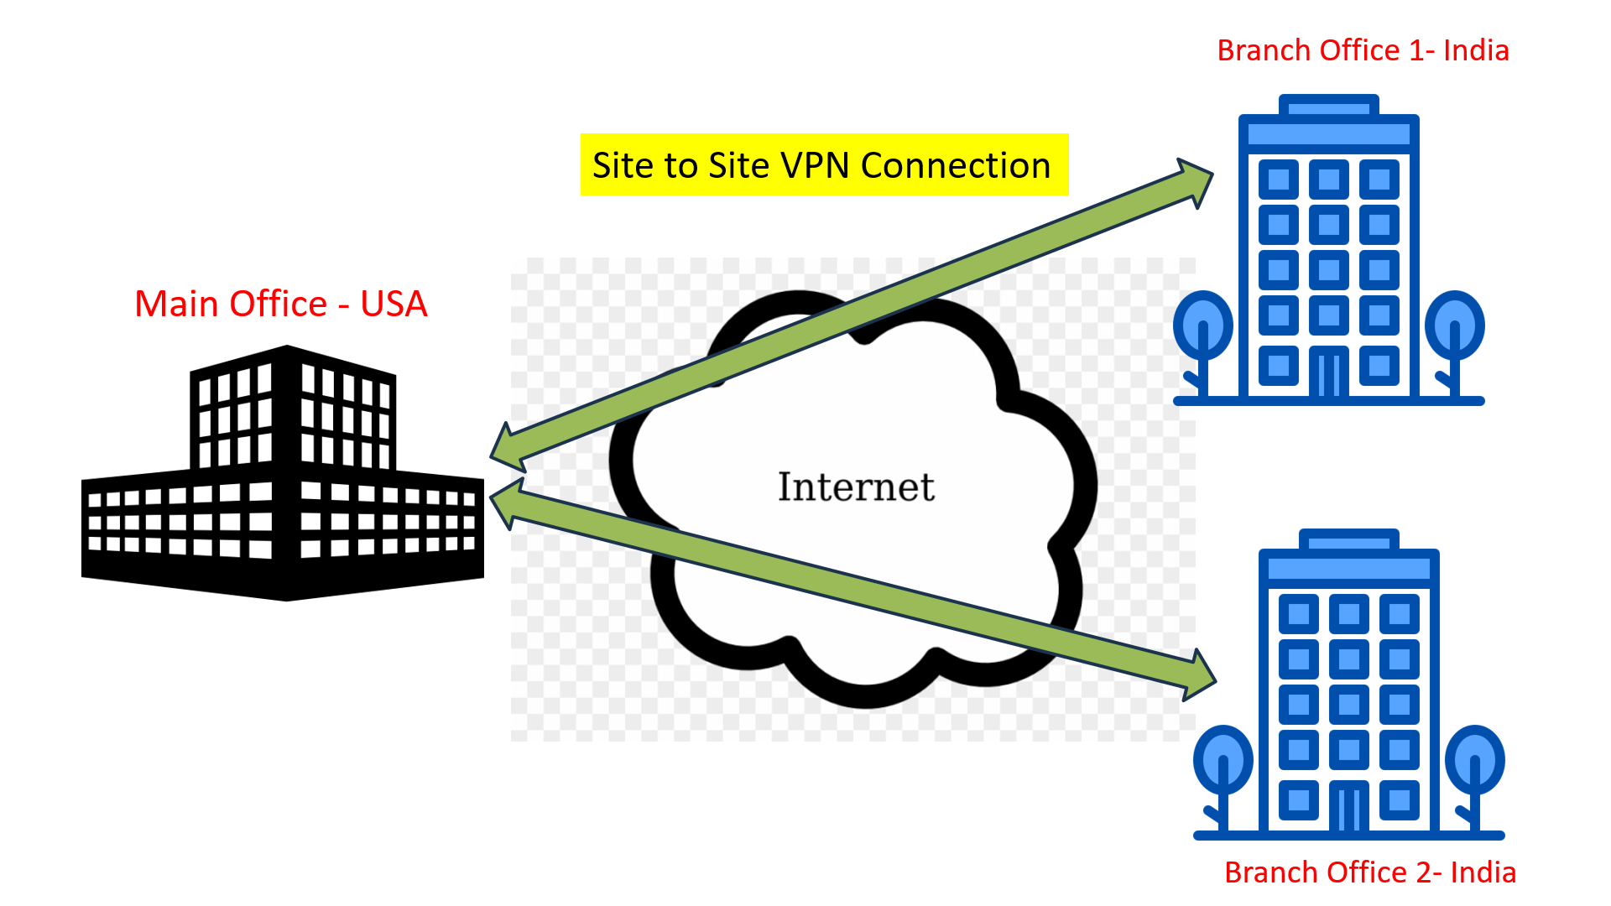
VPNs Explained | Site-to-Site + Remote Access
Imagine you have multiple offices, far apart from each other. A site-to-site VPN is like a secure tunnel that connects these offices' networks over the internet. This tunnel keeps things private:
Encrypted connection: This connection is encrypted, meaning that any data traveling between the two sites is scrambled and protected from being intercepted or tampered with by unauthorized parties. It provides a secure way for businesses to establish private communication channels between their different locations, ensuring confidentiality and integrity of their data transmissions.
Private network: Imagine you have two offices located in different cities. By setting up a site-to-site VPN between them, the computers and devices in both offices can securely share data, files, and resources, such as printers or servers, just as if they were all in the same building.

Slide 2
VPNs Explained | Site-to-Site + Remote Access
A site-to-site VPN is helpful for companies with multiple locations that need to share information securely without setting up expensive private lines. It's like having one big network, even though the offices are miles apart!

Slide 3
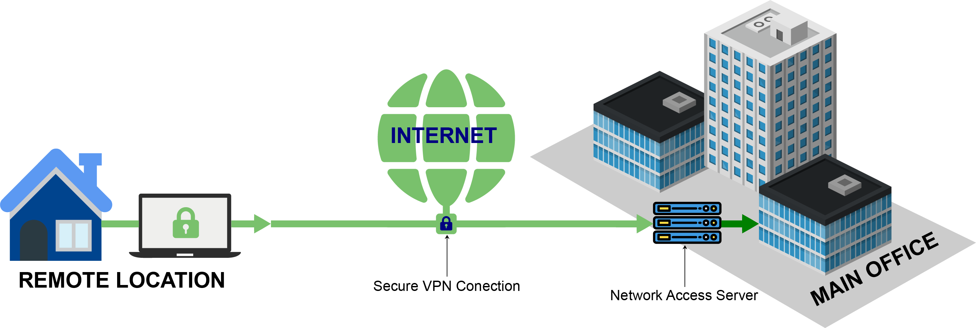
VPNs Explained | Site-to-Site + Remote Access
Imagine you're working from home and need to access your company's internal network, including files, emails, and applications, just as if you were sitting in the office. A Remote Access VPN allows you to do just that securely and remotely.
A Remote Access VPN, often referred to as a Virtual Private Network, is like a secure tunnel between your device (like your laptop or smartphone) and your company's network. This tunnel is created over the internet.
When you connect to your company's VPN server from your device, you're essentially joining your device to the company's private network, regardless of where you are physically located. This means you can access all the resources and services available on the company's network, such as files stored on servers, internal websites, or email systems.

Slide 4
VPNs Explained | Site-to-Site + Remote Access
The key feature of a Remote Access VPN is security. All data transmitted between your device and the company's network is encrypted, which means it's scrambled into a secure code that can only be decoded by authorized parties. This encryption ensures that even if someone were to intercept your data while it travels over the internet, they wouldn't be able to understand or use it.
A Remote Access VPN allows you to securely connect to your company's network from anywhere with an internet connection, enabling you to work remotely as if you were physically present in the office.

Slide 5
VPNs Explained | Site-to-Site + Remote Access
Here's the breakdown for Remote Access VPN:
Remote access: You're connecting from a faraway place (like home, a hotel, or a coffee shop).
VPN: This stands for Virtual Private Network. Think of it as a secret tunnel built over the public internet.
Secure connection: This tunnel encrypts everything you send and receive, like scrambling a message so only authorized people can understand it.

Slide 6
VPNs Explained | Site-to-Site + Remote Access
How Remote Access VPN works:
  You use a VPN app on your device (laptop, phone, etc.)
  The VPN app connects to your company's VPN server (like a gatekeeper for the tunnel).
  Once verified, the VPN app creates the encrypted tunnel between your device and the company network.
  Now you can access your company's files, applications, and resources as if you were physically in the office!

Slide 7
VPNs Explained | Site-to-Site + Remote Access
Benefits:
  Security: Encrypted connection keeps your work data safe, even on public Wi-Fi.
  Flexibility: Work securely from anywhere with an internet connection.
  Access: Get to all the company resources you need, no matter the location.
Remember:
  A Remote Access VPN is provided by your company, so you might need to talk to your IT department to set it up.
  Using a VPN might slow down your internet connection slightly.

Slide 8



Branch Office 1- India
Site to Site VPN Connection
Main Office - USA
Branch Office 2- India

