Slide 1
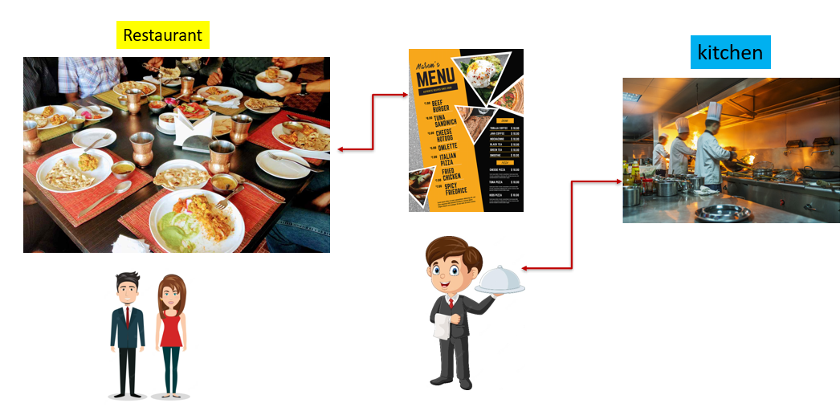
Development & Operations United: Understanding DevOps
What is DevOps?
Imagine you have a restaurant.
Chefs in the Kitchen: These are the people who create and cook the dishes. In the world of software, these chefs are like the developers who write and create the code for software applications.
Waiters and Waitresses: These are the people who take the food from the kitchen and serve it to the customers, making sure everything runs smoothly. In software, this role is similar to operations teams who manage and deploy the software, ensuring it runs properly on servers and is accessible to users.

Slide 2
Development & Operations United: Understanding DevOps
The Problem Without DevOps:
In many traditional restaurants, there can be problems if the kitchen (chefs) and the serving staff (waiters/waitresses) don’t communicate well. For example:
The chefs might cook something the waiters aren’t prepared to serve.
The waiters might not know when the food will be ready.
In software, if developers and operations don’t communicate well, it can lead to:
Software that doesn’t work well on the servers.
Delays in deploying new features or fixing problems.

Slide 3
Development & Operations United: Understanding DevOps
How DevOps Helps?
DevOps is like having a team where chefs and waiters work closely together from the beginning. They:
Collaborate and Communicate: Chefs know what the waiters need, and waiters understand what the chefs are doing.
Share Responsibilities: Everyone works together to ensure that the food is prepared and served efficiently and effectively.
In software, DevOps means:
Developers and Operations Work Together: They collaborate throughout the entire process of creating, testing, and deploying software.
Automation: Using tools to automate repetitive tasks like testing and deployment, ensuring that everything works smoothly and quickly.
Continuous Improvement: Regularly updating the software with new features and improvements without disrupting the service.

Slide 4
Development & Operations United: Understanding DevOps
Benefits of DevOps
Faster Delivery: New features and fixes can be delivered to users more quickly.
Better Quality: Fewer errors and better performance because of continuous testing and monitoring.
More Reliable: Systems are more stable and issues are resolved faster.
Happier Teams: Developers and operations teams work better together, reducing stress and misunderstandings.

Slide 5
Development & Operations United: Understanding DevOps
Summary:
So, in simple terms, DevOps is a way of making sure that the people who create software and the people who run it work together seamlessly, like a well-coordinated restaurant team, to serve the best possible "dish" (software) to the customers.

